Slide 1
On the journey of life….
....we are glad to be together as a school community.
Notes:
Slide 1: Use these gathering words for this term, or your usual greeting if you prefer. Why not invent some actions to make them extra memorable?!

Slide 2
As we gather today….
....may we learn from each other and hear from God.
Notes:
Slide 2: Use these gathering words for this term, or your usual greeting if you prefer. Why not invent some actions to make them extra memorable?!

Slide 3
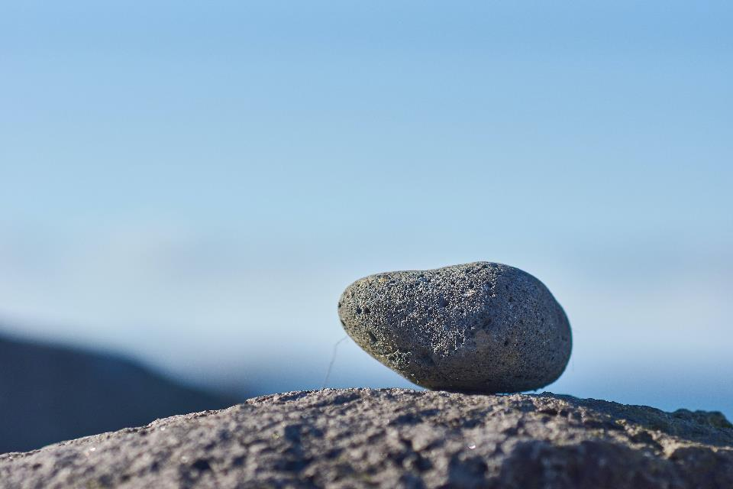
Picture copyright-free from pixabay
What can we remember?
Notes:
Slide 3-6: During this term, we are using some of the stories of God’s people to help us as we think about our own school community. We’re going to start our time together today with a question to talk about: ‘What are some things that we remember?’ [use the pictures to help you talk together – but also talk about the things that pupils are currently being asked to remember in their school work]

Slide 4
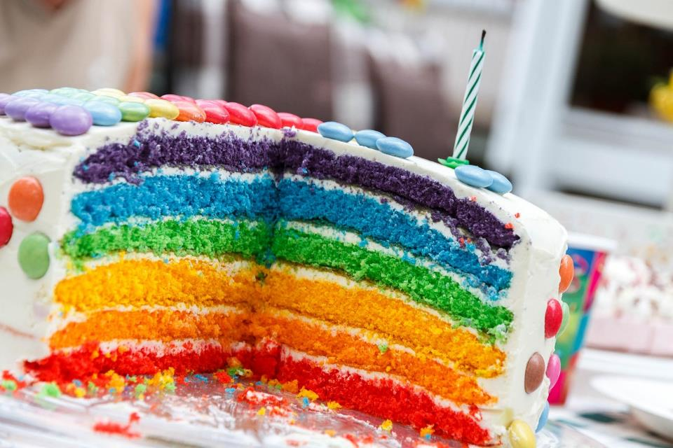
Notes:
Slide 4: We remember birthdays – with cake, to celebrate being a whole year older

Slide 5
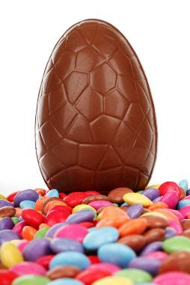
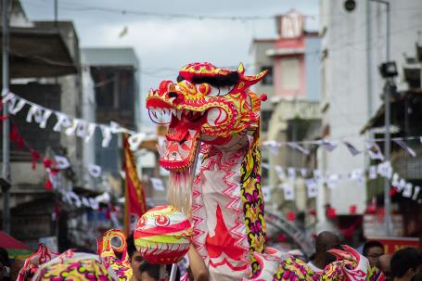
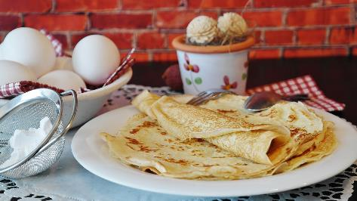
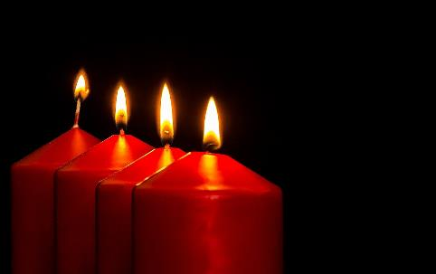
Notes:
Slide 5: We remember different days in the year in different ways (Top, right > left):
Easter, with eggs
Chinese New Year, with a dragon dance
Shrove Tuesday, with pancakes
Eid Mubarak (after Ramadan), by watching for the new moon
Christmas, using Advent candles

Slide 6
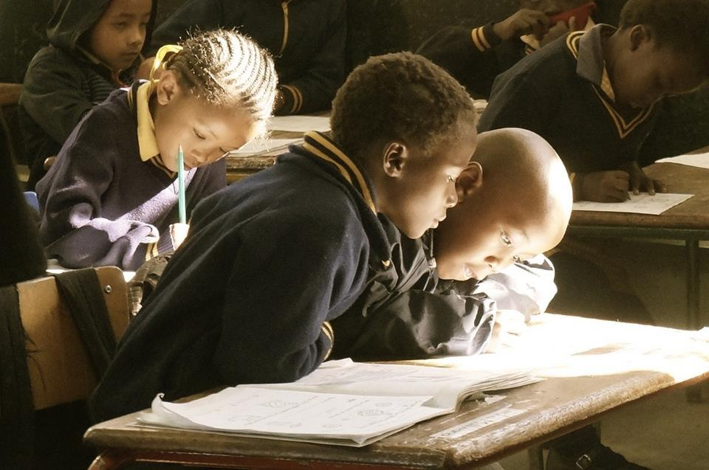
Notes:
Slide 6: What have we been remembering in our classrooms recently?

Slide 7
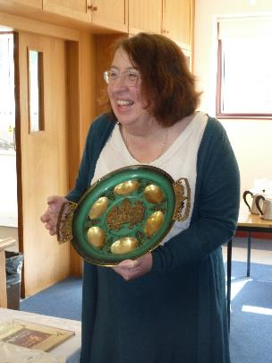
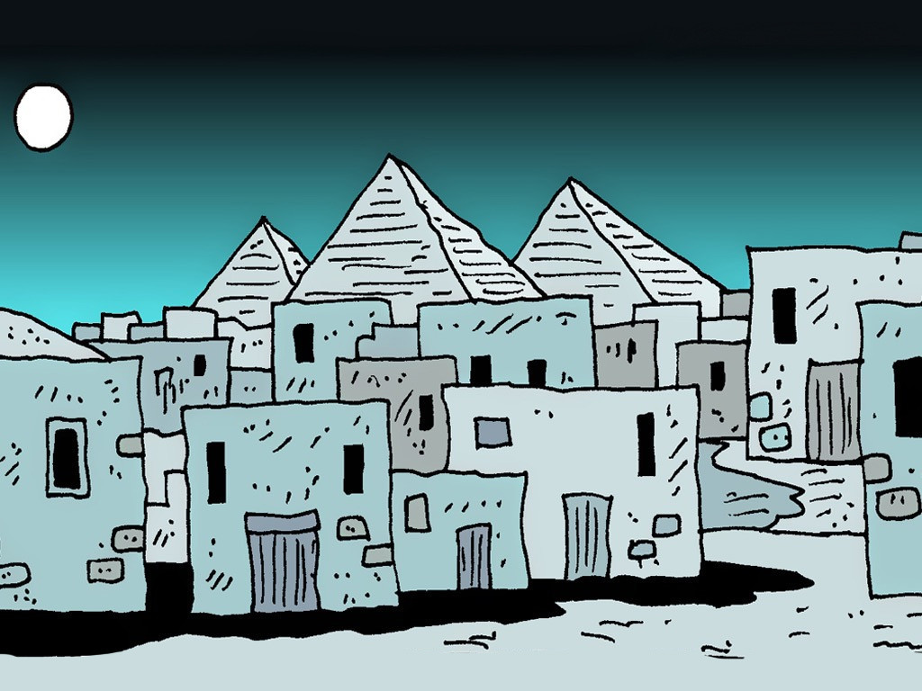
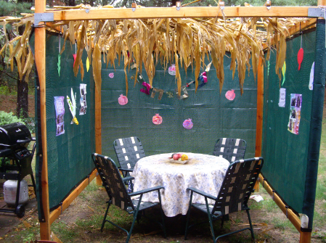
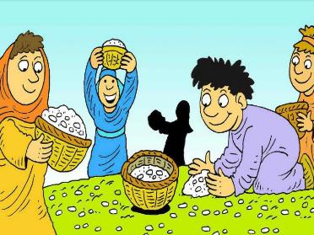
‘Remember that….’
Notes:
Slide 7: You might remember these two events from our story [show pictures] which Jewish people remember every year in the festivals of Passover and Sukkot. [remind children how if you need to]
We’re going to pause the story of Moses for today to think really deeply about some words that God said to the people: ‘Remember that….’
Many times in the stories of God’s people, the Israelites, he uses these words.

Slide 8
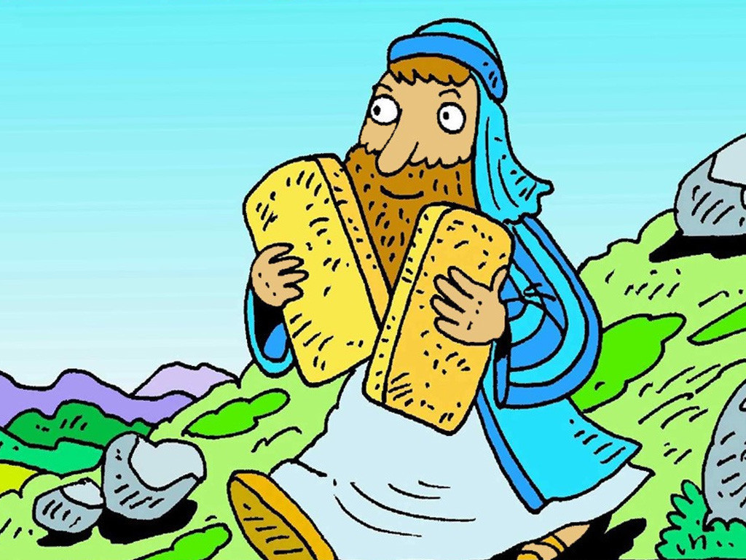
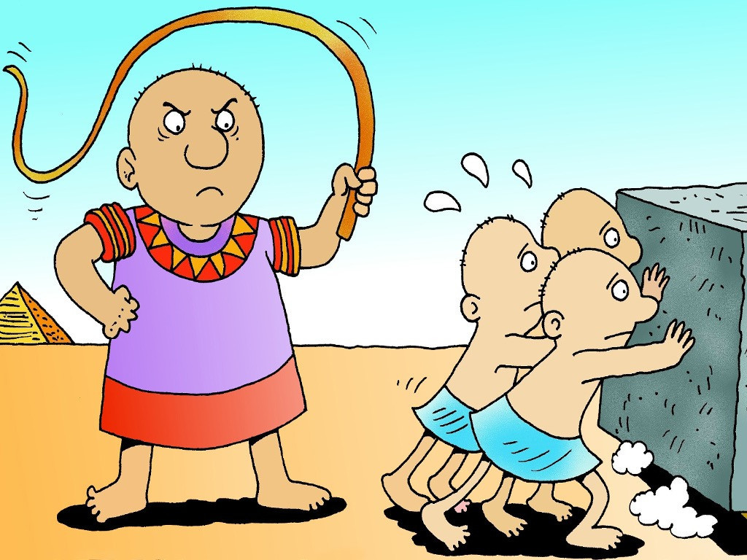
‘Remember that you were slaves in Egypt.’ Deuteronomy 15:15
Notes:
Slide 8: As well as giving them the Ten Good Rules, God also spoke to the people about finding ways to help them to remember what had happened to them – and how they were slaves in Egypt. (Deuteronomy 15:15)

Slide 9
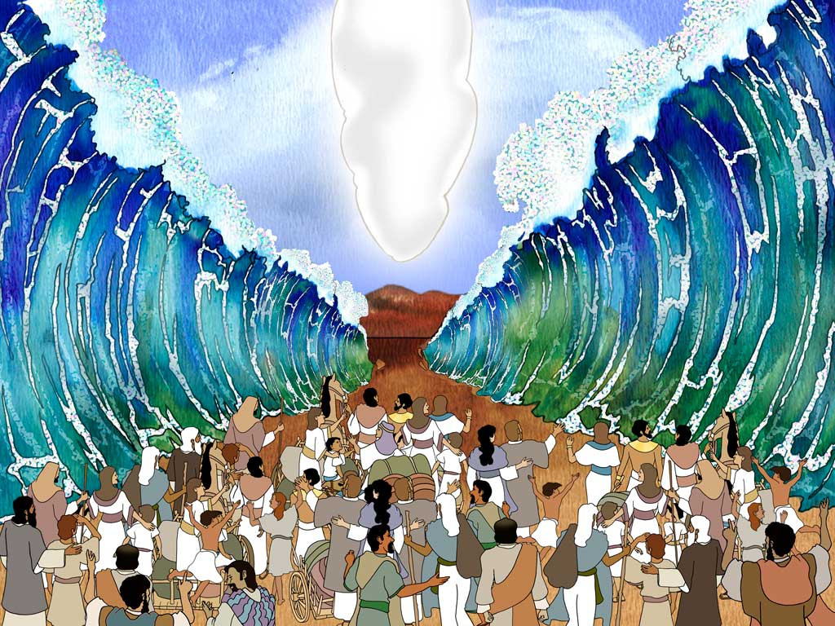
‘Remember that the Lord your God saved you.’ Deuteronomy 15:15
Notes:
Slide 9: and how God had saved them.

Slide 10
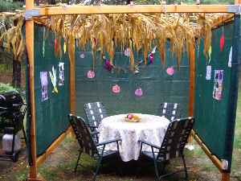
….I wonder why it was important for the people to ‘remember’?....
….I wonder what remembering might have taught them about God?....
….I wonder what it’s important for us to ‘Remember that…..?’….
Notes:
Slide 10: Wondering questions
….I wonder why it was important for the people to ‘remember’?....
….I wonder what remembering might have taught them about God?....
….I wonder what it’s important for us to ‘Remember that…..?’….

Slide 11
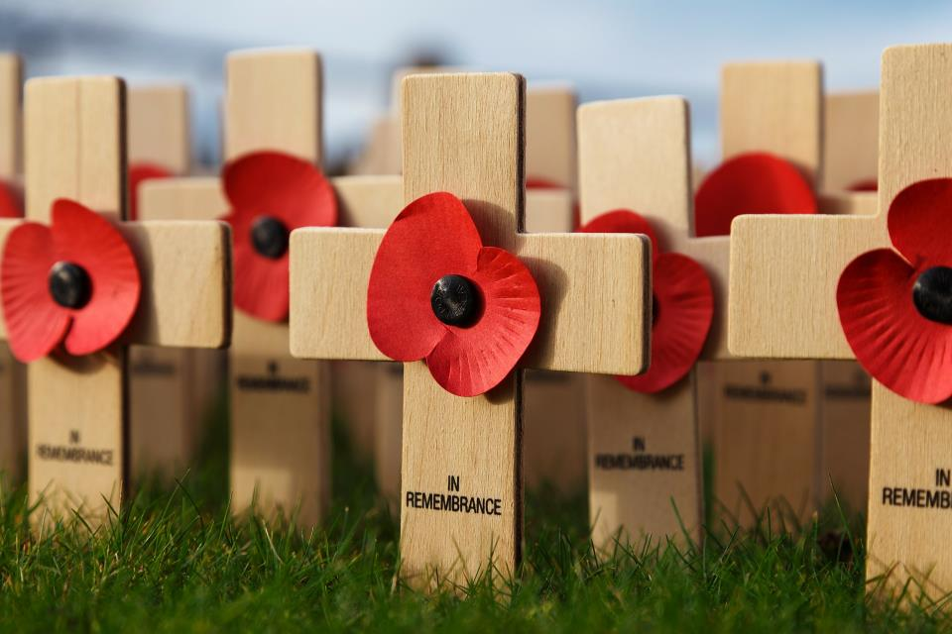
‘Remember that….’
Notes:
Slide 11: At this time of year, we remember as people across the world, using poppies. We remember that, long ago, soldiers all across the world, died to bring peace to our nations.

Slide 12
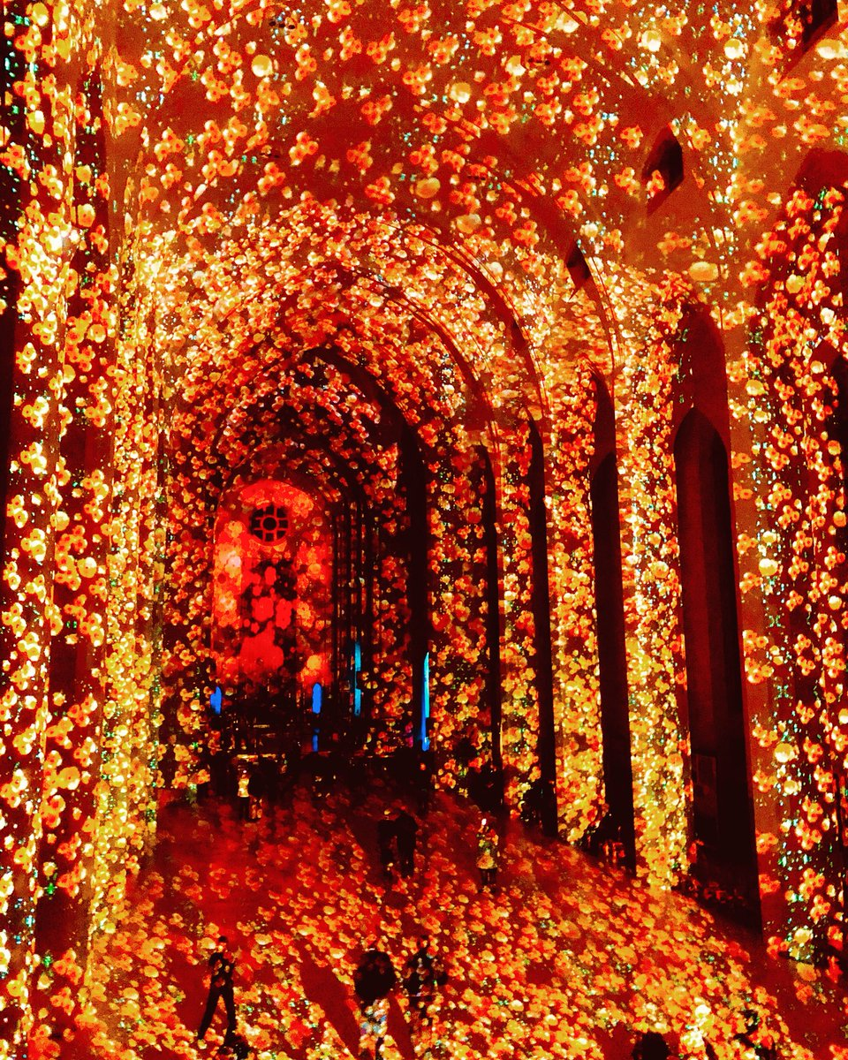
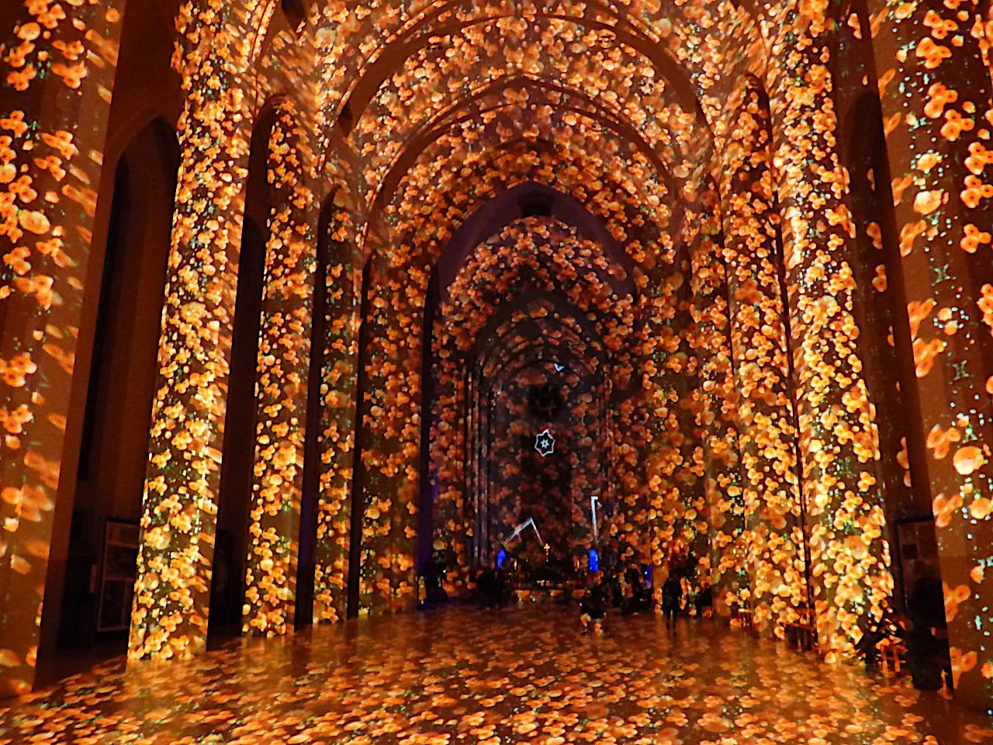
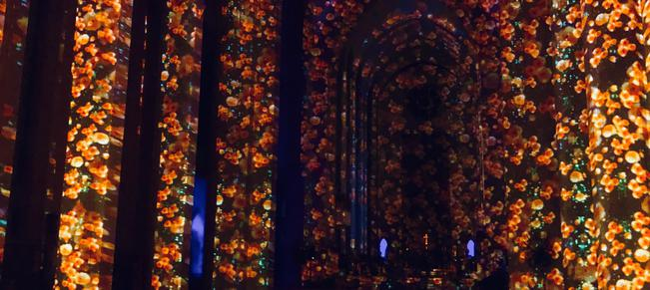
Poppy Fields Guildford Cathedral
Oct 2018, 100 years since the end of WW1
Notes:
Slide 12: This is how the event was remembered in Guildford Cathedral to mark 100 years since peace came in 1918

Slide 13
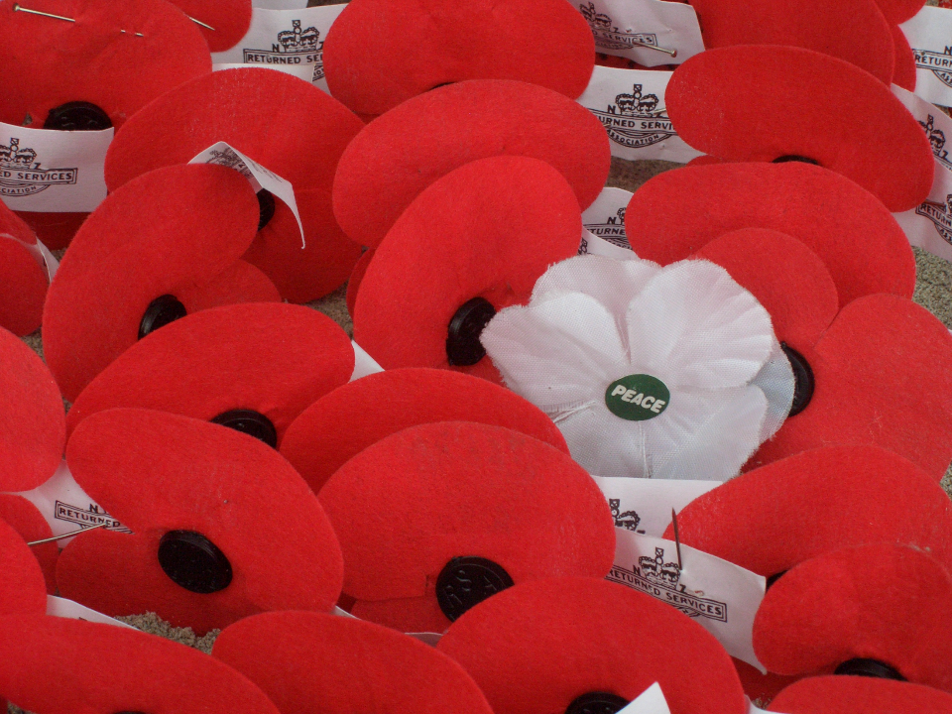
At the going down of the sun and in the morning….
…we will remember them…
Notes:
Slide 13: We’re going to remember now, in our own way – and be thankful for the peace that we enjoy here in Britain.
There are some really special words from a poem that are often spoken as part of the act of remembering:
At the going down of the sun and in the morning….
…we will remember them…
After a short time of silence [1 minute if you can make it!], I will invite you to say the words ‚‘We will remember them.‘ after I say the words ‘At the going down of the sun and in the morning...‘

Slide 14
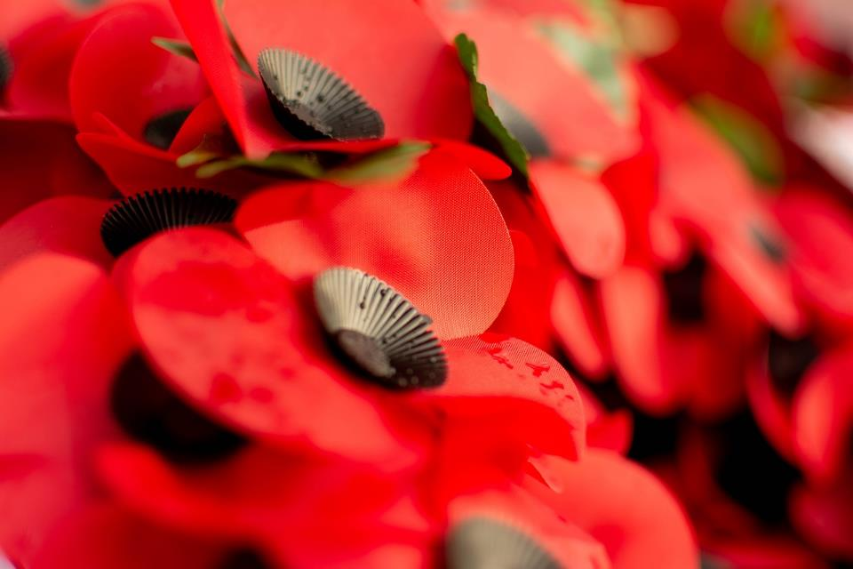
Dear God
We are grateful for the peace that we enjoy – and for those who gave their lives to make it happen. Please help us always to ‘remember them’.
Notes:
Slide 14: I’m going to turn my thoughts into a prayer now. If you’d like to pray too, then find a way to make it your own….
Dear God
We are grateful for the peace that we enjoy – and for those who gave their lives to make it happen.
Please help us always to ‘remember them’.

Slide 15
In parts of the world where peace is scarce, we pray that there will be peacemakers – and an end to war.

Slide 16
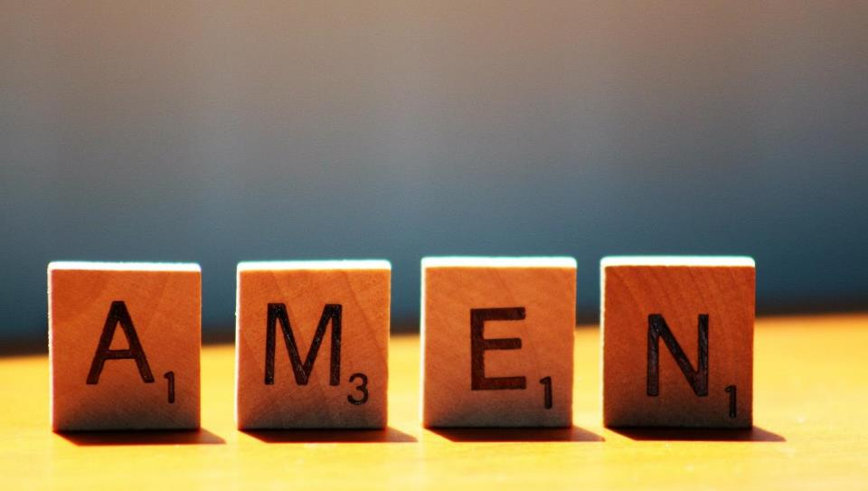

Slide 17
Leader: As we leave this place & time and go into the day ahead…
All: May today’s words help us to become a stronger community.
Notes:
Slide 16: Remind children of today’s key message – to ‘Remember that…..’

Slide 18
Notes:
Reflective activity: ‘Remember that…..’
Put some poppies from your collection box in your reflection area [don’t forget to donate first!] or cut poppy shapes out of red paper.
Children think about something that they think it’s really important to ‘Remember that….’, which could link to a personal reflection or as a reminder that ‘We will remember them…’

