Slide 1
Leader: We are here together
ALL: May we ‘GO FOR GOLD!’ in our words and actions today!
Notes:
Slide 1: Gathering words
Leader: We are here together
ALL: May we ‘GO FOR GOLD!’ in our words and actions today!

Slide 2
What do you really love to do?
Notes:
Slide 2: Let’s start today with a question: What do you really love to do? What brings you joy?
Discuss with a partner….

Slide 3
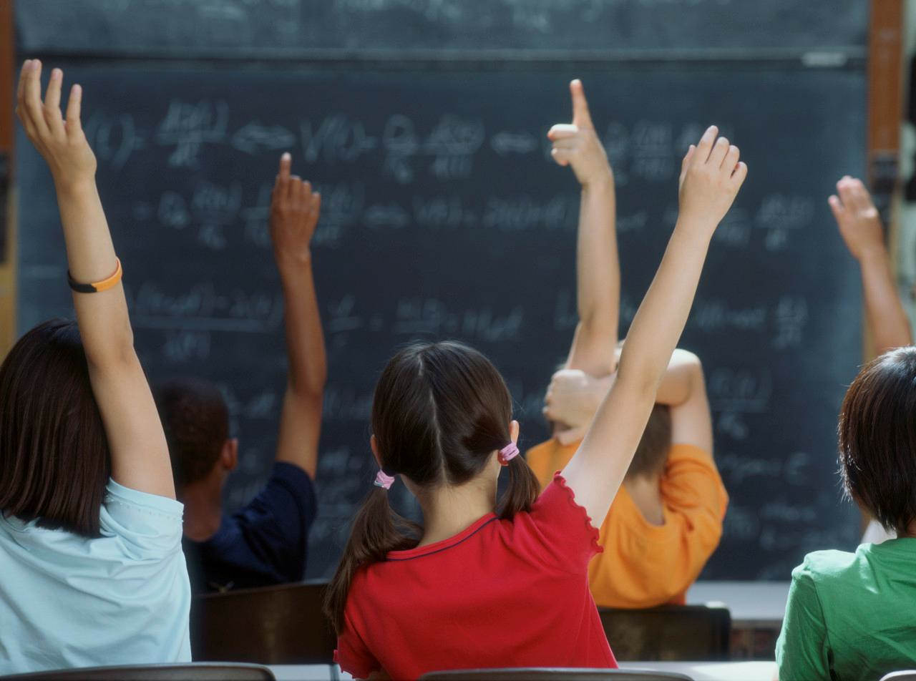
Hands up….
Notes:
Slide 3: …let’s find out what we think, in a very similar way to last week!
Put your hand up if it was…..something musical
Put your finger on your nose if it was…..something to do with books
Put your elbow in the air if it was…..something sporty
Put your hand on your head if it was…..something arty
Wave at me if it was…..something to do with nature or being outdoors
Fold your arms if it was…..something else
You might want to find out a few ideas as you go along, so do spotlight individual pupils if you want to!

Slide 4
The Olympics
Respect
Friendship
Excellence
Determination
Equality
Courage
Inspiration
Olympic rings © Pixabay
Notes:
Slide 4: Over the past few weeks, we’ve been thinking about the Olympics, and the important values that are a part of sports of all sorts.
We’ve also heard about some amazing athletes from across the world and from different times.
Today, we will be thinking about the Olympic value of inspiration and reflecting on what inspires us in our own lives.

Slide 5
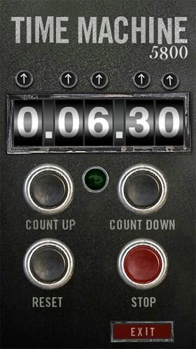
2024
CE
1924
CE
Notes:
Slide 5: So, let’s jump into our Olympic time machine again now, and go back through time and space to…… the 1924 Olympic Games,

Slide 6
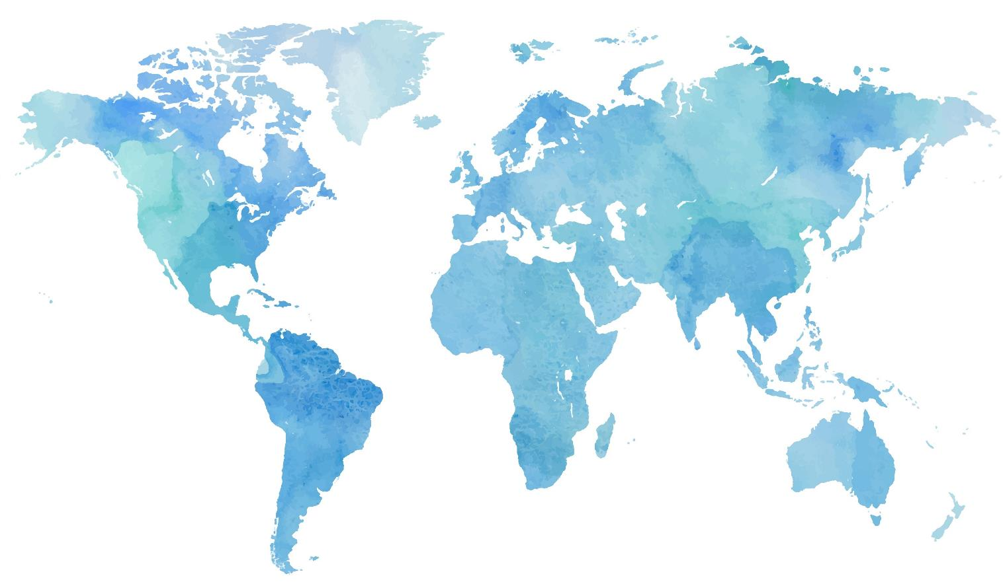
Notes:
Slide 6: …to Paris, France, which is where the first modern Olympics took place and in 1924, was home to the 8th Olympic Games since 1896. It’s also where this year’s Olympics is happening.

Slide 7
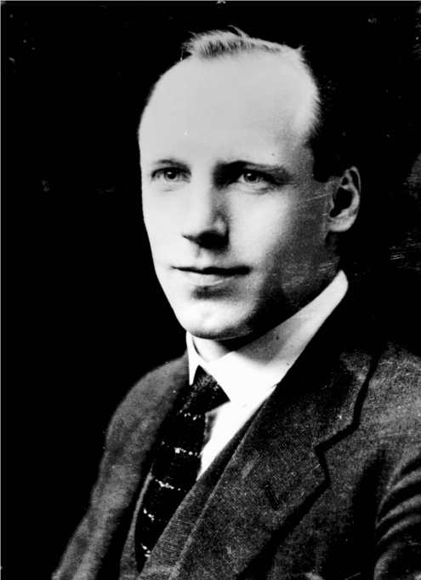
"I believe that God made me for a purpose, but He also made me fast. When I run it is in His pleasure."
Eric Liddell – 1902-1945
© The Eric Liddell Community, used with permission – and with our thanks
Notes:
Slide 7: This man, Eric Liddell was a runner for Great Britain in 1924, and became one of the most famous runners ever: he was affectionately known as the ‘Flying Scotsman’ (because he came from Scotland!) It’s some words that he spoke that will inspire us today, so let’s hear his story.
Eric Liddell was born in China, but when he reached school age, was sent by his missionary parents to school in London. It was while he was still at school that he realised that he was good at sport. His favourite sport was rugby, and he was fast – very fast! Like some of you, he loved nothing better than to feel the wind in his face as he ran.

Slide 8
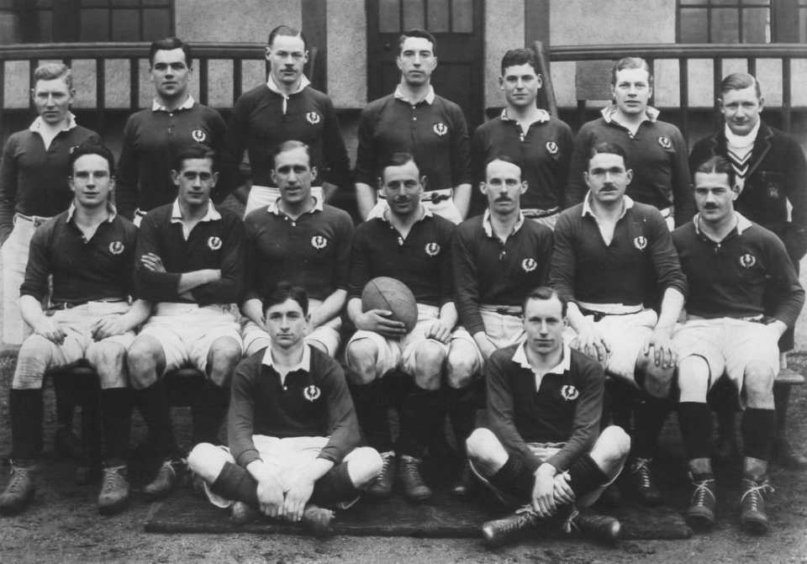
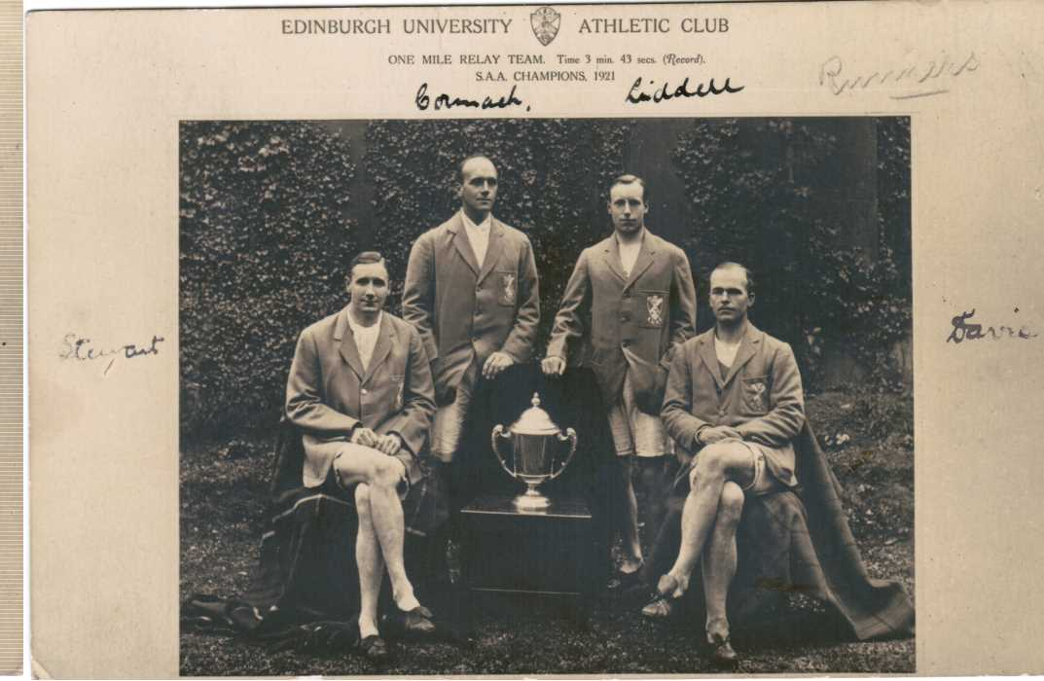
© The Eric Liddell Community, used with permission – and with our thanks
Notes:
© The Eric Liddell Community charity, Scotland rugby team & Edinburgh University athletic club
Slide 8: In 1921, when he joined his brother at Edinburgh University, he was chosen to play for the Scottish national rugby team – and on another six occasions after that. He also loved the running track, and before long, it became obvious that there wasn’t going to be enough time for him to run and to play rugby, and so he chose running – a decision that would make him one of the most famous athletes ever. In the early 1920s, he ran in many races – and won! Many people thought he was good enough to be in the British Olympic team.

Slide 9
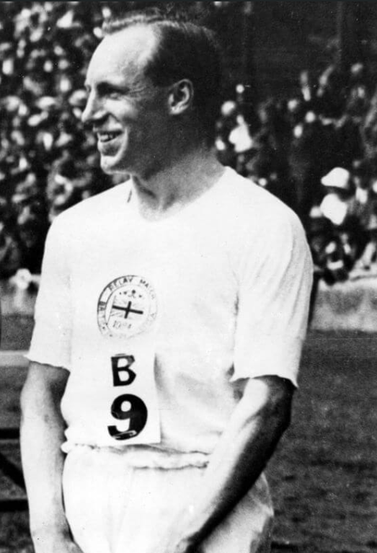
‘When I run, I feel God’s pleasure.’
© The Eric Liddell Community, used with permission – and with our thanks
Notes:
© The Eric Liddell Community charity, Eric winning in 1922
Slide 9: Eric was also a Christian and believed that God had made him good at running.
He once said: “I believe that God made me for a purpose, but He also made me fast. When I run, I feel God’s pleasure.” When he ran, he ran because he knew it was what God had made him to do, and that God enjoyed watching him as much as he enjoyed the running. When he ran fast, he looked very strange – his head would fall backwards and his arms would flail widely as he felt the wind in his face and the exhilarating sensation of speed.

Slide 10
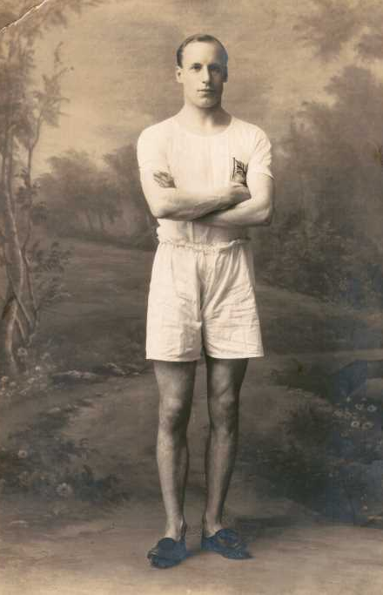
‘Those who honour me, I will honour.’ I Samuel 2:30
© The Eric Liddell Community, used with permission – and with our thanks
Notes:
© The Eric Liddell Community charity, official Olympic portrait for 1924
Slide 10: As the 1924 Olympics came closer, Eric was indeed chosen to run for Britain, but he had a very difficult decision to make. One of the races that he was supposed to be running in was on a Sunday. Eric loved running, but he loved God more, and knew that if he ran in the race, then he wouldn’t be able to go to church and worship God there. So he made the decision that he wouldn’t run on a Sunday, a decision that many other people were very surprised about. So instead of running in his best race, the 100 metres, he now chose instead to run in both the 200 metre and 400 metre races – which he’d never competed in before.
The time for the Olympics came, and he set sail with the rest of the athletes for Paris. People were still talking about the decision that he had made, but he trained hard in the days running up to the race. As he walked up to the starting blocks, someone slipped a piece of paper into his hand. On it was written some words from the Bible, ‘Those who honour me, I will honour.’ – God’s words. At this moment, Eric knew that he had made the right decision, and that God would be with him as he ran this race.

Slide 11
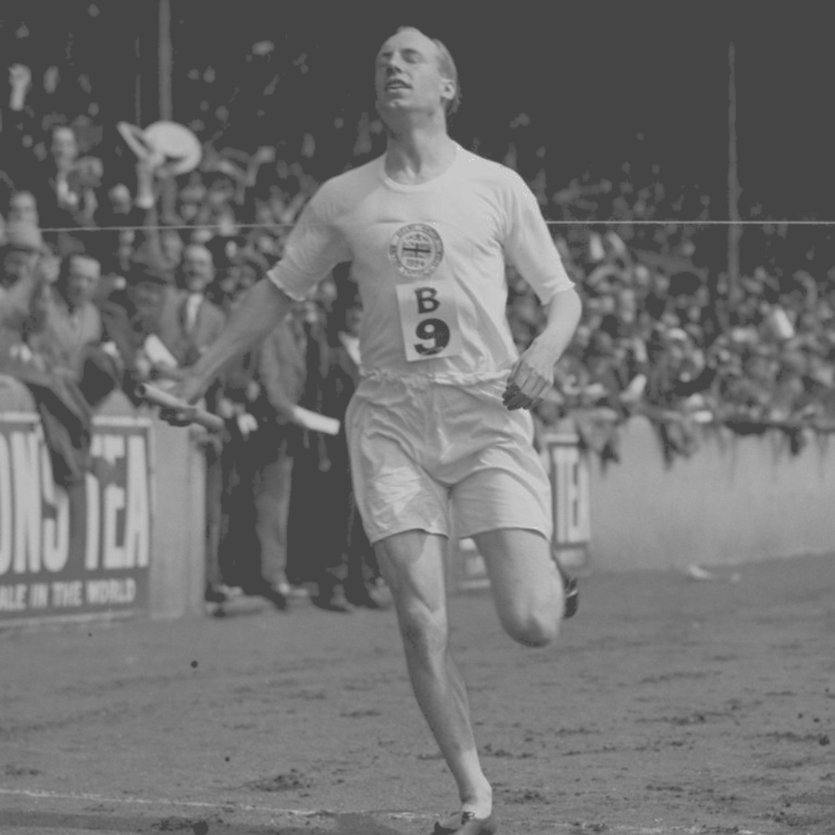
© The Eric Liddell Community, used with permission – and with our thanks
Notes:
© The Eric Liddell Community charity
Slide 11: And so he ran as he had never run before. The crowds watched in amazement as his head fell back and his arms flailed wildly – the sign that he was running as fast as he could, and enjoying the sensation of the wind on his face – running in God’s pleasure. He not only won the race and a gold medal, but beat the world record, running the 400 metres in 47.6 seconds. God had indeed honoured him for the decision he made – and he is still one of the most famous athletes in British history.

Slide 12
….I wonder what Eric meant by ‘feeling God’s pleasure’?....
….I wonder if running helped Eric to feel closer to God?.....
….I wonder what might make you feel joy like this?....or what might make you feel closer to God?.....
‘When I run, I feel God’s pleasure.’
© The Eric Liddell Community, used with permission – and with our thanks
Notes:
© The Eric Liddell Community charity
Slide 12: This story was made into a very famous film called ‘Chariots of Fire’ (which you were listening to as you came in) – but it’s Eric Liddell’s words that are going to inspire us today: ‘When I run, I feel God’s pleasure.’
Let’s just pause for a few moments and wonder together about these words….. [pause and talk about these questions if you would like to]
….I wonder what Eric meant by ‘feeling God’s pleasure’?....
….I wonder if running helped Eric to feel closer to God?.....
….I wonder what might make you feel joy like this?....or what might make you feel closer to God?.....

Slide 13
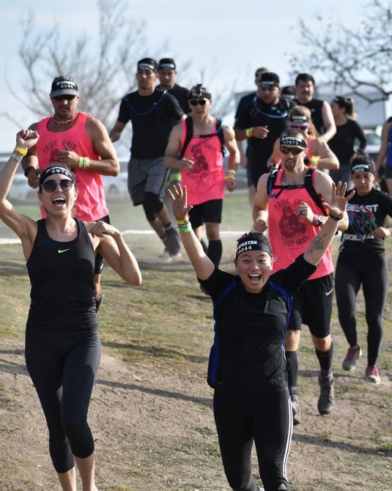
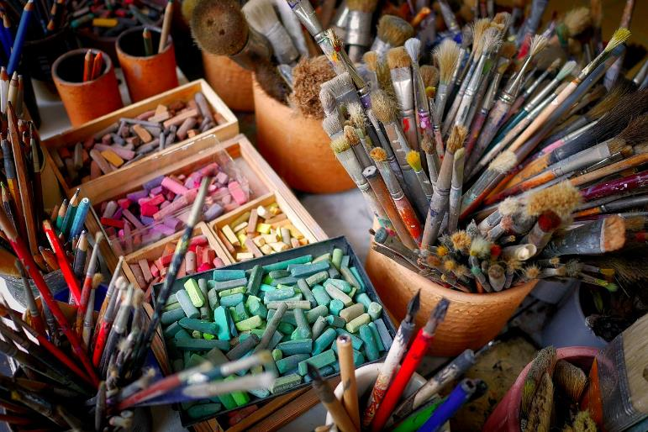
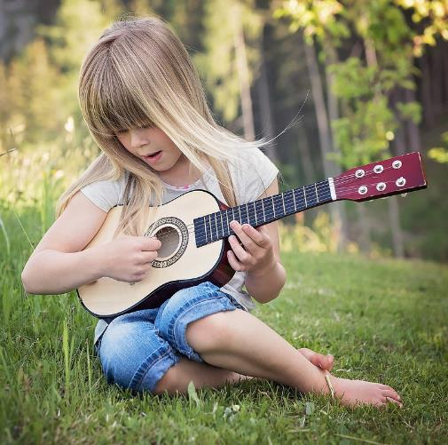
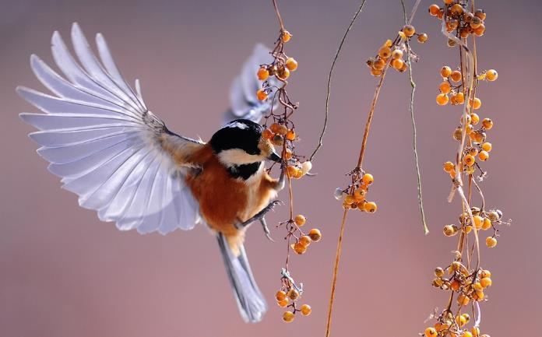
Notes:
Slide 13: Responding and words for worship
We started our assembly by thinking about some of things that make us feel joy. In the quietness now, bring that thing into your mind and into your heart.
Use the silence to be grateful for the joy that you feel when you are doing your favourite thing – or feeling close to God….
And maybe, if you’d like to, say a prayer of thanks in your heart

Slide 14
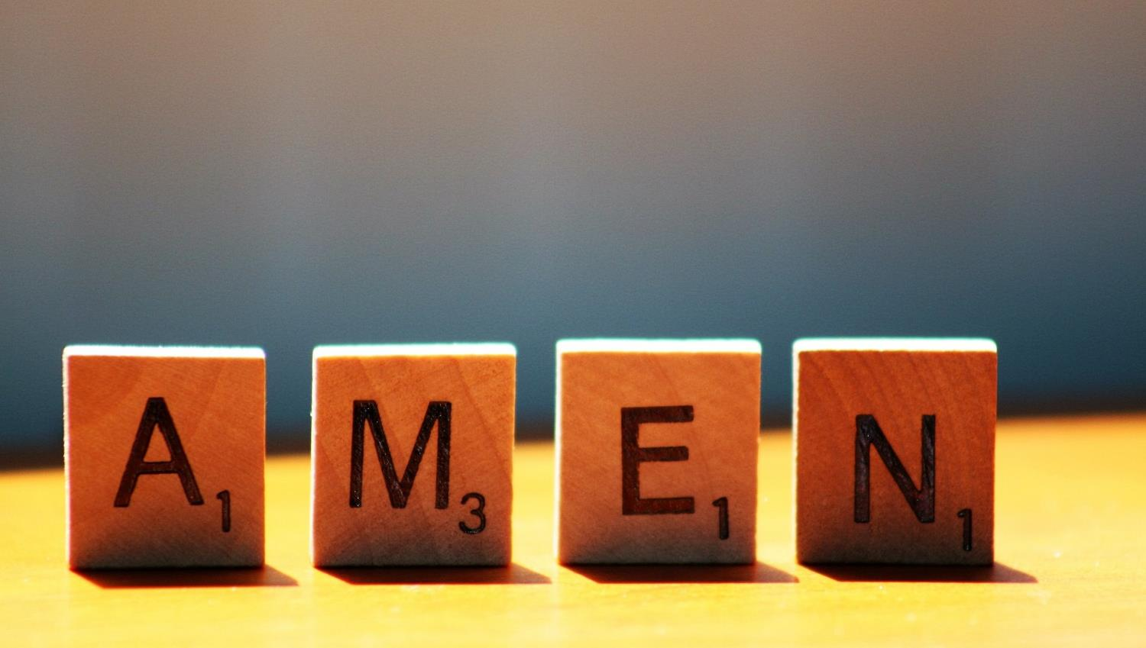

Slide 15
Leader: As we leave this place & time and go into the day ahead…
All: Let’s ‘go for gold’ in all that we do!
Notes:
Sending: Slide 15
Leader: As we leave this place & time and go into the day ahead…
All: Let’s go for gold* in all that we do!
*Again, you might need to unpick what we mean by ‘going for gold’ in the context of today’s words.

Slide 16
https://pixabay.com/videos/beach-ocean-waves-kids-running-29982/
https://pixabay.com/videos/girl-happy-run-peace-nature-141750/
https://pixabay.com/videos/beach-sand-sunrise-shore-water-139365/
Notes:
Slide 16: Reflective areas
There are links to 3 videos in the PowerPoint presentation that show people running in different settings, which you might want to use to give children reflection space in your classroom this week.
Or, cut heart shapes and leave in your reflection area for pupils to use to create a wall of hearts, reflecting the things that bring them pleasure or help them to feel close to God.

