Slide 1
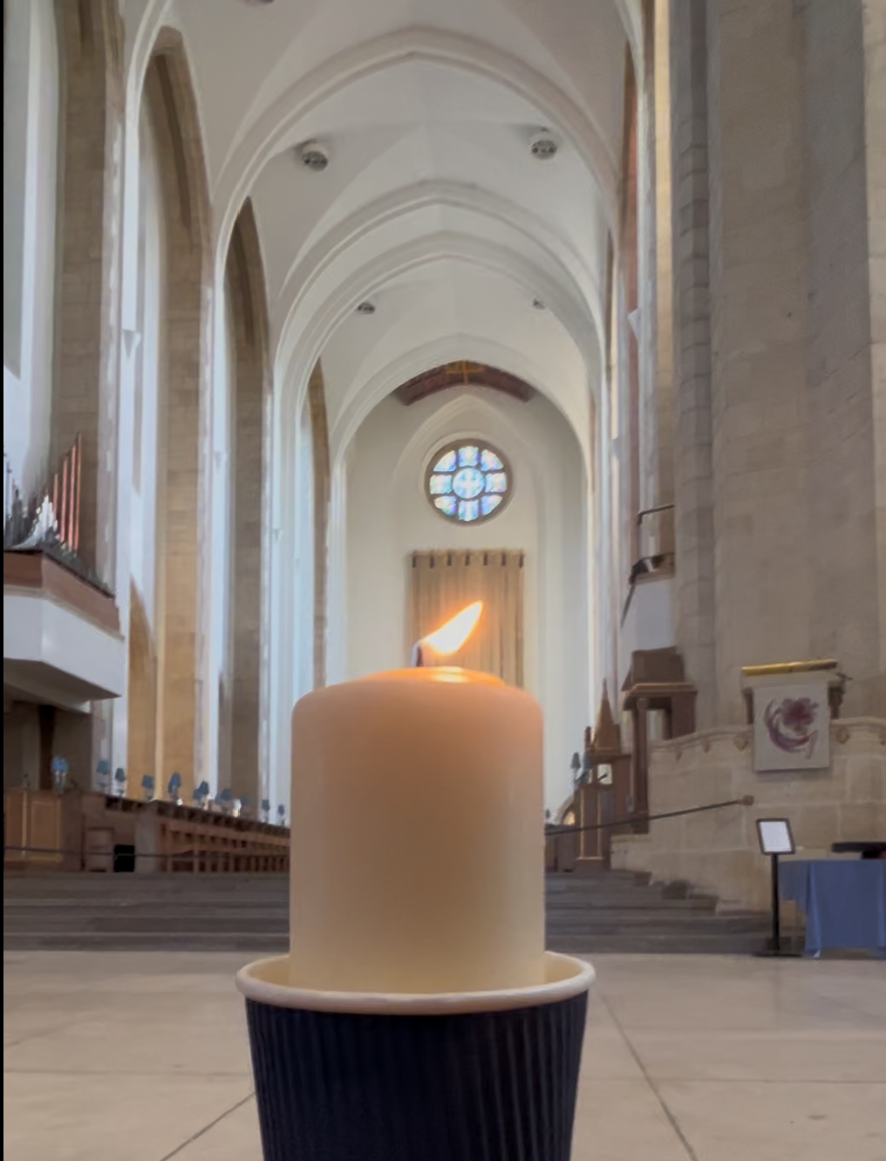
Notes:
Slide 1: Flickering Leavers’ Candle slide – for stilling.

Slide 2

Leader: As we gather together today…
ALL: …we bring our thoughts and our hearts into this sacred space.
Notes:
Slide 2: Gathering
Leader: As we gather together today….
ALL: ….we bring our thoughts and our hearts into this sacred space.

Slide 3
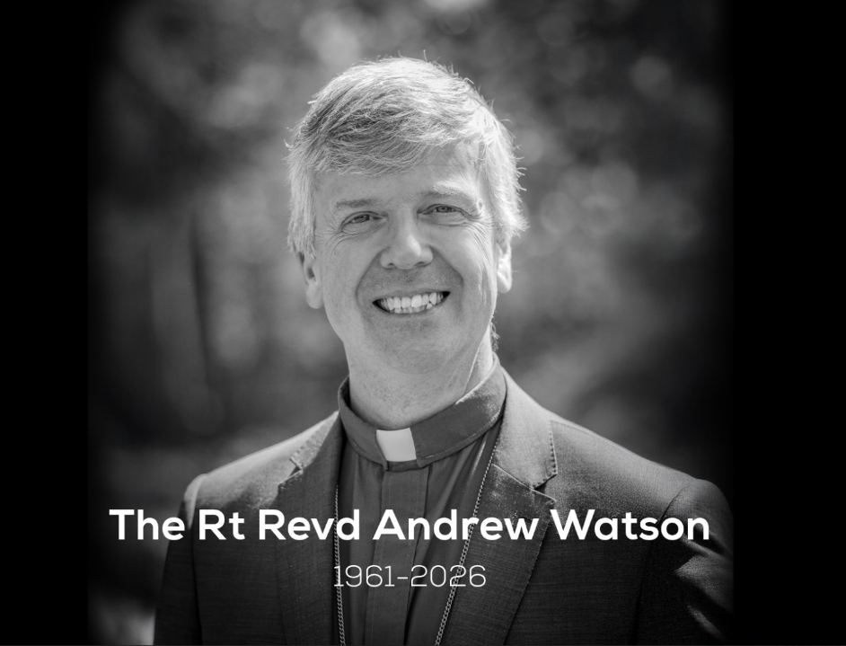
Notes:
Slide 3: Today is Bishop Andrew’s funeral. And in our very short time together today, we will mark this moment together.

Slide 4
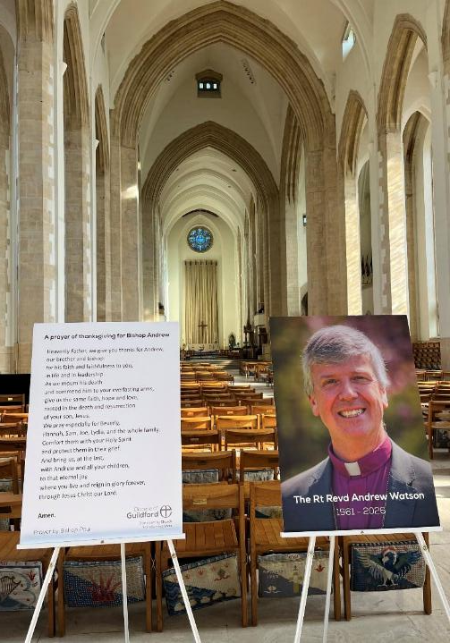
‘Don’t let your hearts be troubled. Trust in God. And trust in me. There are many rooms in my Father’s house…..I am going there to prepare a place for you.’
John 14:1-2
Notes:
Slide 4: In the cathedral that Bishop Andrew loved, hundreds of people will gather today to give thanks for his life, with many thousands more across the Diocese and across the world, joining the service as it is livestreamed.
It will be a special service of remembering, where people who knew Bishop Andrew and loved him will stand with his family and say goodbye.
Christian funerals are a strange mix of tears and joy, for all sorts of reasons.
Tears because it is very natural that saying goodbye in this way is sad.
But also, joyful, because as a Christian, Bishop Andrew believed that death is not the end; that he is now ‘at home’ with God. He spoke about this a lot in the letters that he wrote to the churches and schools in the Diocese in his final days.
Before Jesus’ death on the cross, he spoke these words to his disciples: ‘Don’t let your hearts be troubled. Trust in God. And trust in me. There are many rooms in my Father’s house……I am going there to prepare a place for you.’

Slide 5
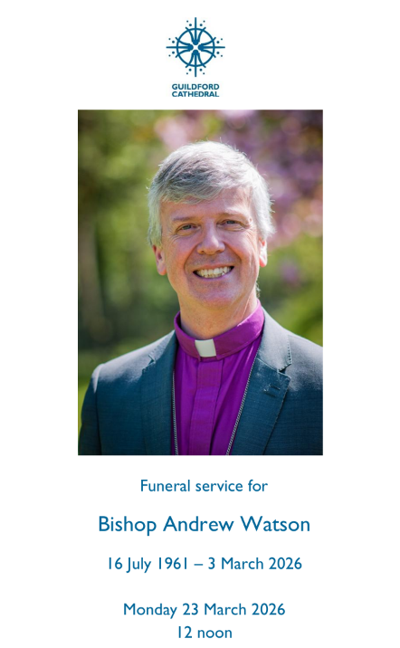
Notes:
Slide 5: The service that Bishop Andrew planned with his family will be full of hymns, music and words that he loved: words which meant a lot to him in the final weeks of his life. All the words speak of his profound trust in God and his gratitude for God’s goodness in his life. One of the pieces that will be sung is based on the words of a very famous Psalm written by David, the Shepherd-King. In this psalm, David talks about his confidence that God will take care of him no matter what happens in life, and ends with these words:

Slide 6

‘Surely your goodness and love will be with me all the days of my life. And I will dwell in the house of the Lord forever.’ Psalm 23:6
….I wonder how these words might bring comfort to those who gather to share in Bishop Andrew’s funeral today, and to his friends and family?.....
….I wonder what there might be in these words for us today, as we also share in these moments?.....
Notes:
Slide 6: Surely your goodness and love will be with me all the days of my life. And I will dwell in the house of the Lord forever.
….I wonder how these words might bring comfort to those who gather to share in Bishop Andrew’s funeral, and to his friends and family?.....
….I wonder what there might be in these words for us today, as we also share in these moments?.....

Slide 7
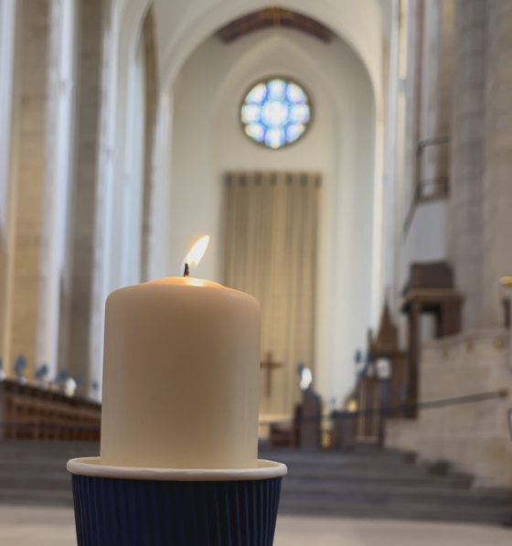
Notes:
Slide 7: Responding and words of worship Leavers’ Candle NB this version doesn’t flicker! If you don’t have your own candle to light, then use the slide at the beginning.
There are 2 options to choose from here.
You might remember that Bishop Andrew gave schools a candle at last year’s Leavers’ Services.
We’re going to light it now and have a few moments of quiet reflection.
Option 1: You might simply want to watch the flame flicker and use the stillness to pray or to think.
Option 2: People often light candles to help them to remember people, and today, we are going to do this here – to show that we are standing with Bishop Andrew’s family in their sadness. [You may also want to invite pupils and adults to stand up for this serious moment]

Slide 8
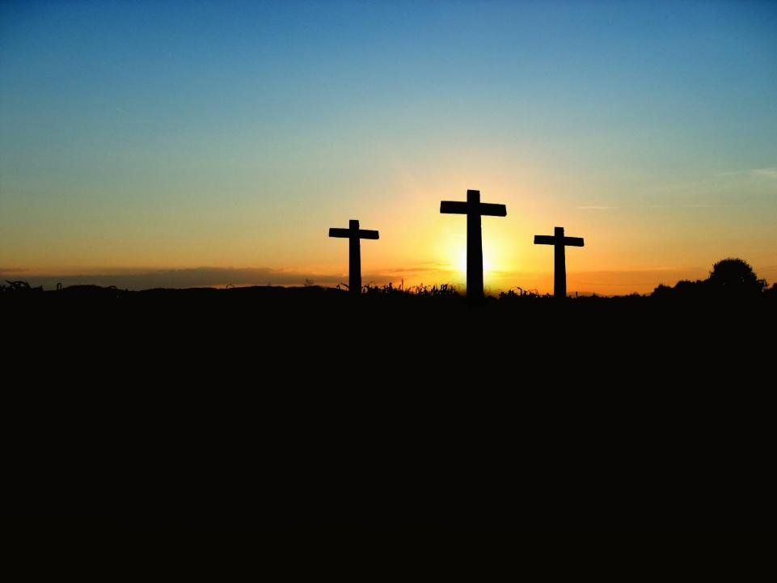
An Easter Blessing
Notes:
Slide 8: An Easter Blessing, as a prayer
The words of this Easter blessing will be / were spoken over the congregation at the funeral, and we use them now at the end of our time together, as a prayer over us, to send us out in hope. You might want to just listen to the words, or take them into your heart:

Slide 9
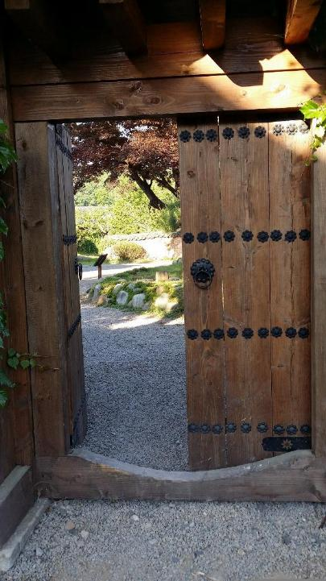
God the Father, by whose love Jesus was raised from the dead, open to you who believe the gates of everlasting life.
Notes:
Slide 9: God the Father, by whose love Jesus was raised from the dead, open to you who believe the gates of everlasting life.

Slide 10
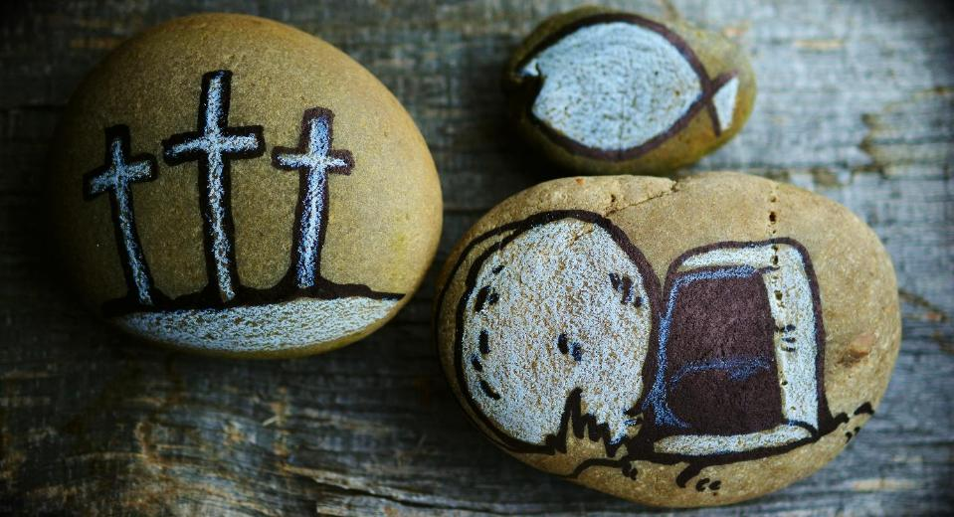
God the Son, who in bursting the grave has won a glorious victory, give you joy as you share the Easter faith.
Notes:
Slide 10: God the Son, who in bursting the grave has won a glorious victory, give you joy as you share the Easter faith.

Slide 11

God the Holy Spirit, whom the risen Lord breathed into his disciples, empower you and fill you with Christ’s peace.
Notes:
Slide 11: *This image shows the dove, one of the symbols of the Holy Spirit, from the Cathedra (the Bishop’s Chair) in Guildford Cathedral, which is the Cathedral of the Holy Spirit. Bishop Andrew would have used this chair during services.
God the Holy Spirit, whom the risen Lord breathed into his disciples, empower you and fill you with Christ’s peace.

Slide 12


Slide 13
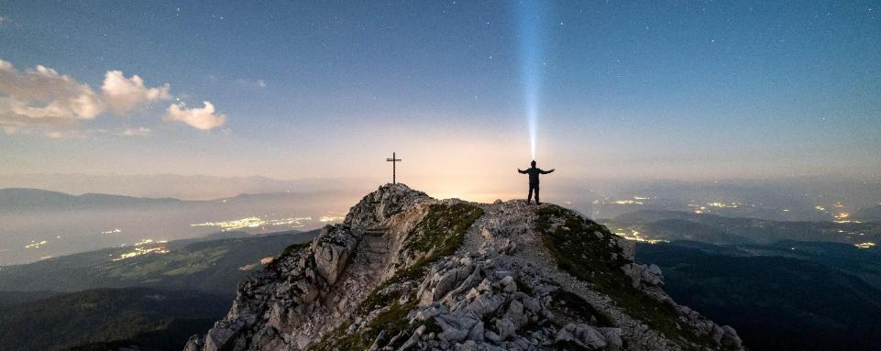


Leader: As we leave this place & time of remembrance for Bishop Andrew, may he rest in peace….
All: ….and rise in glory!
Notes:
Slide 13: Sending
We are going to use some more traditional words from funeral services to end our time together. The words remind us of Bishop Andrew’s belief that as a Christian, death is not the end. The words that people often say are: ‘May he rest in peace and rise in glory!’ So, I invite you to say the words ‘and rise in glory’ when I say ‘May he rest in peace….’
Leader: As we leave this place & time of remembrance for Bishop Andrew, may he rest in peace…
All: ….and rise in glory!
[NB If you feel you need to, remind children of who they can talk to in school if they want to.]

Slide 14
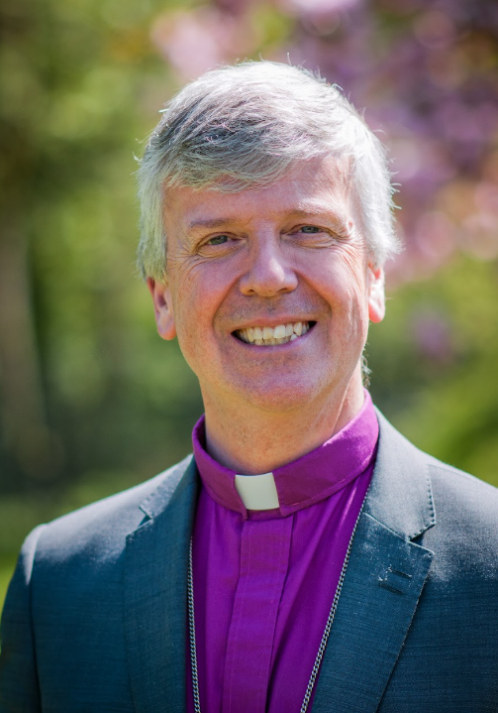
Heavenly Father,
We give you thanks for Andrew, our brother and bishop: for his faith and faithfulness to you in life and in leadership.
As we mourn his death and commend him to your everlasting arms, give us the same faith, hope and love rooted in the death and resurrection of your son, Jesus.
We pray especially for Beverly, Hannah, Sam, Joe, Lydia and the whole family. Comfort them with your Holy Spirit and protect them in their grief.
And bring us, at the last, with Andrew and all your children, to that eternal joy where you live and reign in glory forever, through Jesus Christ our Lord.
Amen.
Notes:
This is a special prayer that has been written by Bishop Paul to help remember Bishop Andrew and to pray for his family.
Please do use this in school if it helps your community.

