Slide 1
Leader: We are here together
ALL: May we ‘GO FOR GOLD!’ in our words and actions today!
Notes:
Slide 1: Gathering words
Leader: We are here together
ALL: May we ‘GO FOR GOLD!’ in our words and actions today!

Slide 2
Taking Part
Notes:
Slide 2: We’re going to start our time together today thinking about Taking Part, by taking part ourselves in something together now – a quiz. On these cards I have some riddles. The answers to the riddles are all things we can take part in. You can put your hand up quietly as soon as you think you know the answer, but I won’t ask anyone until I’ve finished reading the whole riddle. Are you ready? [use riddle cards, which match to slides 3-8]
Here’s a puzzling question for us: did we take part in the quiz because we wanted to be the one who guessed the right answer, or because it was fun? [ask a few children] I’m glad that it was a mixture of both!

Slide 3
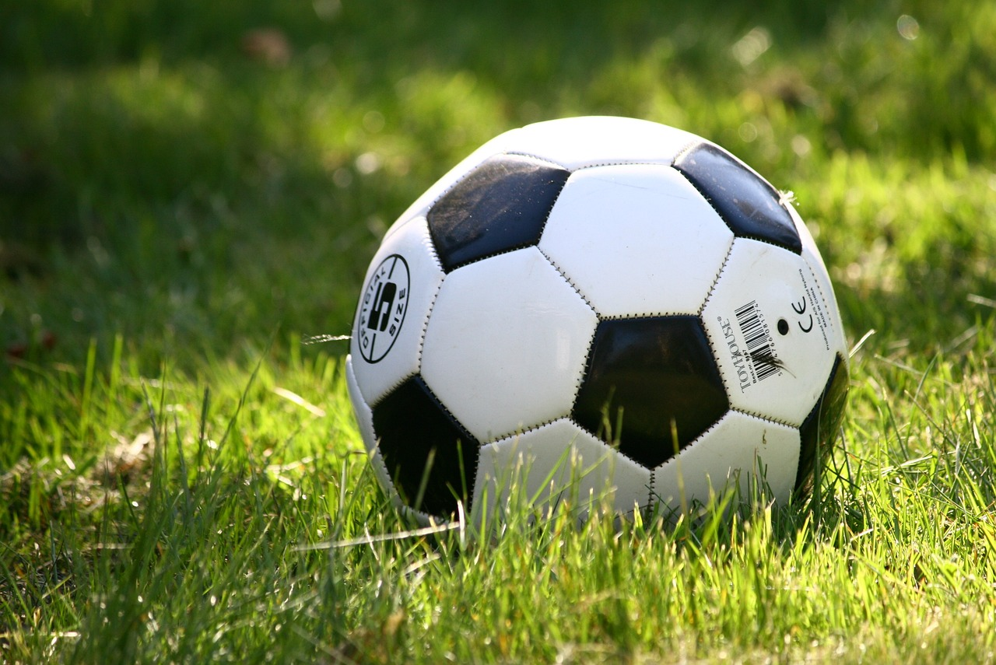
Notes:
Football:
You play this game with a ball.
There are two teams of players who wear different coloured shirts.
It gets played on a pitch.
You try to kick the ball into the opposing team’s goal.
The answer is…..football

Slide 4
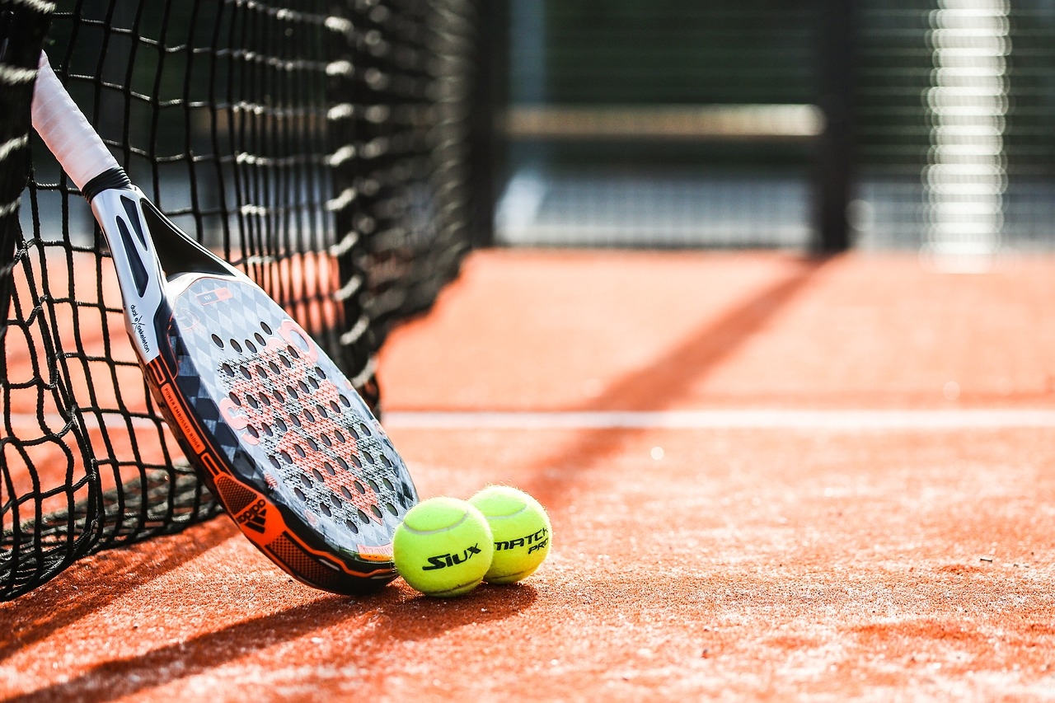
Notes:
Tennis:
This game can be played by 2 or 4 people.
Each player has a racquet and they’re often dressed in white.
The game gets played on a court.
You hit a small ball over a net in the middle.
The answer is…..tennis

Slide 5
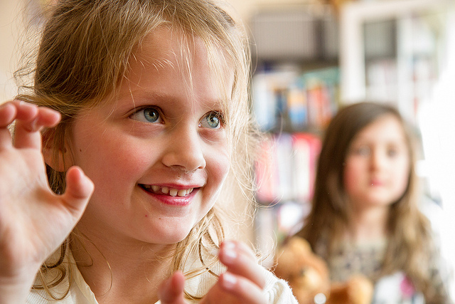
Notes:
Musical Statues:
You might play this game at parties.
Everybody dances to some music.
When the music stops, you have to stand very still.
The answer is…..musical statues

Slide 6
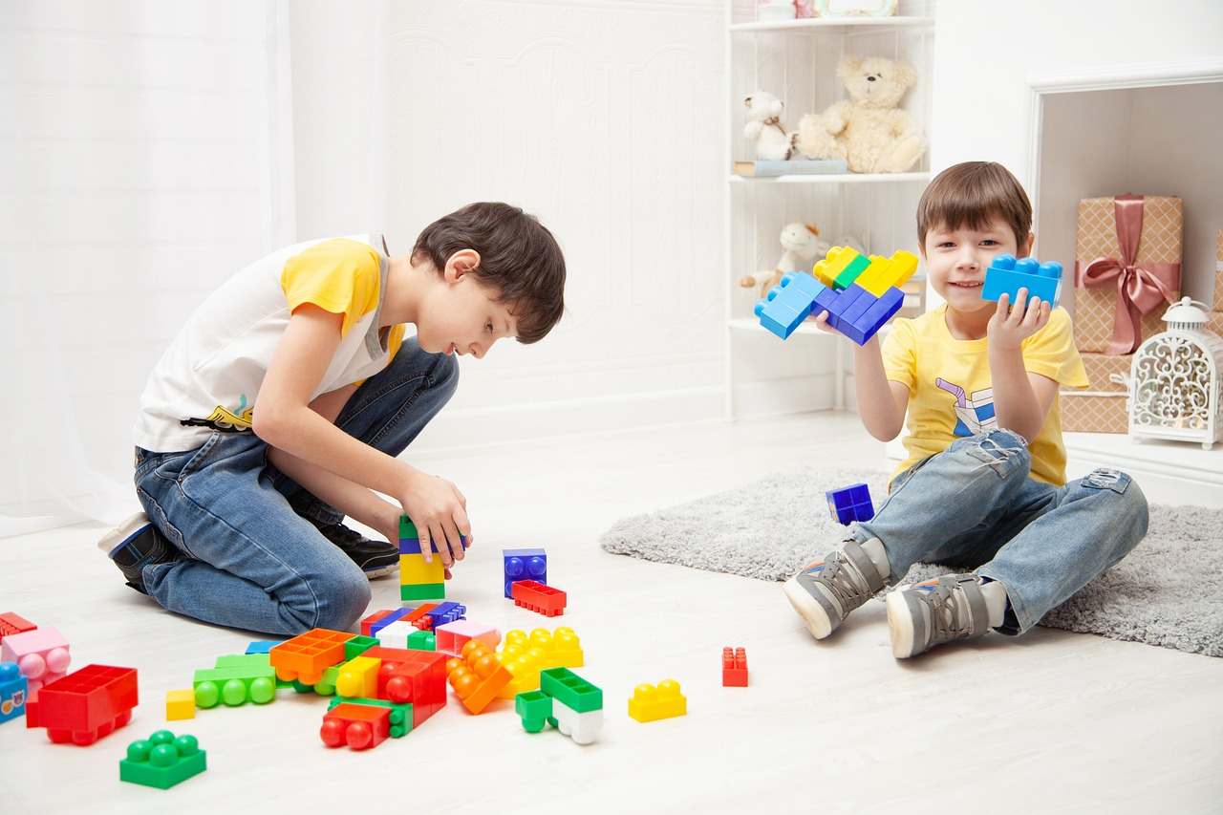
Notes:
Tidying up:
You do this at the end of a lesson at school, or at the end of the day at home.
It stops things from getting broken or lost.
It’s best if lots of people help.
It makes the room look neat.
The answer is…..tidying up!

Slide 7
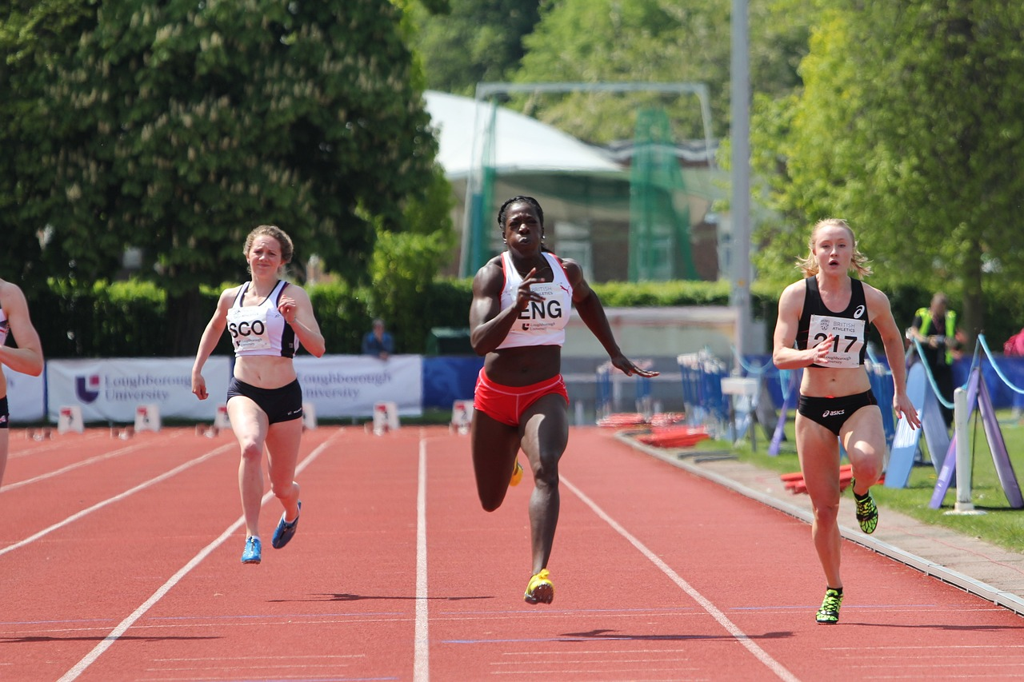
Notes:
Running a race:
You need your legs to do this.
You can have lots and lots of people taking part.
There is a starting line and a finishing line.
It can start with someone saying ‘Ready, steady, go!’
The answer is…..running a race

Slide 8
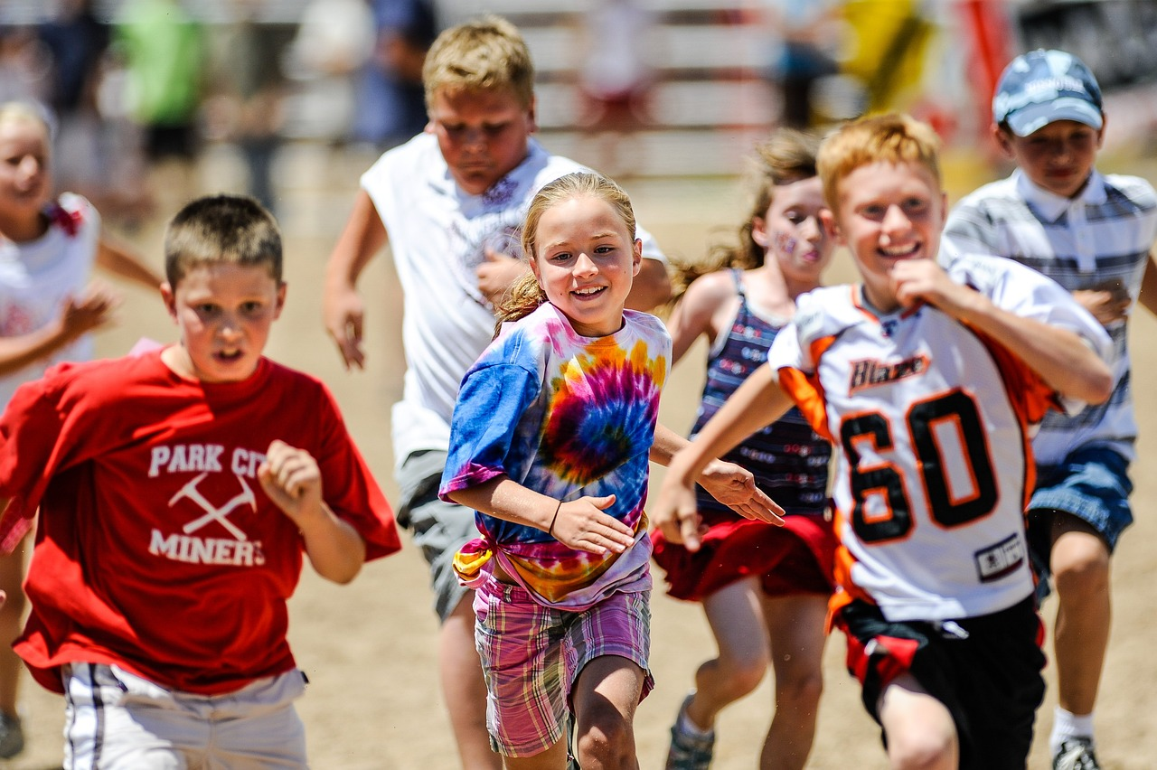
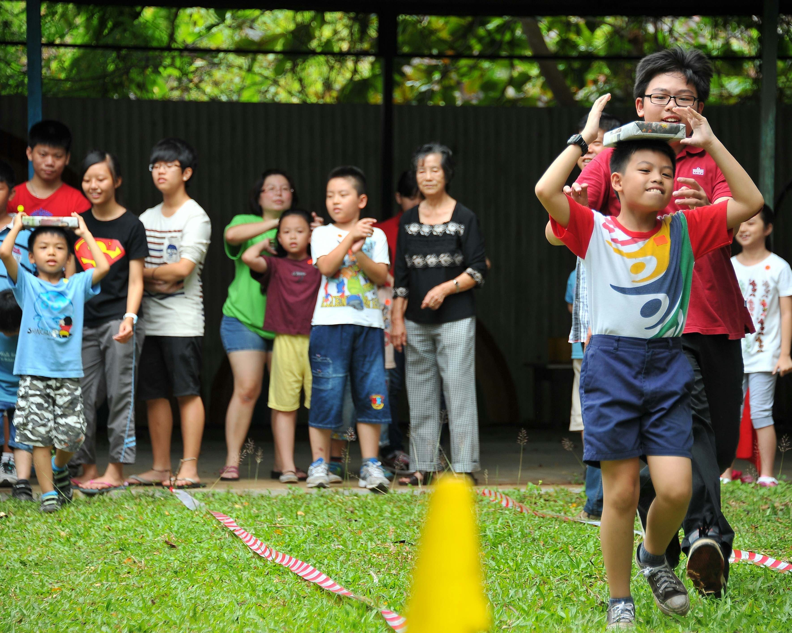
Notes:
Sports Day:
We do this every year in school.
There are lots of different races and events.
Different classes / houses compete against each other and have a lot of fun.
One of our favourite events is…..
The answer is…..Sports Day!

Slide 9
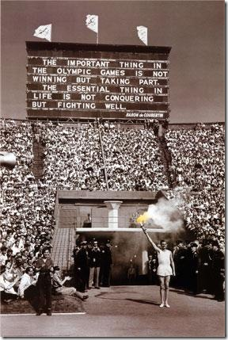
“The important thing in the Olympic Games is not winning, but taking part.”
Notes:
Slide 9: If you remember back to one of the very first Olympic assemblies we had this term, we thought about the words of the inventor of the very first modern Olympics, Baron Pierre de Coubertin:
“The important thing in the Olympic Games is not winning, but taking part.”
Something that happened in the 2008 Olympic Games is a fantastic example of Baron de Coubertin’s words.

Slide 10
2024
CE
2008
CE
Notes:
Slide 10: So, let’s jump back into our Olympic time machine and go back in time 16 years ….to 2008,

Slide 11
Notes:
Slide 11: ….when the Olympic Games were held in Beijing, China.

Slide 12
The Olympics
Respect
Friendship
Excellence
Determination
Equality
Courage
Inspiration
Olympic rings © Pixabay
Notes:
Slide 12: Today we are going to be focusing on the Olympic value of respect – and find out about how one runner earned the respect of the whole crowd as she ran.

Slide 13
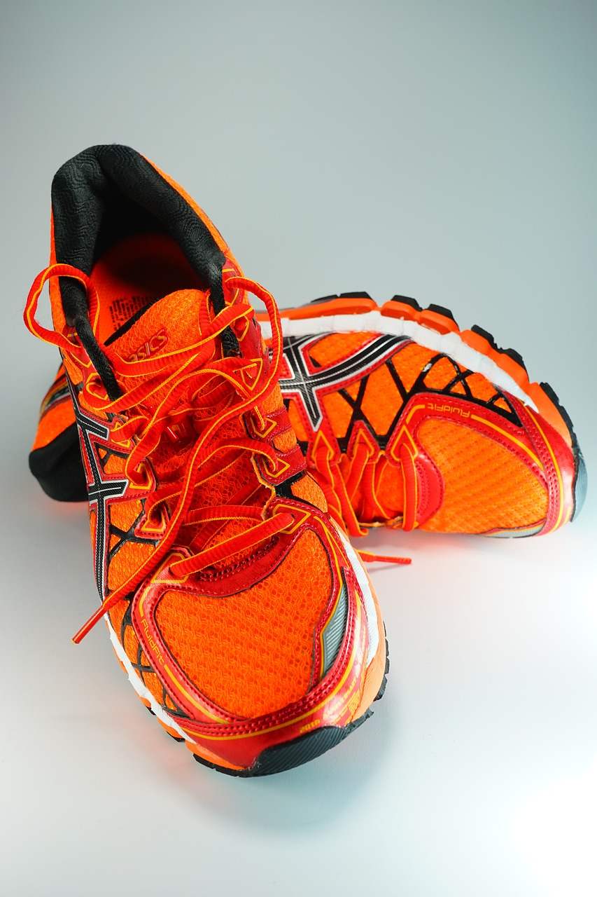
“I am proud to bring the Somali flag to fly with all of these countries, and to stand with the best athletes in the world.”
Notes:
Slide 13: Samia Yusuf Omar was one of only 2 athletes sent by the country of Somalia to the 2008 Olympic Games, and she was only 16 when she competed. Somalia is one of the world’s poorest countries, and has been devastated by war over the past few decades, so Samia trained under the most difficult of circumstances, with no facilities – often the streets weren’t even safe enough for her to go out running (*see note in the introduction). She even had to borrow equipment from other countries to take part in the Olympics, and sadly there are no official photos of her running in the 200m because she wasn’t from one of the bigger countries! Before the competition, she said: “We know that we are different from the other athletes,” Samia said. “But we don’t want to show it. We try our best to look like all the rest. We understand we are not anywhere near the level of the other competitors here. We understand that very, very well. But more than anything else, we would like to show the dignity of ourselves and our country.”
Neither she nor the other competitor from Somalia won any medals – in fact, they both came last. But many people noticed and commented on their attitude. She earned peoples’ respect when she proudly finished her race last. Samia’s time was the slowest in the race, but her personal best, at 32.16 seconds! Both athletes went back to Somalia proud just to have taken part. Taking part in the Olympics had been her dream for many years.
After the race, Samia said: “This is the highest thing any athlete can hope for. It has been a very happy experience for me. I am proud to bring the Somali flag to fly with all of these countries, and to stand with the best athletes in the world.”

Slide 14
….I wonder what we can learn from the example of Samia Yusuf?…..
…I wonder what she shows us about being a good loser?....
….I wonder how Baron de Coubertin’s words about taking part might inspire us?....
Notes:
Slide 14: Responding and words for worship
Let’s be quiet and still with our own thoughts now…..
Today we’ve been thinking about taking part.
…..I wonder what we can learn from the example of Samia Yusuf?…..
….I wonder what she shows us about being a good loser?....
….I wonder how Baron de Coubertin’s words about taking part might inspire us?....
We heard a couple of weeks ago that a famous Christian teacher called Paul wrote something in the Bible about taking part in a race. He said ‘Run the race with perseverance.’ Running with perseverance means keeping on going. There will be times in our lives when we find things hard to do, like choosing to be a good sport whether we win or lose. In our lives too, it’s not winning that’s important - it really doesn’t matter whether we are first or last. It’s how we take part, and how we live our lives that really matters.
….I wonder how Paul’s words about persevering might help us if we find this difficult?

Slide 15
Notes:
Slide 15: Prayer
So now let’s take a few moments to reflect or pray…. I’m going to use the words of a prayer asking God for his help: if you want to make the prayer your own, then please do join in with the Amen at the end.
Dear God
Thank you for the fun that we can have taking part – in games, in races, (and in Sports Day). Help us to remember how to be good sports, whether we win or whether we lose. May we live our lives in ways that please you – and encourage others.

Slide 16
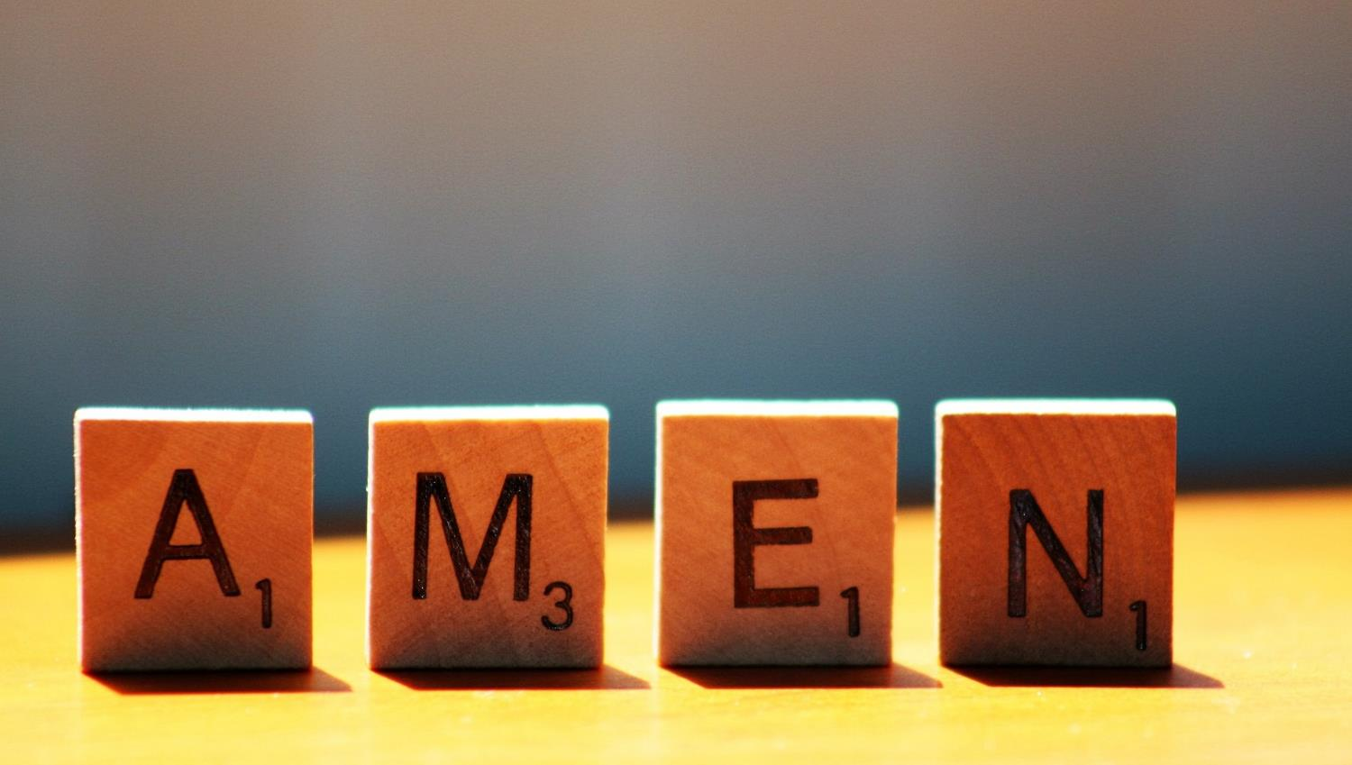

Slide 17
Notes:
Sports Day section: (omit this section and slide 17 if your assembly is not also related to Sports Day.) Soon, we’re going to have our Sports Day. The most important thing about Sports Day as far as teachers are concerned is that you take part – and that you learn how to be good at taking part whether you win or not. We want everyone to have a good day and remember all the time that it’s supposed to be fun.
There is nothing wrong with wanting to come first at something, but in real life, you can’t always win at everything. Whenever you take part in something, there are going to be people who win, and people who lose. Part of life is learning how to be a good sport, whether you win or lose.
I have another game for us to help us think more about this. On the screen, we are going to see some statements about being a good winner or being a good loser. As we read them together, you can help me to decide whether it’s something to do with being a good winner or a good loser. (Talk very briefly about each as they are displayed – especially the ones that are appropriate for both categories- you can see the statements on p5)

Slide 18
A good winner….. A good loser….
…..doesn’t show off.
…..doesn’t say ‘It’s not fair!’.
…..feels sad for those who don’t win.
…..claps other children.
…..tries hard again next time.
…..tells other children they’ve done really well.
Notes:
Slide 18: Talk very briefly about each as they are displayed – especially the ones that are appropriate for both categories (you can see the statements & ‘answers’ on p5)

Slide 19
Leader: As we leave this place & time and go into the day ahead…
All: Let’s ‘go for gold’ in all that we do!
Notes:
Sending: Slide 19
Leader: As we leave this place & time and go into the day ahead…
All: Let’s go for gold* in all that we do!
*Again, you might need to unpick what we mean by ‘going for gold’ in the context of today’s words.

Slide 20
Notes:
Slide 18: Reflective areas
Put a class jigsaw puzzle in your reflective area this week, but remove one piece (and keep it safe!) As the day/week progresses, children should discover that the jigsaw is incomplete – which allows you to make the point that the same is true in your class / school: it is incomplete without everybody!

