Slide 1

Pictures copyright-free from pixabay
Leader: We are a creative community. As we gather together today…
ALL: May our thinking, talking and wondering help us to grow.
Notes:
Slide 1: Gathering
Use the new greeting, with BSL actions if desired.
Leader: We are a creative community. As we gather together today….
ALL: May our thinking, talking and wondering help us to grow.
Here are BSL actions for some of the words:
Leader’s words:
Creative: https://www.signdictionary.co.uk/view/creative?q=creative#title
Community: (we use the word ‘gathering’ as it’s a simpler sign!) https://www.signbsl.com/sign/gathering
Gather together: https://www.signbsl.com/sign/gather (1st video)
Pupils’ response:
Think: https://www.brightbsl.co.uk/signs/think
Talk: https://www.signbsl.com/sign/talk (1st video)
Wonder: https://www.signbsl.com/sign/wonder (1st video)
Grow: https://www.signbsl.com/sign/grow (2nd video)

Slide 2
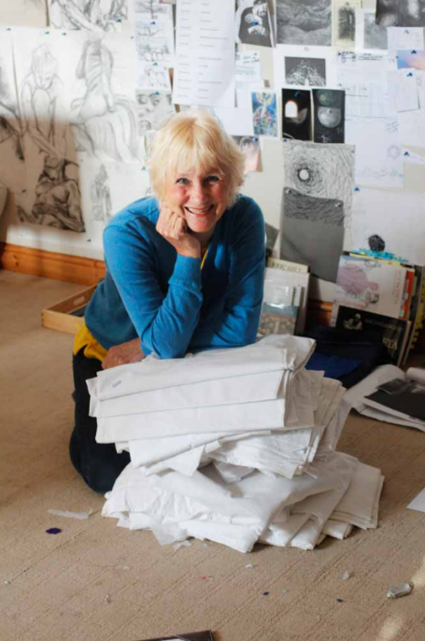
Threads Through the Cross
Notes:
Slide 2: Threads Through the Cross
This is our final week looking at Jacqui’s panels, and we come to the very end of the Passion story.

Slide 3

SURPRISE!!
Notes:
Slide 3: Surprise!!
What’s the biggest surprise you’ve ever had?
How did it feel?
Have you ever had a surprise when you least expected it?
[Share together with talking partners or small groups]

Slide 4
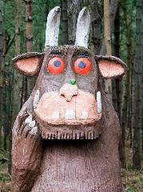
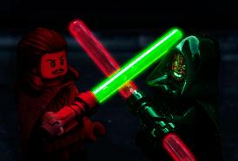

A mouse took a stroll through a deep dark wood. A fox saw the mouse and the mouse looked good…
A long time ago, in a galaxy far, far away…….
The sun did not shine, it was too wet to play. So we sat in the house all that cold, cold, wet day…
Beginnings
Notes:
Slide 4: I wonder if you remember how at the very beginning of our series together, we looked at the beginnings of stories?
Today, we come to the end of our series, so let’s begin today with some endings!!

Slide 5
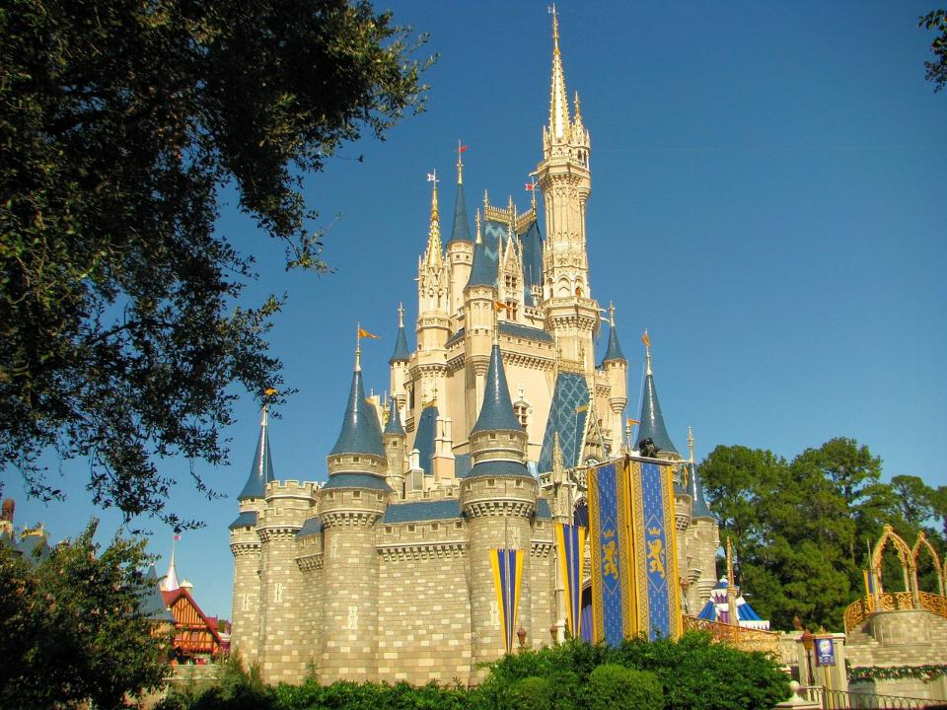
Endings
‘…and they all lived happily ever after.’
Notes:
Slide 5: Many of our favourite stories (especially the fairy story / Disney variety!) end with these words: ‘…and they all lived happily ever after.’ and I expect that many of us often wish that real life was a bit more like that!
I wonder what story endings you can remember? Maybe when Rainbow Fish gave his scales away and gained lots of new friends…. Or the Cat in the Hat left and the house was peaceful again! [give an example from stories you know your children love to get them started, then ask for some examples.]

Slide 6
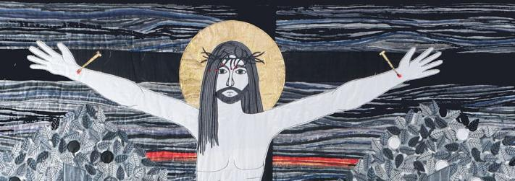
It is finished!
Notes:
Slide 6: Today you will be with me in paradise
You’ll remember that this is where it seemed as if the story had ended for the disciples, when Jesus died on the Cross. Jesus had even said the words ‘It is finished!’
It’s fair to say that this was NOT the ending that the disciples had expected, and with Jesus gone, all their hope had disappeared too…..
But the Cross wasn’t the end of the story, as we remember each Easter time. God’s great big surprise was about to take place!

Slide 7
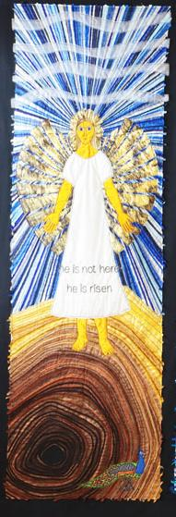
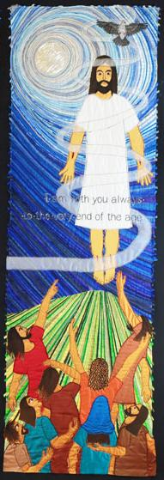

Empty tomb
Ascension
I am with you always – to the very end of the age.
He is not here – he is risen!
Notes:
Slide 7: Empty Tomb and Ascension
So, for a final time, let’s use Jacqui’s work to help us to think. The panel sections show 2 surprise events – the Empty tomb, the Resurrection, which happened 3 days after Jesus died and the Ascension, which happened 40 days after that, when Jesus returned to Heaven to be with his Father. These are the final events in Jesus’ life on earth – so let’s gaze together one last time…..
As you gaze, I wonder what you notice?.... [leave some space for them to take in the sections]
…maybe you notice the angel standing on top of the empty tomb? …or the darkness in the very centre of the tomb?
…maybe you notice Jesus, with the nail marks in his hands and feet?
…I wonder where he is going?...or what the disciples are thinking as they watch?
…maybe you notice the words? He is not here – he is risen! and I am with you always – to the very end of the age.
…I wonder what his friends are feeling as the surprises keep happening?!
With a talking partner, talk about the things that you think are surprising about these two panels….. [share some ideas together]
Information about the birds this week:
the peacock is an ancient Christian symbol of resurrection, as each new year it sheds then re-grows its tail feathers.
the skylark regularly ascends high into the sky as it flies – but you can still clearly hear its call from the ground!

Slide 8
Hopeless
Hopeful
I am with you always – to the very end of the age.
Notes:
Slide 8: Hope-less to Hope-ful
Jesus’ disciples were not expecting either of these surprise events, because they thought that it had all ended when Jesus died.
They went from feeling hope-less and disappointed, to hope-ful, filled with hope. Jesus said that when he went back to be with his Father in heaven, he would send them a gift, a helper, the Holy Spirit, which meant that he could be with them always, to the very end of the age.
This hope is the gift also for any people who would follow Jesus – a promise to the very first Christians, and every Christian since, that they would never be alone.
I wonder what brings you hope when you need it?

Slide 9
I am with you always – to the very end of the age.
….I wonder how Jesus’ words made a difference to the disciples?....or to Christians today?....or maybe for us?....
….I wonder what might be feeling a bit hope-less for us or our world?....
….I wonder how our actions might help to bring hope to others this week?....
Notes:
Slide 9: Responding and words for worship
We’ve thought today about the surprise ending to this story, and the new hope that it gave to the disciples…..
We’ve also heard the words that Jesus spoke to the astonished friend who gathered as he returned to Heaven…I am with you always – to the very end of the age.
We’re going to use these words now as we think together…..
….I wonder how Jesus’ words (I am with you always) made a difference to the disciples?....or to Christians today?....or maybe for us?....
….I wonder what might be feeling a bit hope-less for us or our world?....
….I wonder how our actions might help to bring hope to others this week?.... **
[** you might want to add in a few words here about how your school’s vision/values helps to do this in practical ways as part of your school family or wider community]

Slide 10
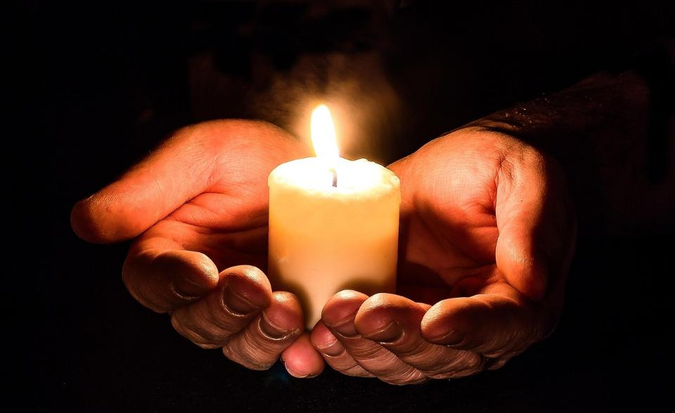
Notes:
Slide 10: Opportunity for reflection / prayer
I’m going to use a short prayer now to help focus us on living in a way that brings hope – and blessing – to all those around us. If you would like to make this prayer your own, then do use the ‘Amen’ at the end.

Slide 11
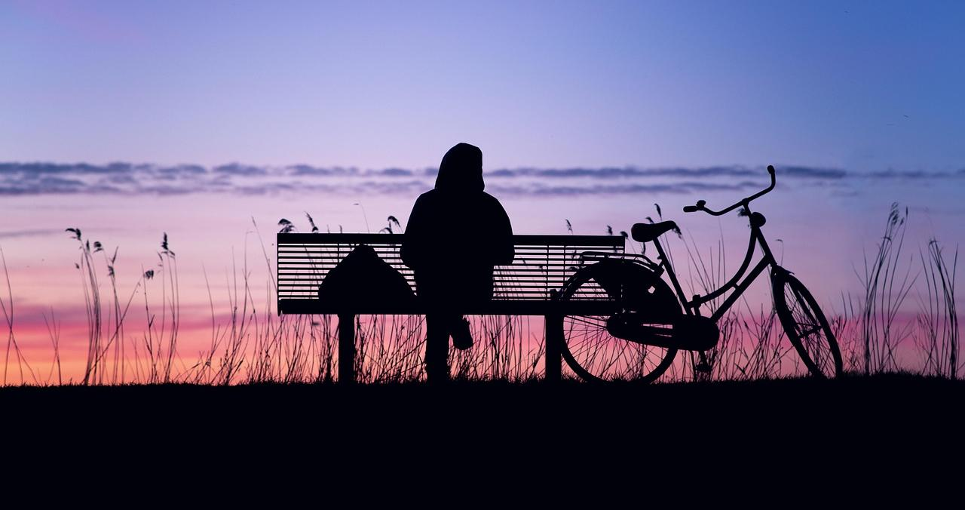
The peace of God be in your heart.
Notes:
Slide 11: The peace of God be in your heart.

Slide 12
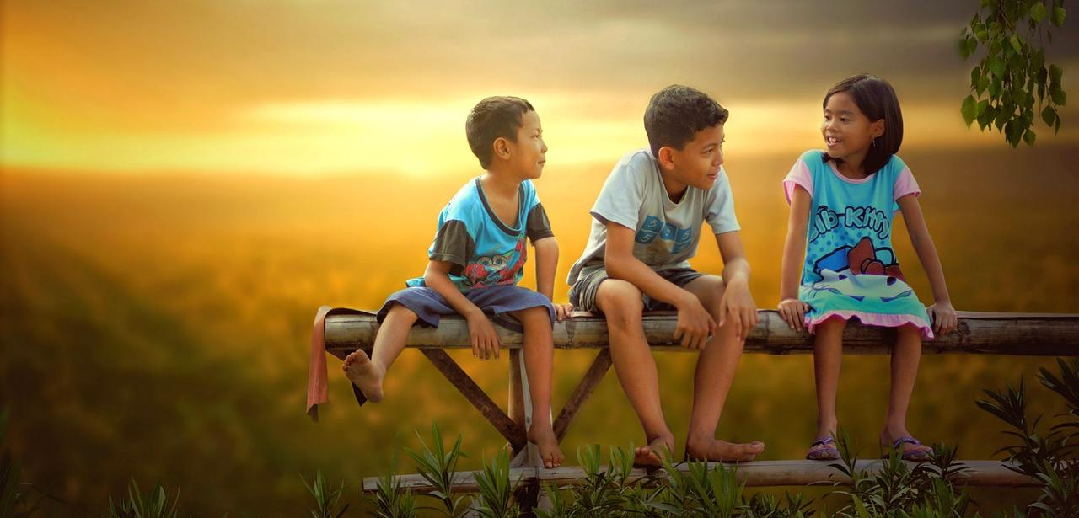
The grace of God be in your words.
Notes:
Slide 12: The grace of God be in your words.

Slide 13
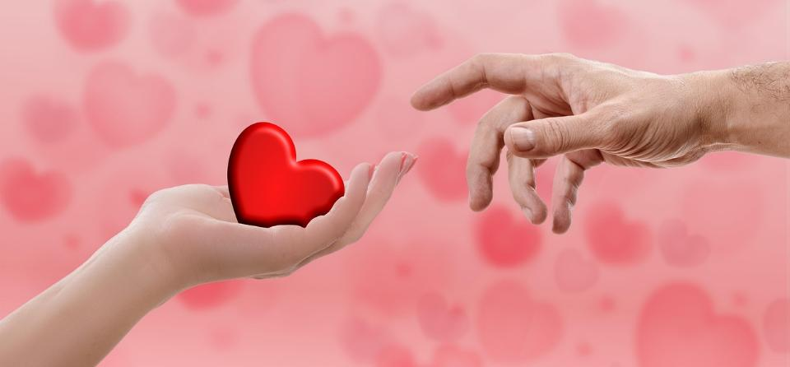
The love of God be in your hands.
Notes:
Slide 13: The love of God be in your hands.

Slide 14
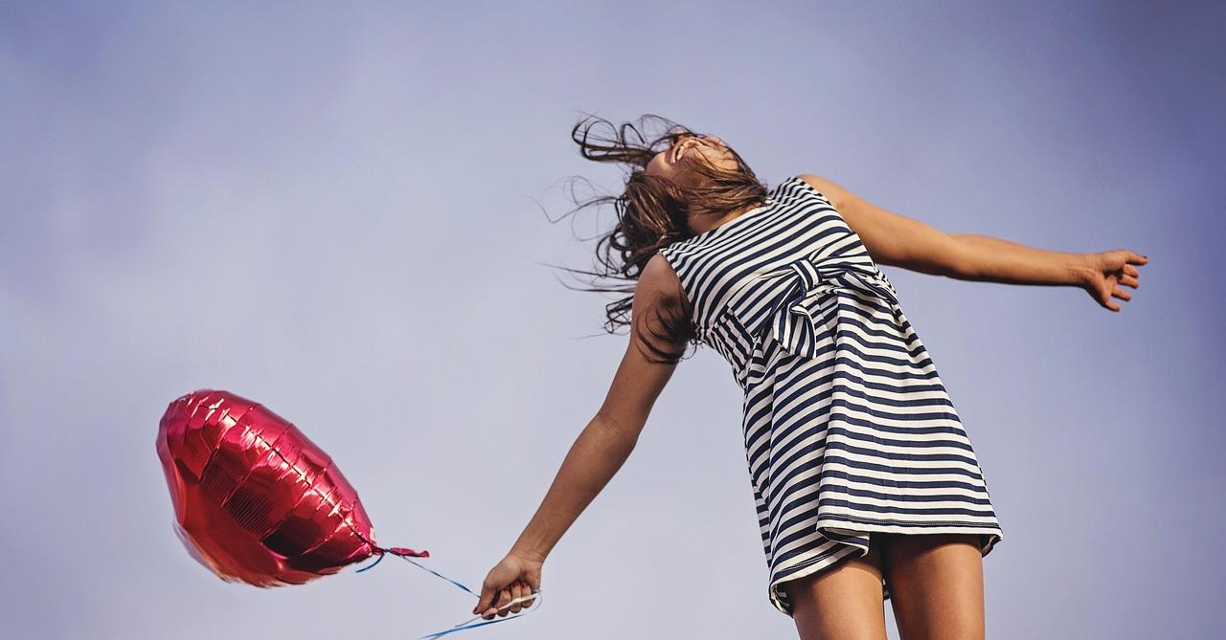
The joy of God be in your soul and in the song that your life sings.
Notes:
Slide 14: The joy of God be in your soul and in the song that your life sings.

Slide 15
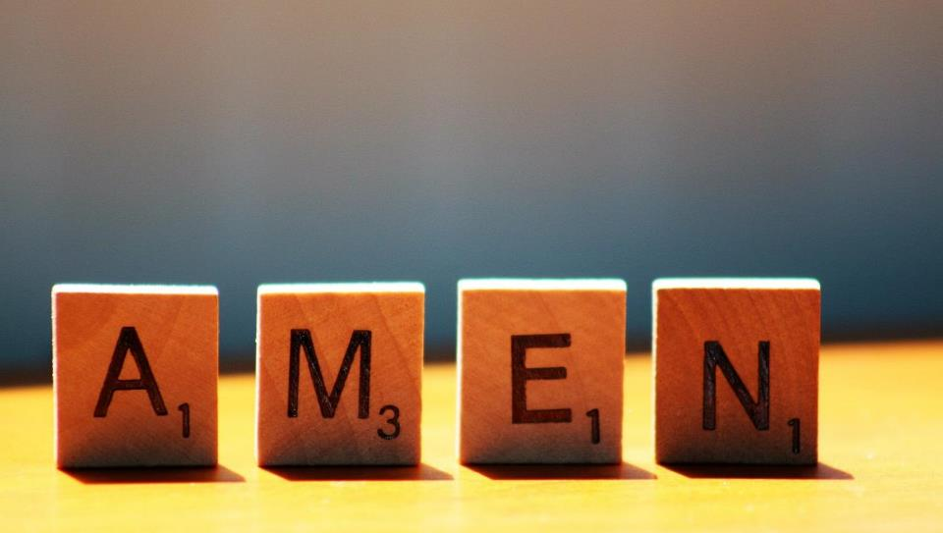

Slide 16
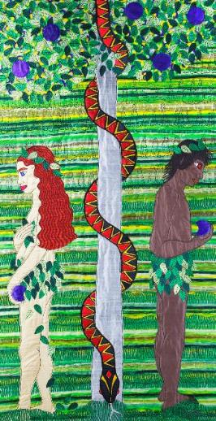
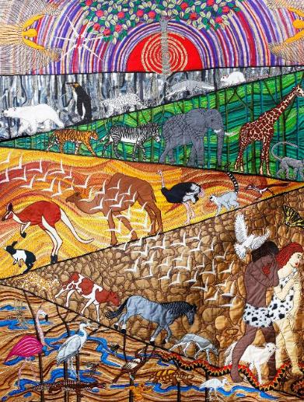
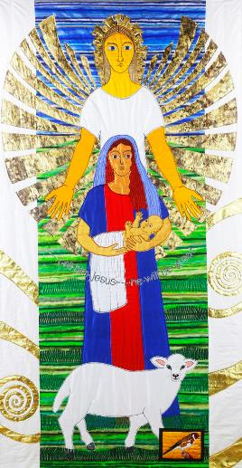
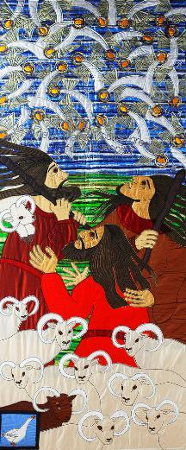
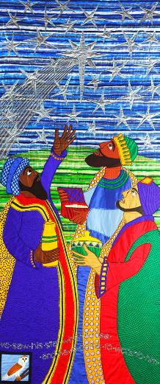

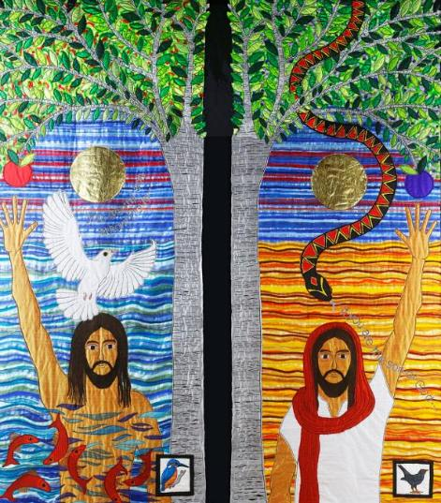
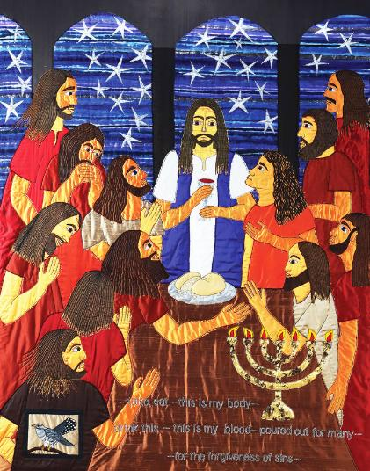

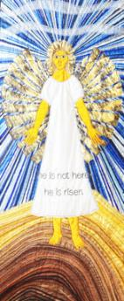
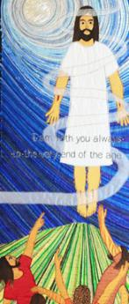
….I wonder what makes this such an important story of hope for some people?....
Notes:
Slide 16: The BIG rescue plan and Threads Through the Cross
Before we leave our time together today, we’re just going to pause for a few moments to reflect on our journey in this term so far through the story of God’s great BIG rescue plan, using Jacqui’s creative gifts to help us. Here’s a selection of the panels – there are too many to fit them all on the screen!
I wonder which of her pieces you liked the best and why?
I wonder which created the most discussions?
I wonder how her work might have helped us to understand this story better?
Or how her work might have inspired you to be more creative?
This big story has shaped how Christians think and act since the very first people chose to follow Jesus, and has had a huge impact on cultures across the world [as we’ve seen in the extra slides….], including our own [you may choose to explain this further e.g. in the calendar, public buildings, the way our justice system works, in works of literature, even the fact that we have free education for all…] and in the life of our school [e.g. your vision/values]
….I wonder what makes this such an important story of hope for some people?....

Slide 17
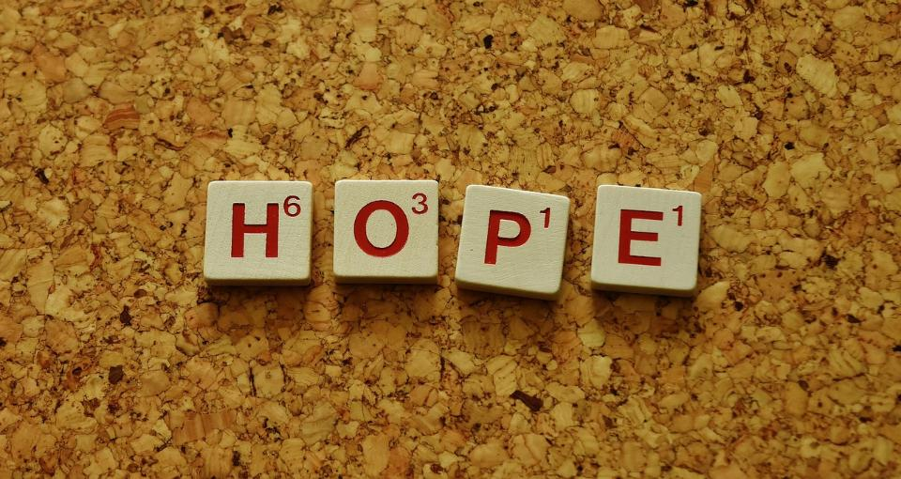


Leader: As we leave this place & time and go into the day ahead…
All: Together, we create a hope-filled community!
Notes:
Sending: Slide 17 (NB note different word from last week!)
Leader: As we leave this place & time and go into the day ahead…
All: Together, we create a hope-filled community!
BSL Together: https://www.signbsl.com/sign/together (1st video); Hope: https://www.signbsl.com/sign/hope
You already have signs for ‘community’

Slide 18

Notes:
Slide 18: Reflective areas
A butterfly is a symbol of hope – it emerges from a brown, lifeless cocoon with bright and beautiful wings.
Do: Make a paper butterfly by folding and cutting.
Think: What might be feeling a bit hope-less for us or our world?....Or things we are disappointed about? Write or draw these situations onto the paper butterfly
Talk: You might like to turn your thoughts into a prayer or talk together about how our actions might bring hope to others.

Slide 19
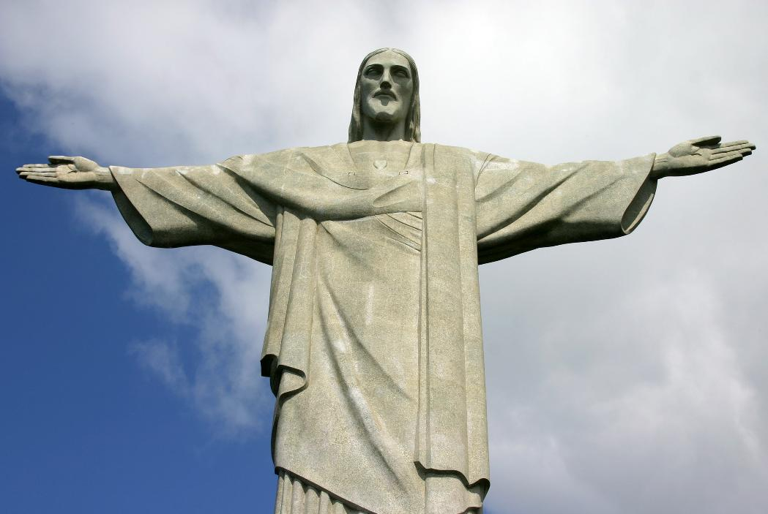
Statue of Christ the Redeemer,(risen) in Rio de Janeiro
from Art in the Christian Tradition
Notes:
Slide 19: Showing the resurrected Jesus from different cultural perspectives
Link to original artwork: https://diglib.library.vanderbilt.edu/act-imagelink.pl?RC=57362, which includes some key information.
Looking at these two creative interpretations of this part of the story may be something that links with your RE curriculum, reflecting the fact that Christianity is a global religion, encouraging pupils to appreciate the diversity that exists across cultures, traditions and geographical areas. It’s important for pupils’ wider understanding that they are given opportunities to think about how Christians show Jesus as being ‘like them’, and that this important story for Christians is imagined in different ways across the world. It also creates an inclusive classroom environment, giving all pupils opportunity to see themselves in the art that they view.
You may wish to consider these questions:
What is the same? What is different?
Which cultures / traditions does the sculpture come from? [You can find out about it here: https://www.britannica.com/topic/Christ-the-Redeemer]
Why do we think this?
What questions might we want to / need to ask?

