Slide 1
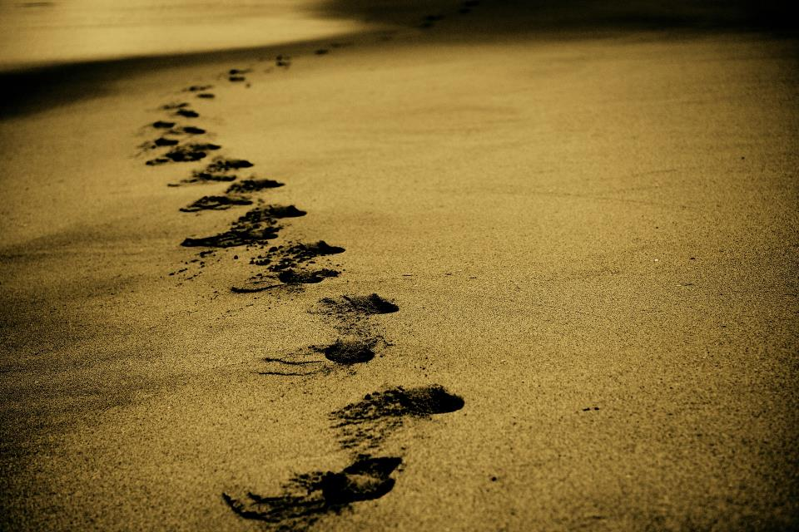
Picture copyright-free from pixabay
Leader: We are on this journey together…
Children: We are friends along the way…
ALL: May God go with us.
Notes:
Slide 1 or 2 [choose whichever image you prefer, or use them in rotation]:
Use the greeting for this term
Leader: We are on this journey together…
Children: We are friends along the way…
ALL: May God go with us.
BSL interpretation:
Sign for ‘way’ (nearest to the idea of ‘journey’): British Sign Language BSL Video Dictionary - way
Sign for ‘friends’: British Sign Language: friends
Sign for ‘God: British Sign Language BSL Video Dictionary - God
Sign for ‘go with us’ – we have invented this! After you’ve signed ‘God’, bring your finger down alongside your other finger and make them ‘journey together’ in front of you.
Engaging:
As we heard last week, in the final term of this school year, we are beginning a new theme:

Slide 2
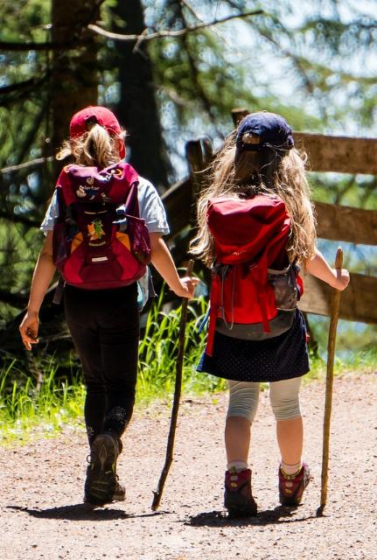
Picture copyright-free from pixabay
Leader: We are on this journey together…
Children: We are friends along the way…
ALL: May God go with us.
Notes:
Slide 1 or 2 [choose whichever image you prefer, or use them in rotation]:
Use the greeting for this term
Leader: We are on this journey together…
Children: We are friends along the way…
ALL: May God go with us.
BSL interpretation:
Sign for ‘way’ (nearest to the idea of ‘journey’): British Sign Language BSL Video Dictionary - way
Sign for ‘friends’: British Sign Language: friends
Sign for ‘God: British Sign Language BSL Video Dictionary - God
Sign for ‘go with us’ – we have invented this! After you’ve signed ‘God’, bring your finger down alongside your other finger and make them ‘journey together’ in front of you.
Engaging:
As we heard last week, in the final term of this school year, we are beginning a new theme:

Slide 3
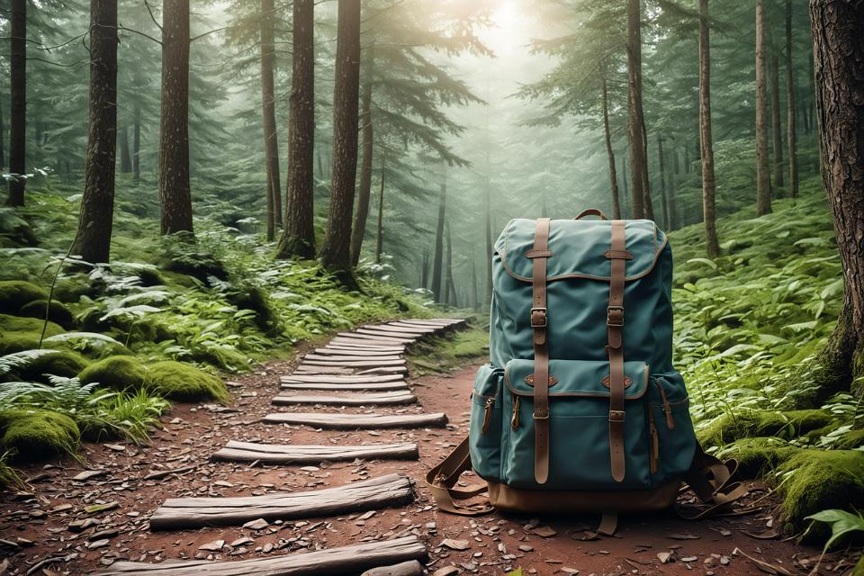
Picture copyright-free from pixabay
To boldly go….
Notes:
Slide 3: To boldly go…. We have been on a journey this term – ‘boldly going’ together! I wonder what you’ve enjoyed the most….or learnt from the most? Here’s a reminder of some of the places we’ve been and the people who’ve shared their wisdom with us…

Slide 4
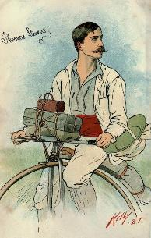
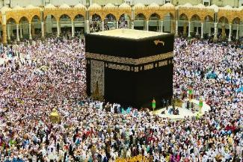
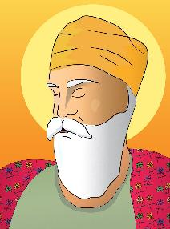
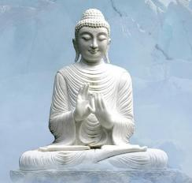
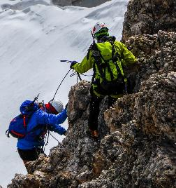
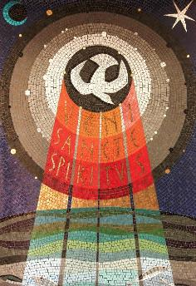
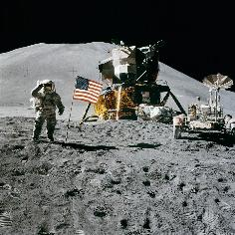
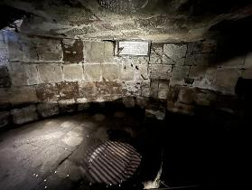
Notes:
Slide 4: [Recap what you’ve experienced together during your ‘journeying’ assemblies, maybe using the pages of the reflection journal (Passport) if you used it. Encourage children to talk about the journeys that have impacted them during the term. There are a few pictures to help remind you….. From L-R, top-bottom (not in week order!): Thomas Stevens; Amelia Earhart; Hajj & the story of Hajar; Guru Nanak and the needle; climbing Everest, trust; Moon landing & the women who made it happen; Buddha’s wisdom for the journey; Paul’s conversion & adventures; Holy Spirit comes at Pentecost] We’ve come to the end of this journey together today and are going to take some time now to think about what God might have to say to us as we all get closer to the end of term, and for some of you, the end of your time at our school.

Slide 5
Picture copyright-free from pixabay
What’s in the rucksack today?
Your Journey
Notes:
Slide 5: But first, another story using all the objects that we packed for this term! It’s a story about Your Journey with us.…[use script on p.4, with slides 5-13]

Slide 6
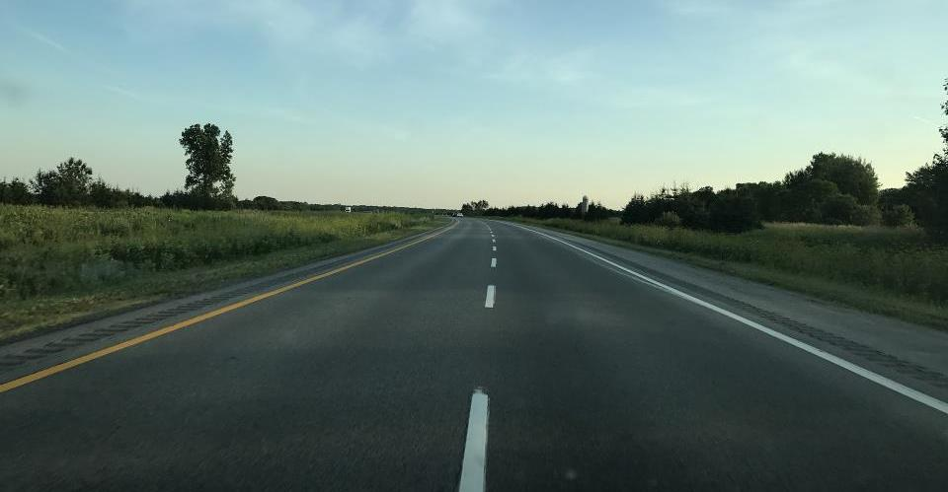
Notes:
Slide 6: Your time with us at ………School has been a bit like a journey….and like a journey, the road [unroll long cloth to form a ‘road’] stretches behind us…. and ahead of us…

Slide 7
Insert your school logo here
Notes:
Slide 7: For ……years, we have belonged together….. we have been a familiar place, your home, our school [place passport]… we have shared our lives together…

Slide 8
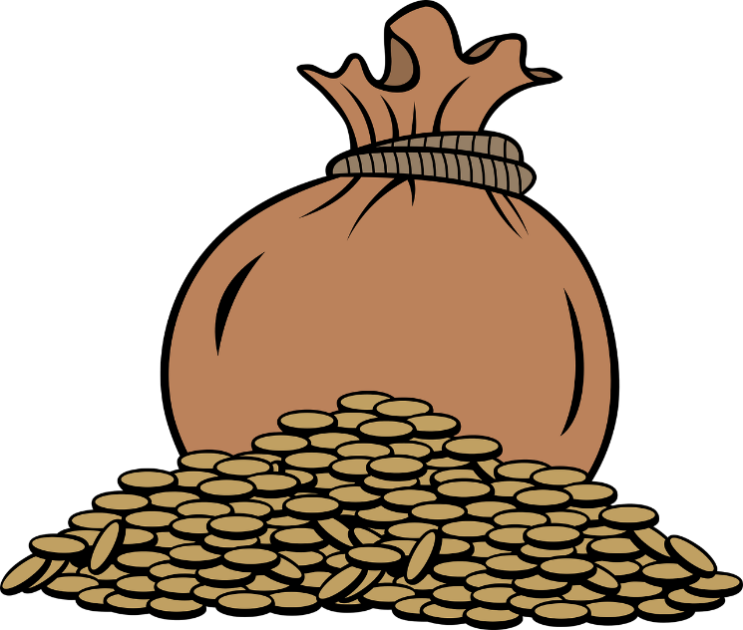
Notes:
Slide 8: We hope that there have been great times that you’ll always remember, moments that will stay with you forever, the treasure [place the money] of happy memories that we can look back on….

Slide 9
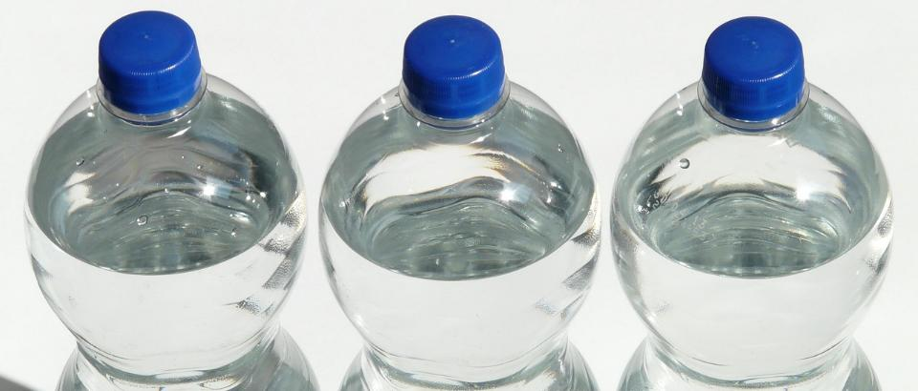
‘Forgive each other as God forgives you.’ Colossians 3:13
Notes:
Slide 9: …We know that there will have been times when things have got in a mess and we’ve needed to clean up [place bottle of water] …. to say sorry…and to forgive each other….

Slide 10
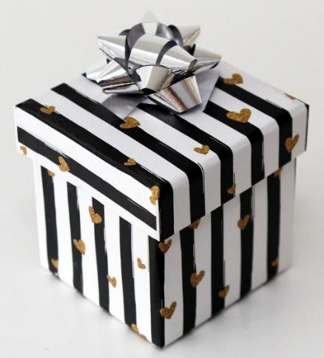
Notes:
Slide 10: …Your new school or new class is another kind of new beginning for you….….a chance to reflect on who you are, and the gift [place gift] that you will be to your new community….

Slide 11
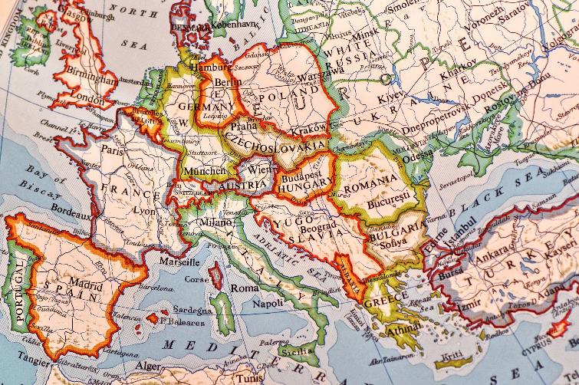
Notes:
Slide 11: …On your journey with us, we hope that you have learned many things, that you have gained not just knowledge, but wisdom, and that all these things will equip you for the world that lies ahead [place map] as you travel on in your school journey….

Slide 12
Notes:
Slide 12: ….we hope that your time with us will help you to shine your light brightly [place torch]…. and know where to find light when the road is dark….

Slide 13
‘Seek God’s will in all you do, and he will show you which path to take.’ Proverbs 3:6
Notes:
Slide 13: ….to help you to find your way when you are lost….[place compass]… and help others to do the same….

Slide 14
‘You are precious to me, and honoured, and I love you.’ Isaiah 43:4
Notes:
Slide 14: ….but more than anything, we hope you leave us seeing yourself, and others, as God sees you, [place glasses] … full of potential….. precious….and unique….and loved….

Slide 15
‘I will be with you – always and forever!’
Matthew 28:20
Notes:
Slide 15: ….And as we pack up ready to move on, we want to remind you of some words that Jesus spoke to his friends before he left earth and moved on himself [tie luggage label onto bag]: ‘I will be with you – always and forever.’

Slide 16
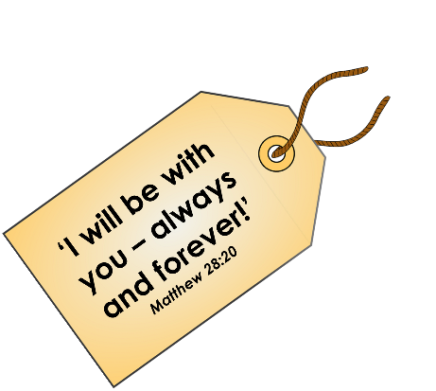
….I wonder which have made you think?...
…or which might encourage you at the end of this school year?....
….I wonder what Jesus’ words might have made for them?.... or what difference they might make to us as we ‘boldly go’?!....
Notes:
Slide 16: Responding (and words for worship):
Let’s be quiet as we come to the end of this time together today.
In the stillness now….
…Think about the people who have helped you and been with you so far this year.....
....your family......your teachers.....your friends.....
….It’s good to know that all these people have been ‘with us’ in many different ways.....
….we have also been on many journeys and adventures this term…..
….. I wonder which have made you think?.......
….or which might encourage you at the end of this school year?....
….We’ve also heard the words of Jesus today, spoken to his friends the disciples as he ascended to heaven, to reassure them as they faced new challenges.
….I wonder what difference Jesus’ words might have made for them?....
..….or what difference these words might make to us as we ‘boldly go’?!....
Now I’m going to pray. If you agree with what I’m saying and would like to make the prayer your own, then please join me by saying ‘Amen’ at the end:

Slide 17
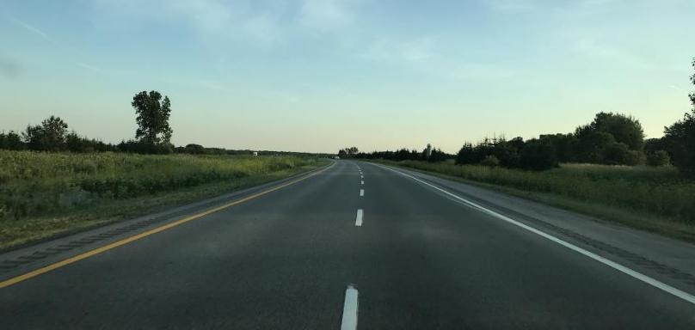
Dear God
Thank you for all the people who have been with us during this year – our families, friends and teachers. Thank you that you promise to go with us as we take one more step along the world. Please help us to remember that just as you were with all those people from the Bible, you promise to be with us too.
Notes:
Slide 17: Dear God
Thank you for all the people who have been with us during this year – our families, friends and teachers. Thank you that you promise to go with us as we take one more step along the world. Please help us to remember that just as you were with all those people from the Bible, you promise to be with us too.

Slide 18
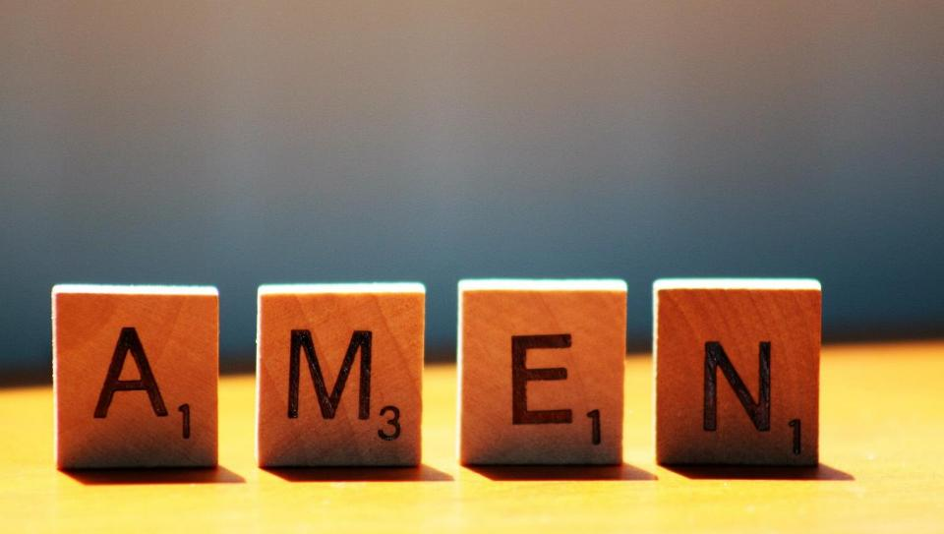

Slide 19
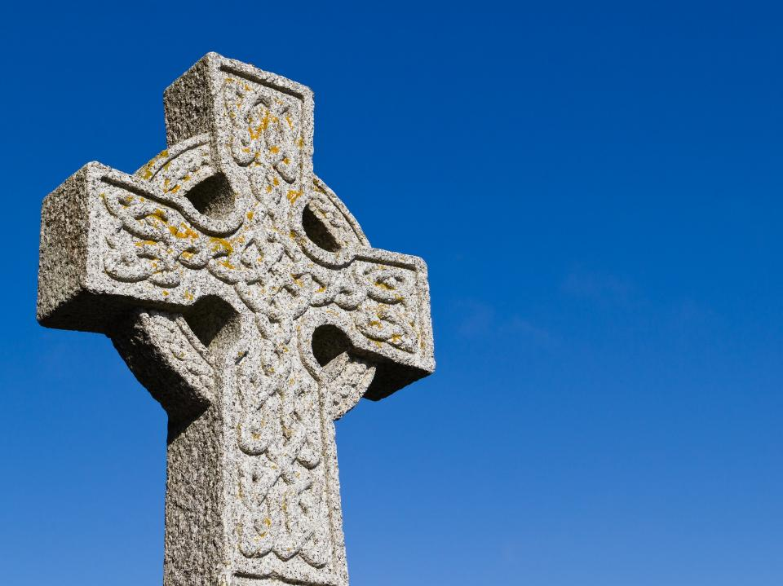
A Celtic Blessing
Notes:
Slide 19: Optional extra blessing, which you might want to say over one another before you leave:
It’s a blessing we’ve used before, and it’s very old, probably from Ireland (which is one part of the British Isles) This blessing talks about wishing someone well as they go on their journey….that their journey will be an easy one. This may be an actual journey, but it could also mean the journey of people’s lives. As you listen, you might not understand every word, because the language is like a poem, so I’m going to use some pictures to help us. [Try to leave a pause between each slide, and resist the urge to explain the words: let them sink in and let the words and pictures ‘speak’ to children at whatever level they will absorb them, even if it’s only to enjoy how they sound. Read it more than once if you think it will help.] You might just want to put a hand on the shoulder of the person next to you as we bless each other….

Slide 20
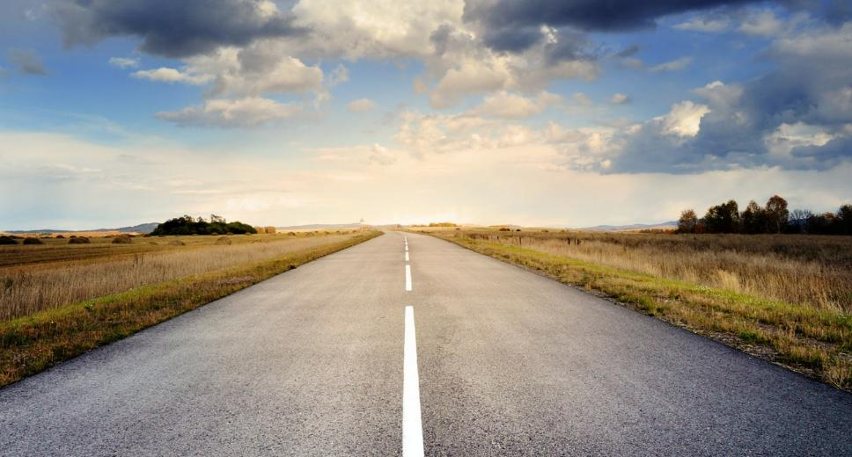
May the road rise up to meet you.

Slide 21
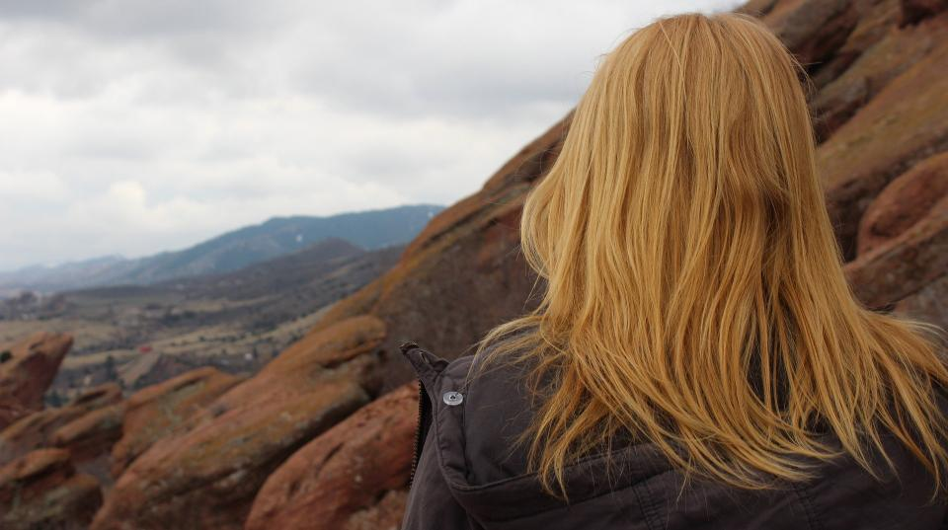
May the wind be always at your back.

Slide 22
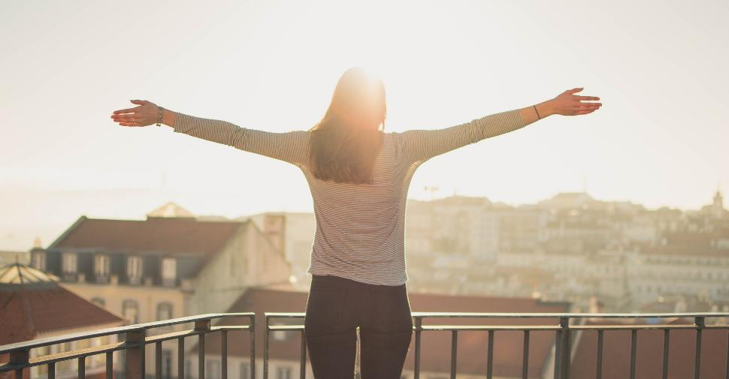
May the sun shine warm on your face,

Slide 23
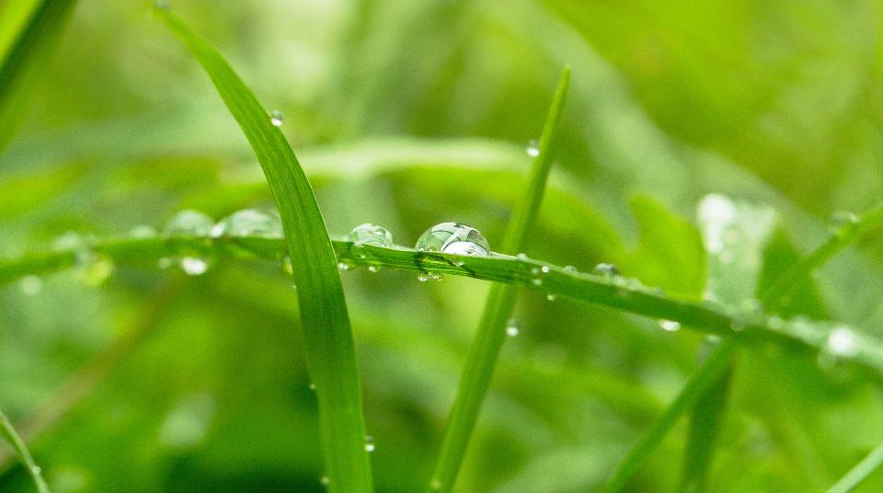
…the rains fall soft on your fields…

Slide 24
…and until we meet again,

Slide 25
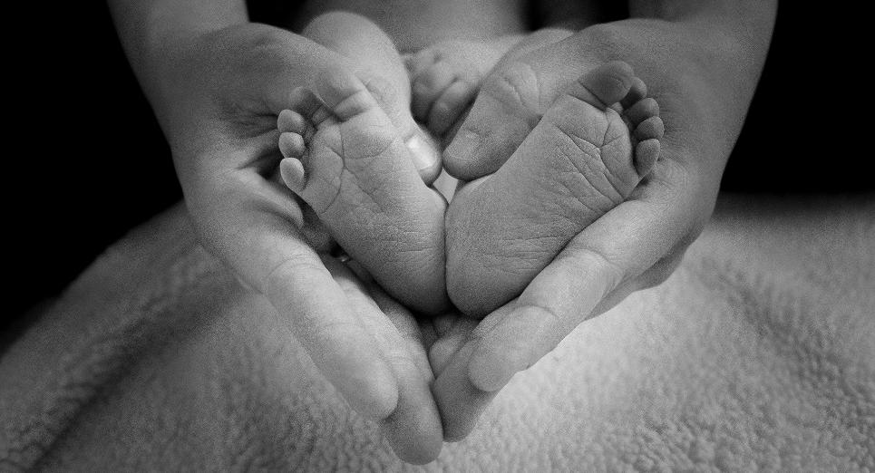
…may God hold you in the palm of his hand.
Notes:
Slide 18: ….may God hold you in the palm of His hand.
At this time in the life of our school, it’s good to be able to send each other on our way and look forward to the time when we will be back together again. In a few moments, I’m going to use the words again as a prayer for our school community, but first let’s just have a few moments of quiet….

Slide 27
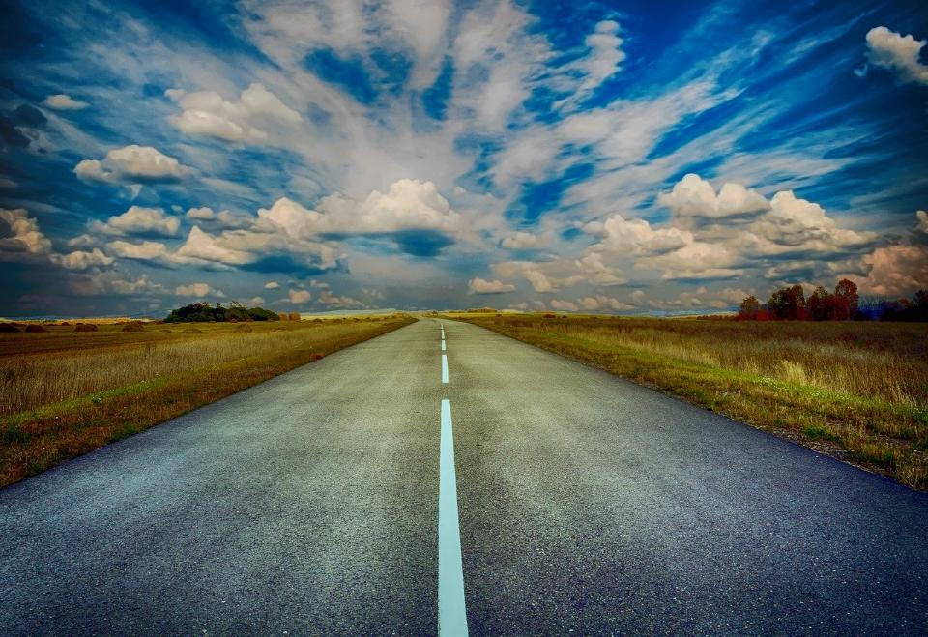
Picture copyright-free from pixabay
Leader: We have journeyed together today. As we leave this place and time and go into the day ahead…
ALL: …May God go with us.
Notes:
Slide 27: Use this term’s leaving words
Leader: We have journeyed together today. As we leave this place and time and go into the day ahead….
ALL: ….May God go with us.
Sign for ‘God: British Sign Language BSL Video Dictionary - God
Sign for ‘go with us’ – we have invented this! After you’ve signed ‘God’, bring your finger down alongside your other finger and make them ‘journey together’ in front of you.

Slide 28
Notes:
Ideas for classroom reflection: Bible verse label & some blank luggage labels, one per child if you can
Pick up a finger labyrinth. As you trace the route with your finger, think about the journey that you have been on during this school year.
Look at the words on the big label. Talk about what difference they might have made to the people God spoke to.
Choose a label for yourself. You might want to write your thoughts or a prayer on the back.

