Slide 1


Follow my
lead!
Notes:
Slide 1: This term, we are thinking about leading, leaders, and followers – and will find out about and learn from the lives of different leaders from across the ages.

Slide 2


Leader: As we share these stories of leaders…
ALL: May we follow their example
in thoughts
and words
and actions.
Notes:
Slide 2: Use these new gathering words for this term, or your usual greeting if you prefer. The greeting comes with BSL signing, you can view the demos using links under the slide.
Leader: As we share these stories of leaders…
ALL: May we follow their example in thoughts and words and actions.
Signs for greeting: click on links
Thoughts: British Sign Language BSL Video Dictionary - thought (signbsl.com)
Words (use 3rd definition): British Sign Language BSL Video Dictionary - word (signbsl.com)
Actions: British Sign Language BSL Video Dictionary - action (signbsl.com)

Slide 3

You’re invited to
a feast
Please bring an inspiring guest of your choice
Notes:
Slide 3: I wonder….. If I was to hold a very special banquet – that’s a big party with FOOD!! – who might you invite to come with you? Your guest needs to be someone who inspires you, whose example you follow….
While you [the children] think who they might invite, I’m going to tell you a bit about who I would invite and why, then I’ll ask the adults here to share their thoughts, because they’ve had a little more time to think about it than all of you! [Invite adults to share their ideas, include yourself in this – hopefully this will help to guide children’s thinking]

Slide 4
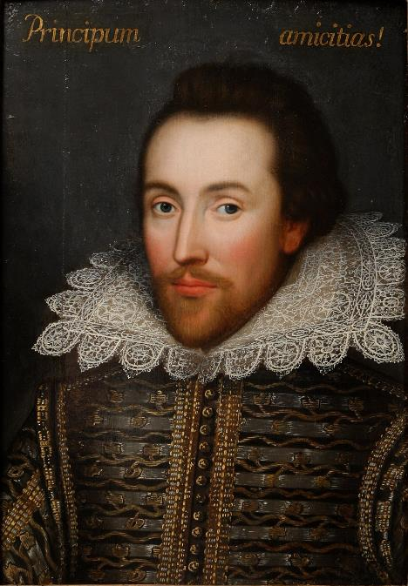

My guest of honour is….
‘tower of strength’
‘too much of a good thing’
‘wild goose chase’
‘Love all, trust a few, do wrong to none.’
All’s Well That Ends Well
Notes:
Slide 4: Who is your inspiring guest of honour? [Add your choice to this slide. You’ll see who I [Rachel] have chosen – and why, to get you started.]
Rachel’s choice: My fantasy guest would be this man, William Shakespeare, who was born on April 23rd, 1564. He wrote some of the greatest plays of all time – about all sorts of people from all walks of life. His words are some of the most well-known and many phrases we use today were invented by him….we talk about someone being a ’tower of strength’ (a great support), or going on a ‘wild goose chase’ when we’ve gone here there and everywhere looking for something or having ‘too much of a good thing’ – these are all his words! But here’s one of my favourites: ‘Love all, trust a few, do wrong to none.’ love everyone, be careful who you give your trust to, but do no wrong to anyone. Not bad words to live by!!
Talk about why you have chosen them and what you find inspiring about this person, as this will help other adults – and the children] Then share together the responses from a selection of children.
Over this term, we are going to be learning from the lives and examples of any different leaders – including our new King, Charles III, as he is formally crowned at his coronation next weekend. But for today, we’re going to start where we often start in our times together, with a story about Jesus, and a story that he told…

Slide 5
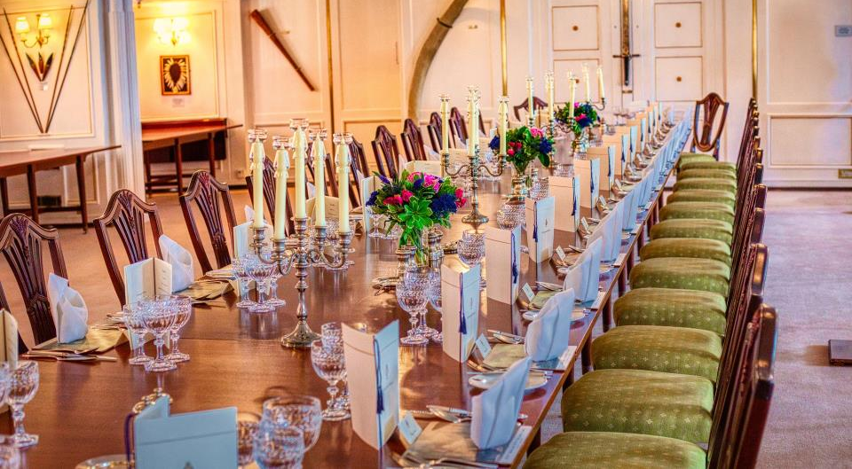
The Feast
Notes:
Slide 5: The Feast
The story Jesus told was about a feast – and some guests, not unlike the fantasy guests we’ve just been talking about. As with all of Jesus’ stories – called parables – there is a hidden meaning about what it’s like in God’s Kingdom. It might help you to know that people were often surprised by who Jesus chose to spend time with: he didn’t choose important people in the town or celebrities, but chose poor people, tax collectors and sinners – the people who others often ignored.
As we share this story together, there is a part for you to join in. When I say the words you’re invited to a feast I want you to say ‘Yes – YOU!!!!’ and when I say NOT ME!, you can respond by saying ‘I can’t come!’ [you could add some actions to this if you’d like!] Follow the script on p. 4, which follows pictures in the PowerPoint

Slide 6
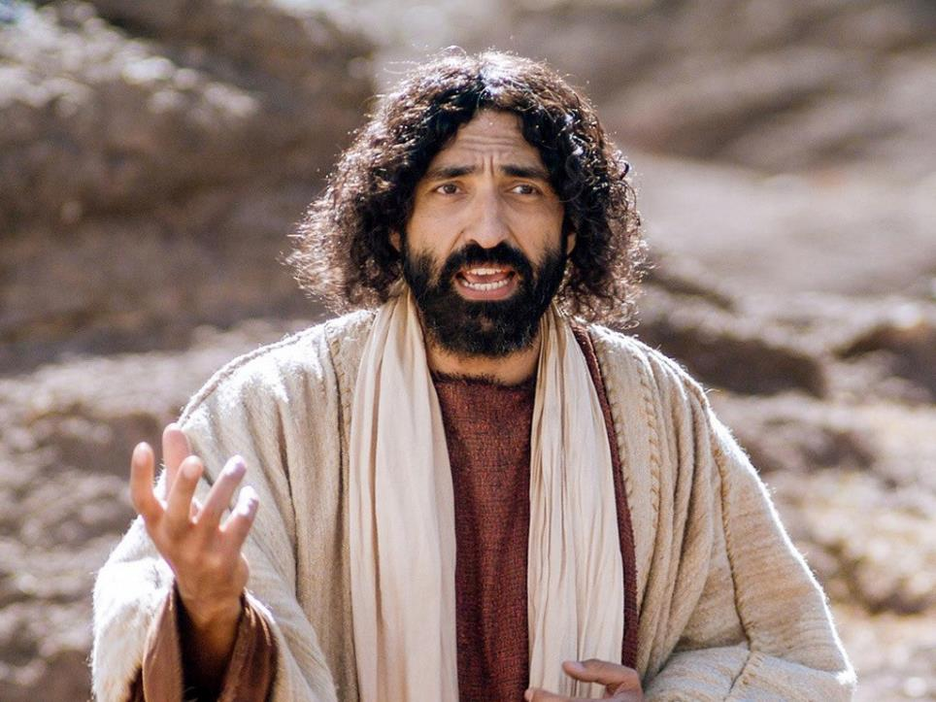

Notes:
Slide 6: Wherever Jesus went, people would follow – for all sorts of reasons. It didn’t matter who they were, Jesus welcomed everybody and he wanted people to know that the same was true of God’s Kingdom.
And so he told this parable…..

Slide 7
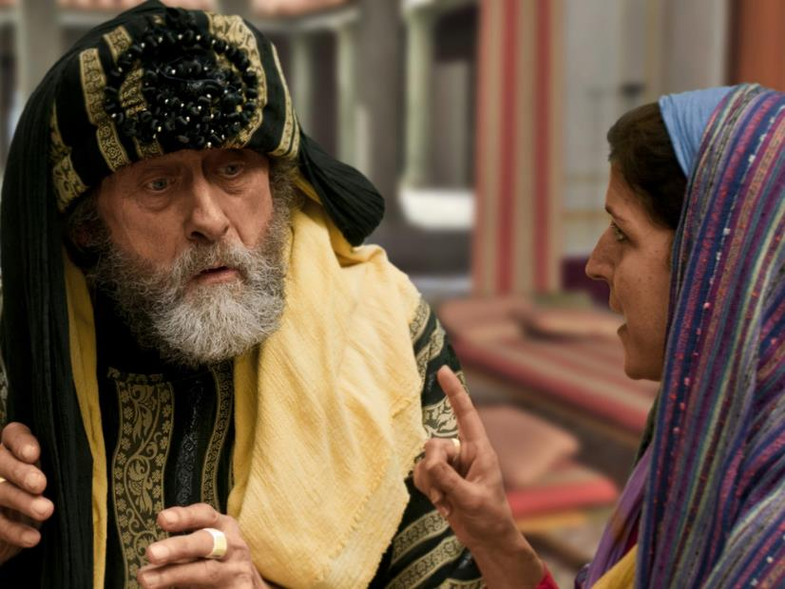
Notes:
Slide 7: A man gave a big banquet and invited many people: he wrote each an invitation saying…
You’re invited to a feast – ‘Yes – YOU!!!!’

Slide 8
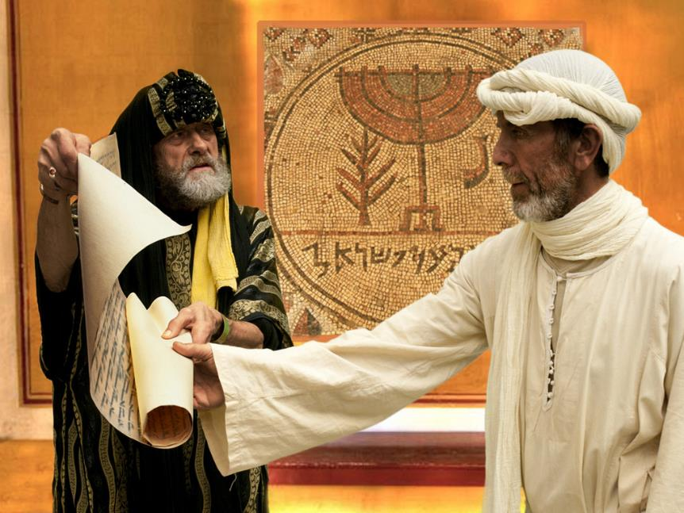
Notes:
Slide 8: He sent his servant out with the invitations: You’re invited to a feast – ‘Yes – YOU!!!!’
But one by one, the people who’d been invited all made excuses:

Slide 9
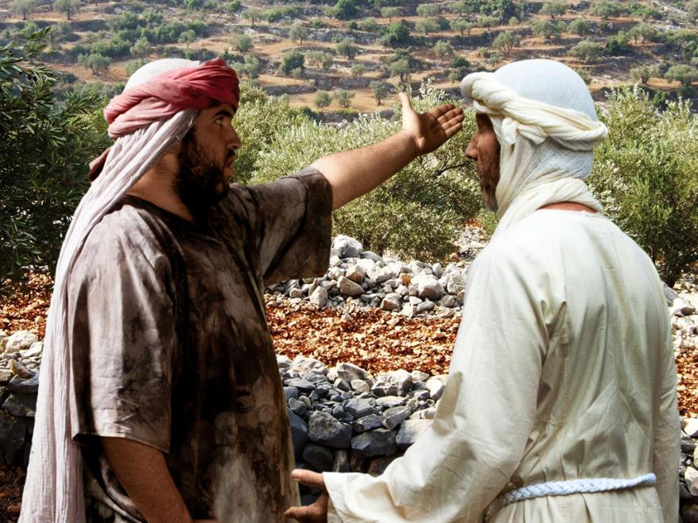
Notes:
Slide 9: ‘I’ve just bought a field and I must go and look at it right away,’ said one. ‘Not me! – ‘I can’t come!’

Slide 10
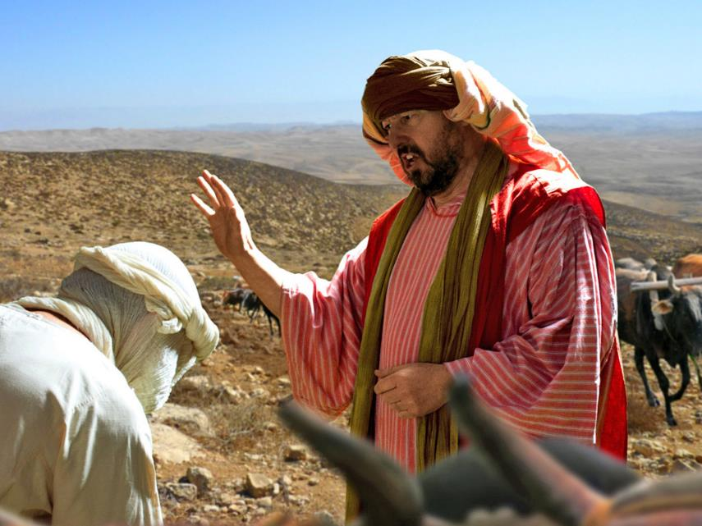
Notes:
Slide 10: ‘I’ve just bought some new oxen for my plough and I must go and try them out’ replied another. ‘Not me! – ‘I can’t come!’

Slide 11
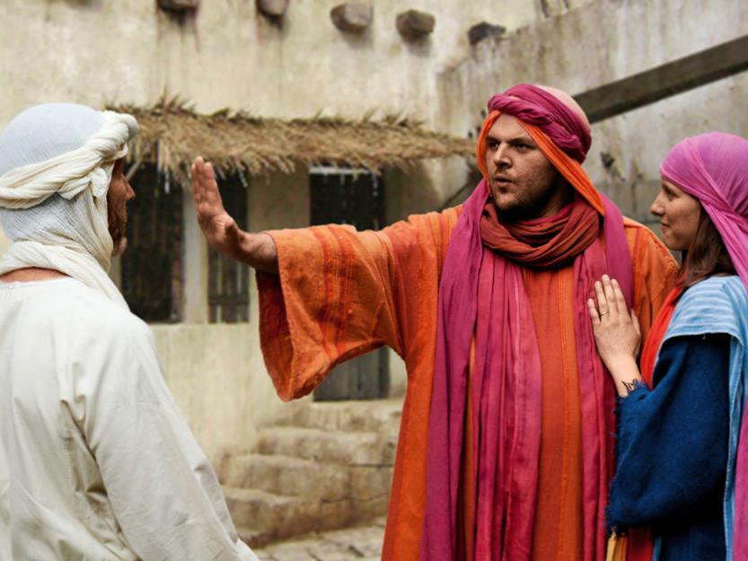
Notes:
Slide 11: ‘I’ve just got married,’ replied a third. ‘Not me! – ‘I can’t come!’
And so the excuses went on…. ‘Not me! – ‘I can’t come!’

Slide 12
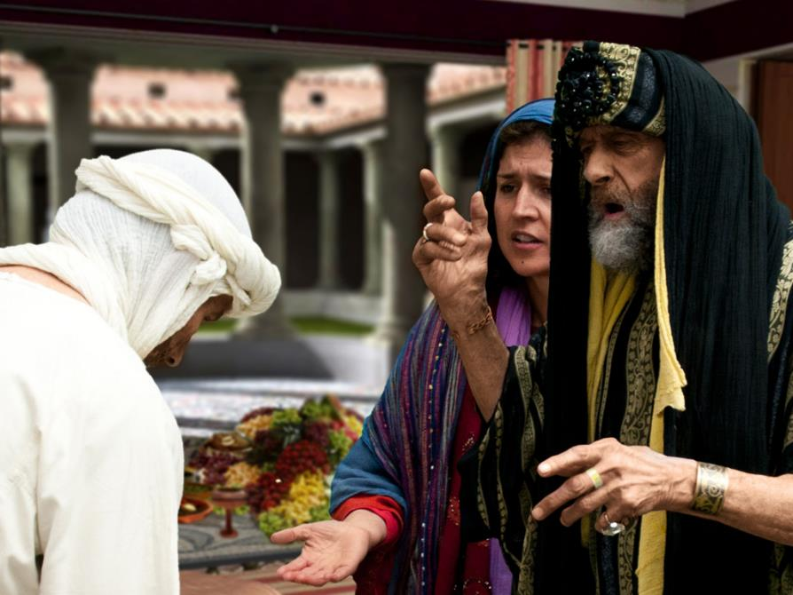
Notes:
Slide 12: The servant went back to his master and told him all that had happened. His master was sad….and a little angry.
So, he sent his servant out with the same invitation: You’re invited to a feast – ‘Yes – YOU!!!!’

Slide 13
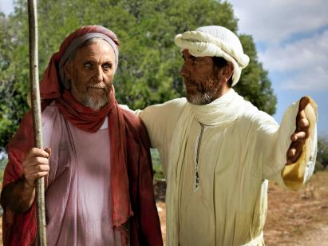
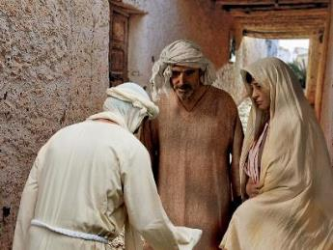
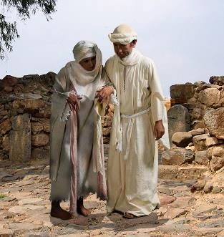
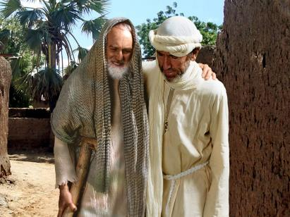
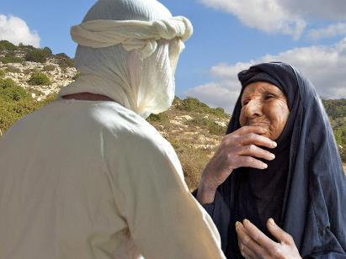
Notes:
Slide 13: But this time, he told him to go out into the streets and invite the poor, the homeless, and the lonely, and say to them: You’re invited to a feast – ‘Yes – YOU!!!!’

Slide 14
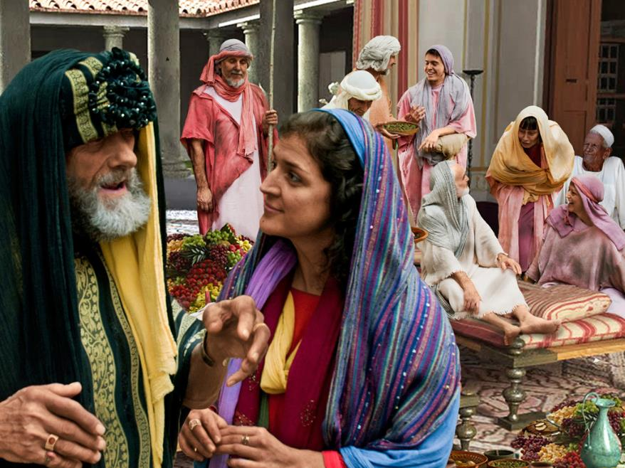
Notes:
Slide 14: And the master’s house was full!

Slide 15


…. I wonder how the master felt to have people say no to his invitation?...
…. I wonder how the people who did come to the feast felt about being in the master’s house?...
Notes:
Slide 15: Before we take time to be still and think, let’s have a few minutes to think and TALK! …. I wonder how the master felt to have people say no to his invitation?...
…I wonder how the people who did come to the feast felt about being in the master’s house? [talk together about your ideas]being in the master’s house?

Slide 16
…. I wonder what you think Jesus wanted his listeners to learn from this story about God’s Kingdom?...and about who’s important to God?…
….I wonder how Jesus showed this to the world in the way that he lived?....
Notes:
Slide 16: Responding (words for worship):
….in the stillness of this moment, let’s be quiet and think…..
….We’ve heard a story from Jesus that he told to some people who were gathered for a meal….
….I wonder what you think Jesus wanted his listeners to learn from this story about God’s Kingdom?...and about who’s important to God?
….I wonder how Jesus showed this to the world in the way that he lived?....

Slide 17
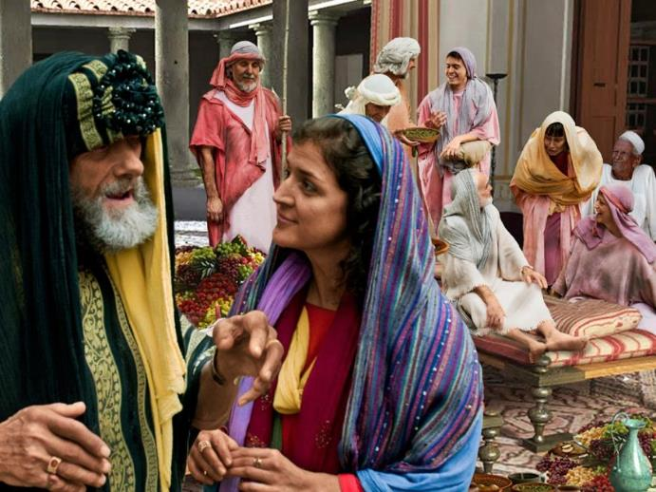
Help us to remember….
We are all welcome here.
Notes:
Slide 17: I’m going to turn my thoughts into a prayer now. If you’d like to pray too, then we’re going to recycle a prayer from one of our assemblies last term: join in with the words ‘we are all welcome here’… I will also give you some space to think each time. So, let’s pray.
God who welcomes all,
Whenever we see someone who looks left out….[leave a pause]
Help us to remember, ‘We are all welcome here’
Whenever we feel that no-one notices us…. [leave a pause]
Help us to remember, ‘We are all welcome here’
Whenever someone new or someone different joins our class….[leave a pause]
Help us to remember, ‘We are all welcome here’
God, in your Kingdom, help us to remember, ‘We are all welcome here’

Slide 18


Slide 19
Follow my
lead!
Notes:
Slide 19: We don’t usually have anything after we’ve had our quiet reflection time, but I want to just go back to the beginning of our time together today. We started our time together thinking about people who inspire us, the leaders we look up to.
Over this term, we are going to spend time thinking about some leaders from across history who have lived lives that have inspired people to live better. We hope that we will learn from their example, and be better leaders ourselves
[Optional: In our day, as in Jesus’ day, leaders can sometimes let us down – or not always be people that we can look up to. That’s also something we will talk about]

Slide 20




Leader: As we leave this place & time and go into the day ahead…
All: May our school be a place of welcome for all
Notes:
Sending: Slide 20
Leader: As we leave this place and time and go into the day ahead…
All: May our school be a place of welcome for all.

Slide 21


Follow Jesus’ example!
Make our school a place where everyone is welcome – invite someone to join in with you….
Notes:
Slide 21: Present this week’s challenge, to think about what they could you do this week that shows that they are being welcoming, or inviting, to others:
Put out some special paper on which children can write invitations: they can make up their own context e.g. you are invited to play with me in the playground tomorrow playtime. (NB You may need to make a list of suitable invitations of welcome so that pupils don’t invite everybody to something that causes an issue for your parents!)

