Slide 1
Leader: We are here together
ALL: May we ‘GO FOR GOLD!’ in our words and actions today!
Notes:
Slide 1: Gathering words
Leader: We are here together
ALL: May we ‘GO FOR GOLD!’ in our words and actions today!

Slide 2
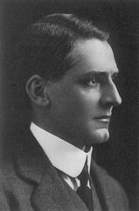
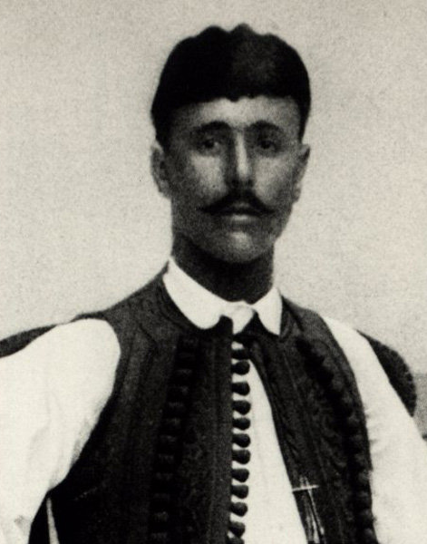
Edwin Flack
Spiridon Louis
Notes:
Slide 2: Last week we heard about the very first modern Olympics and thought about the story of Edwin Flack (the ‘Hare’) and Spiridon Louis (the ‘Tortoise’) – and how he showed the Olympic value of determination in the marathon that he ran. We’ll be hearing about some more athletes’ stories during today – and we’ll be sharing a very special Olympic version of a very famous story that Jesus told….but first…

Slide 3
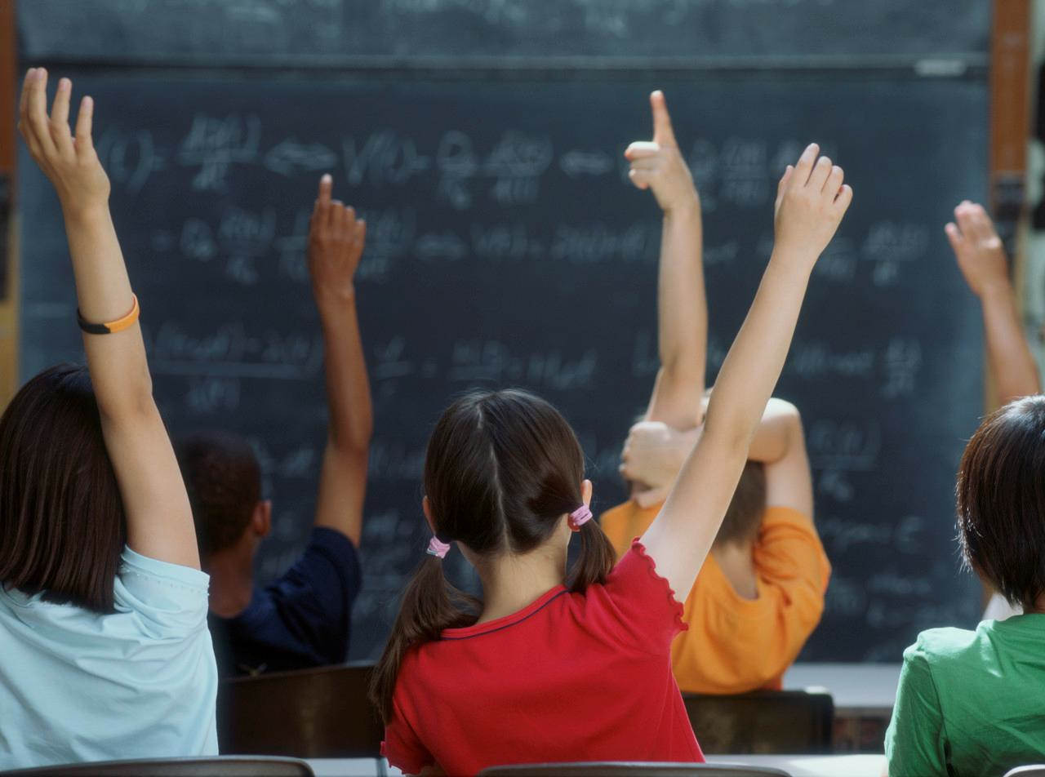
Hands up….
Notes:
Slide 3: …we’re going to start today’s assembly with a ‘hands up!’ game. I’m going to tell you to put your hand up….or on your head…..or touch your nose (or something else, so listen out!) if you’re good at one of my list of talents, something you’re good at. Are you ready? [do this as fast as you dare!]
Put your hand up if you’re good at…..dancing
Put your finger on your nose if you’re good at…..singing
Put your elbow in the air if you can play a musical instrument
Put your hand on your head if you’re good at…..football
Put your finger on your nose if you’re good at…..painting & drawing
Put your hand up if you’re good at…..riding your bike
Put your elbow in the air if you’re good at…..computer things
Put your finger on your nose if you’re good at…..helping others
Put your hand up if you’re good at……swimming
Put your hand on your head if you’re good at…..something else
We could go on all day celebrating the talents that you each have – and I’m sorry if I didn’t mention something that you’re particularly good at – perhaps you could tell me later…. In our assembly today, we’re going to be thinking today about one of those Olympic values – excellence – and how it’s important to use our talents, the things that we’re good at, properly, to encourage them to grow.

Slide 4
The Olympics
Respect
Friendship
Excellence
Determination
Equality
Courage
Inspiration
Olympic rings © Pixabay
Notes:
Slide 4: Over the past few weeks, we’ve been thinking about the Olympics, and the important values that are a part of sports of all sorts.

Slide 5
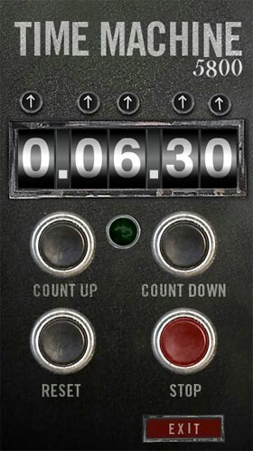
2024
CE
1912
CE
Notes:
Slide 5: We’re going to jump into our Olympic time machine again now, and go back through time and space to…… the 1912 Olympic Games,

Slide 6
Notes:
Slide 6: which took place in Stockholm, in Sweden……Each athlete who takes part in the Olympics usually has one particular talent – perhaps running….or swimming…..or jumping….or throwing, but for one special event, an athlete has to be good at not one thing, but ten!

Slide 7
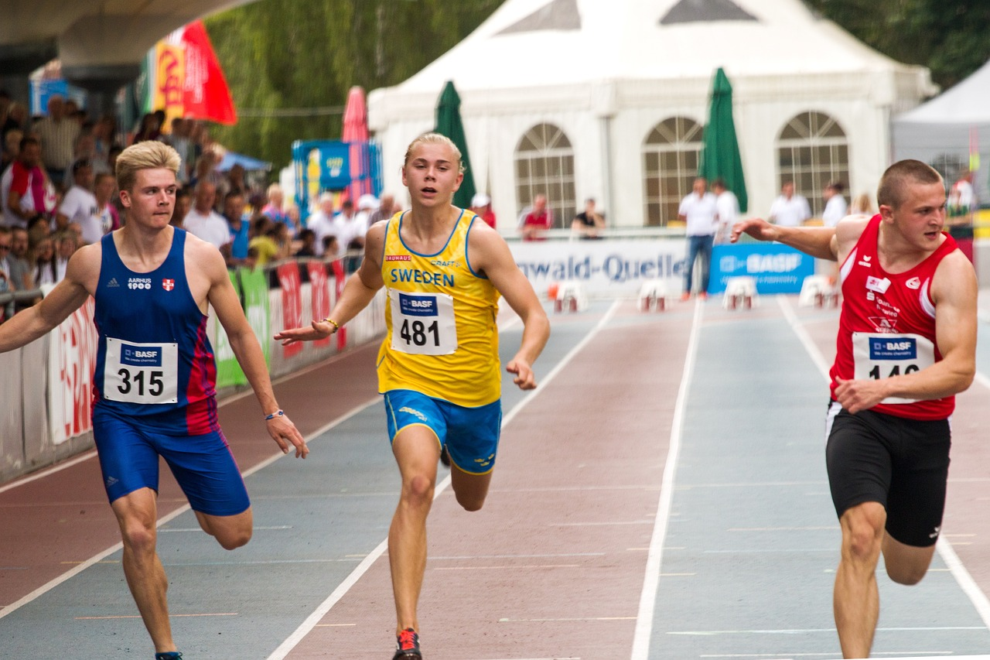
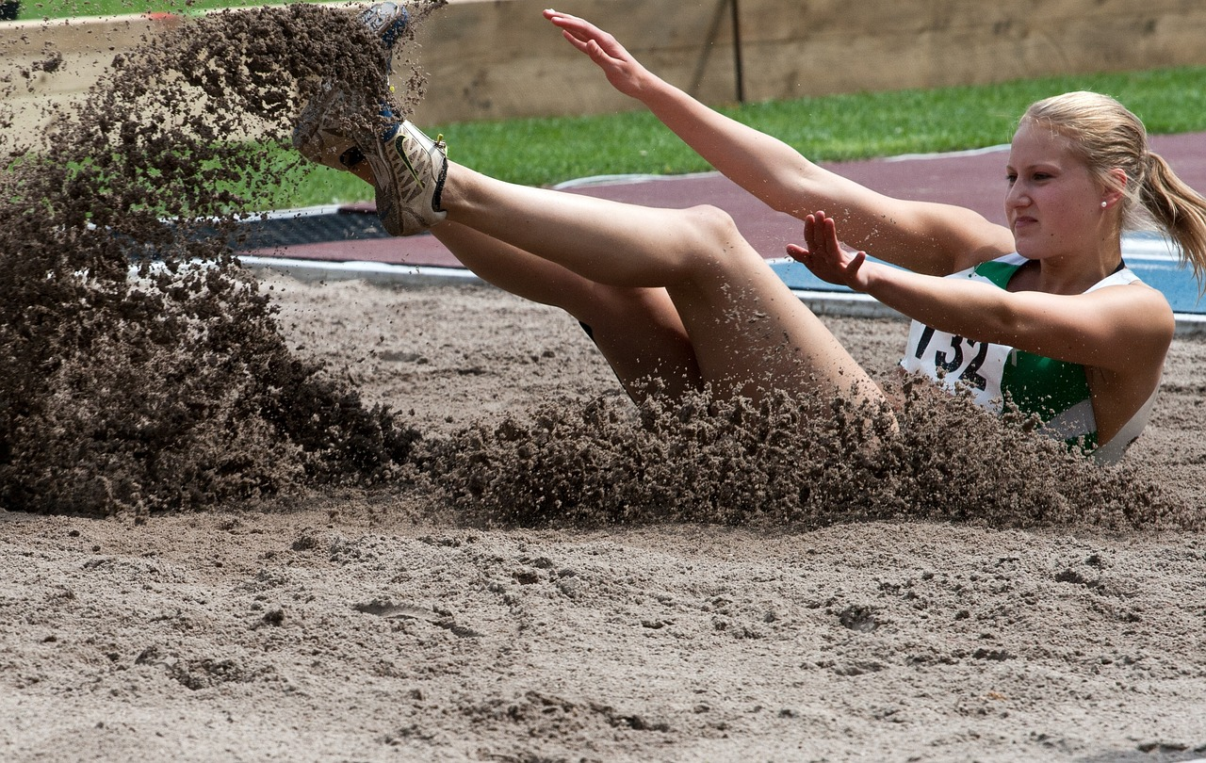
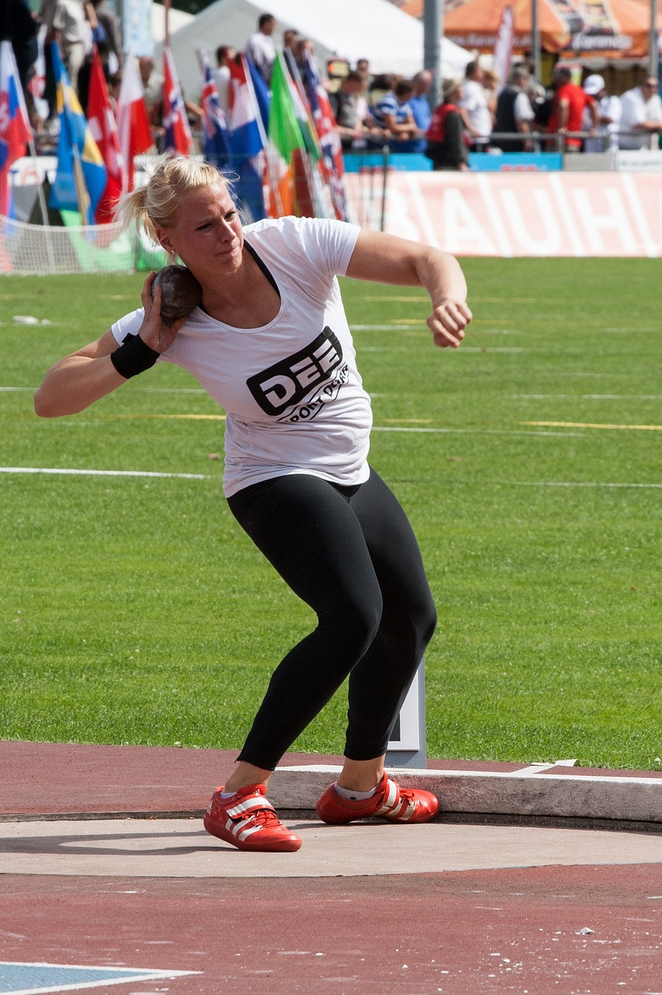
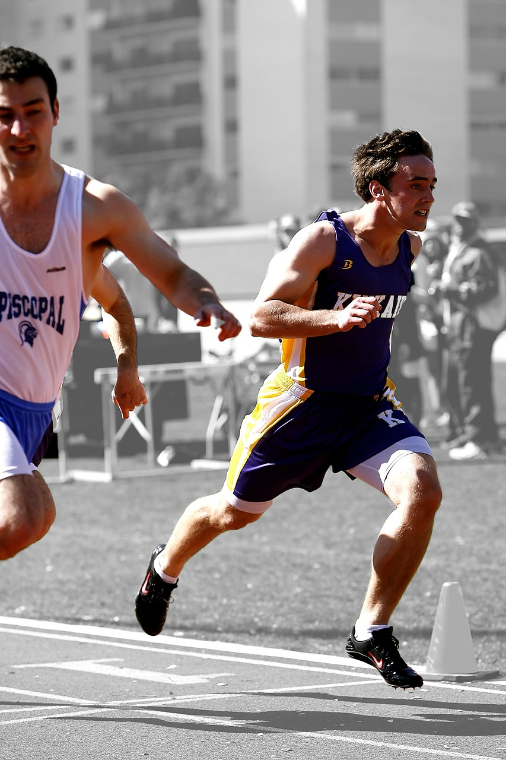
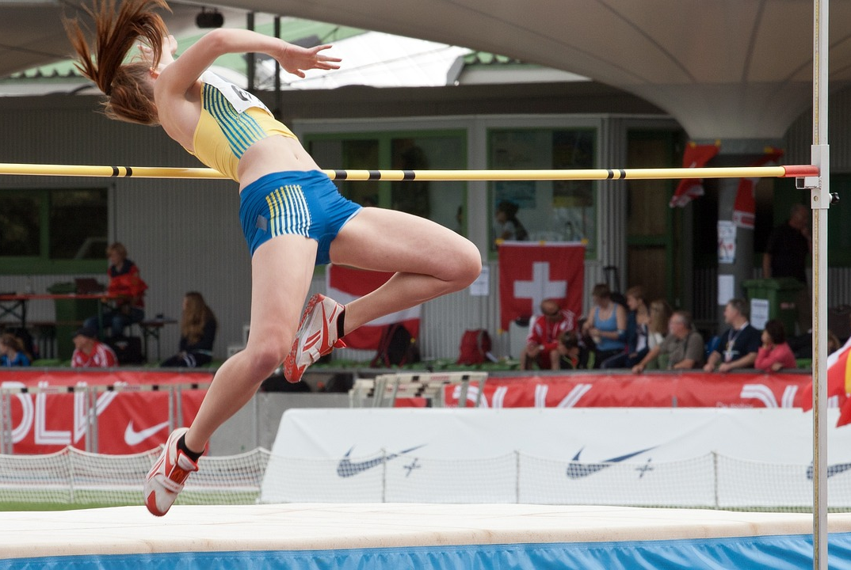
Decathlon
Notes:
Slide 7: This event is the decathlon, and consists of a 100m run, long jump, shot put (that’s throwing a very, very heavy ball!), high jump, a 400m run,

Slide 8
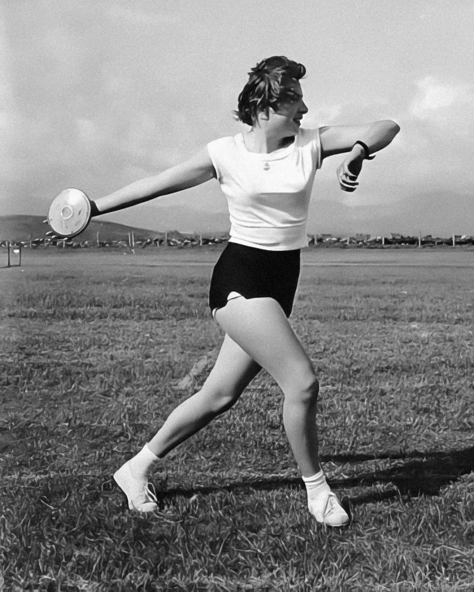
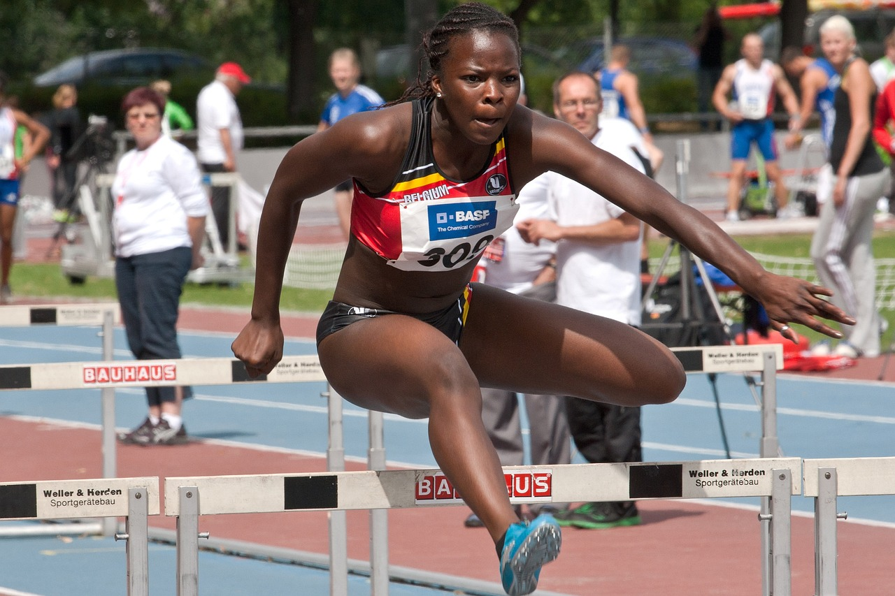
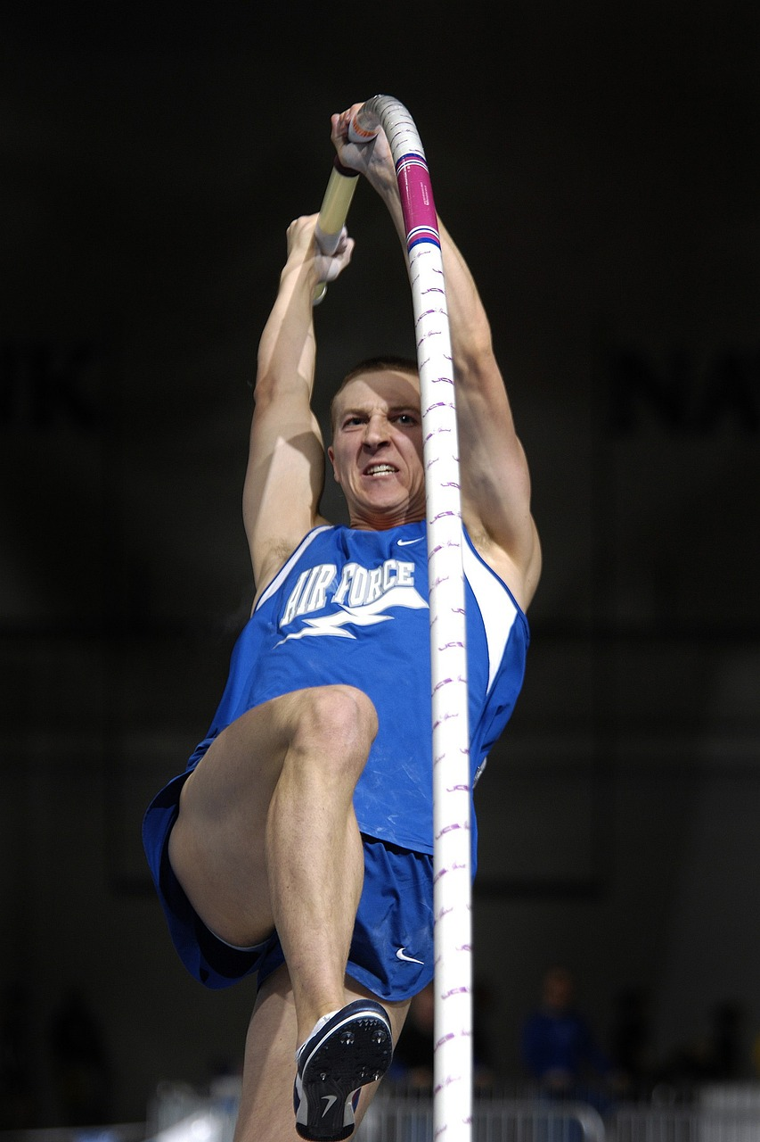
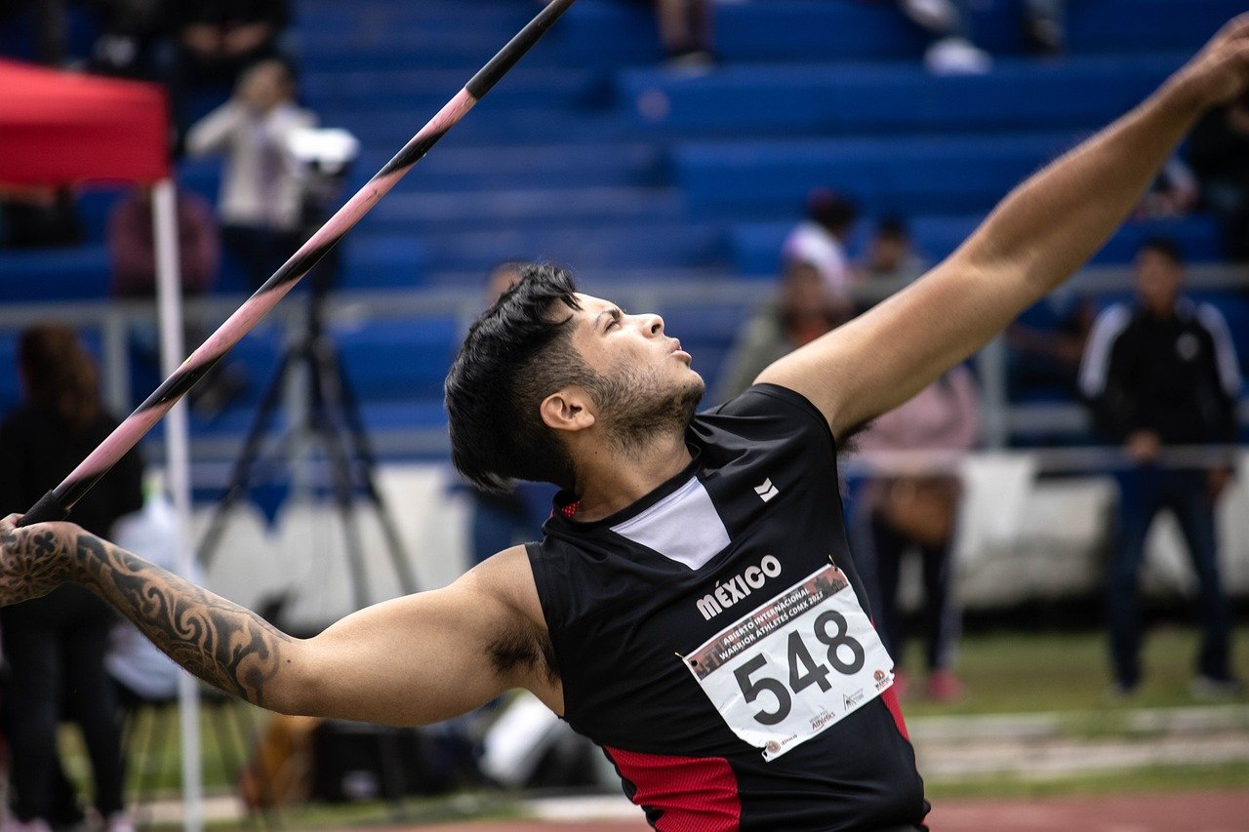
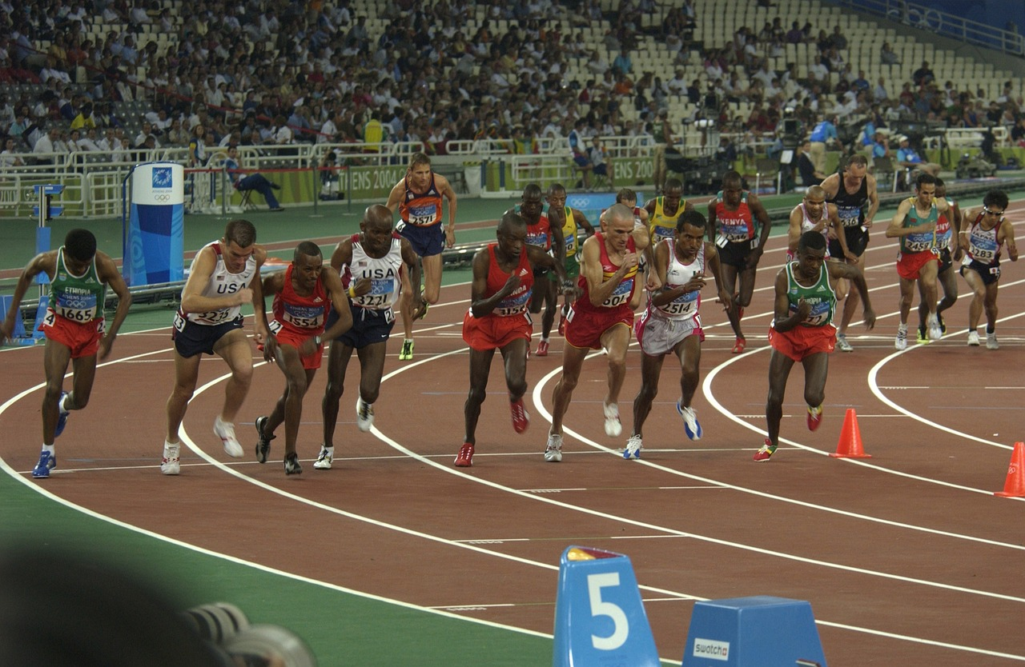
Decathlon
Notes:
Slide 8: jumping hurdles, throwing the discus, a pole vault (that’s using a pole to help you get over a very high bar), a javelin throw and finally, the 1500m run. PHEW!!!

Slide 9
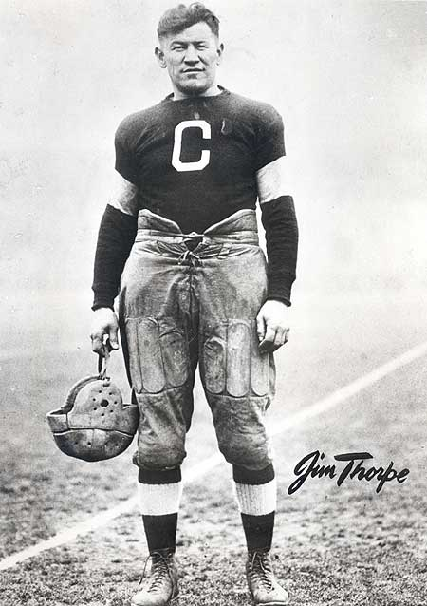
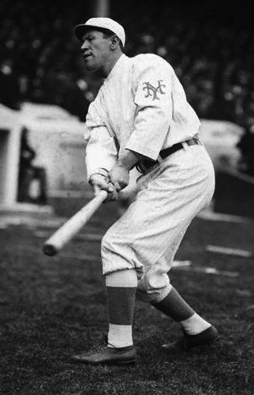
Notes:
Slide 9: In 1912, in the Stockholm Olympics, one very talented sportsman, a man called Jim Thorpe, won a gold medal in the decathlon event. Jim Thorpe was good at many different types of sport, and before being entered in the Olympics, he had played both American football and baseball to a very high standard.

Slide 10
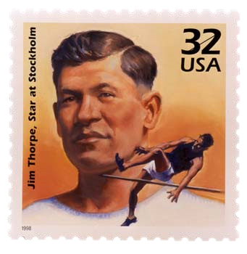
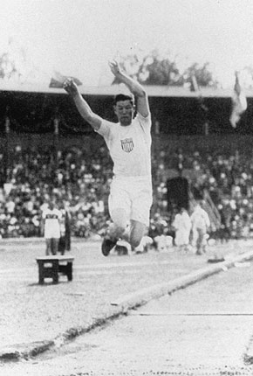
‘You, sir, are the greatest athlete in the world’
King Gustav V of Sweden to Jim Thorpe
Notes:
Slide 10: King Gustav V of Sweden, as he awarded Jim Thorpe his gold medal after the decathlon said ‘You, sir, are the greatest athlete in the world!’ – and indeed, 100 years later, he is still listed as one of the greatest athletes of all time.

Slide 11
Going
for gold!
Notes:
Slide 11: Earlier in our time together, we thought about some of the things we’re good at – our talents. Some people believe that the talents we have – the things we’re good at – are special gifts from God that we’re supposed to look after. All Olympic athletes aim to be the very best that they can be – at the peak of their fitness. Their hopes for Olympic gold rest not just on their talent, but also on their hard work, training for hours and hours every day, week after week and sometimes year after year.
Since the start of the Olympics in 1896, people have watched in amazement at the extraordinary displays of talent, whether it be running, or swimming, or cycling….or the decathlon. But we have also heard how the founder of the Olympics, Baron de Coubertin, said that ‘The important thing in the Olympic Games is not winning, but taking part’, which makes us wonder if there’s more to being ‘excellent’ than just winning?

Slide 12
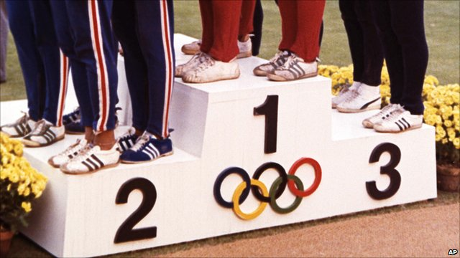
An Olympic ‘parable’
Notes:
Slide 12: I’ve got a story here about some Olympic athletes, and it’s a bit like one of Jesus’ parables. Jesus’ parable was about what three servants did with some money that their master gave them, and this story is a bit like that. It’s a story that might help us to see that excellence is not just to do with winning, but to do with how we handle our talents…..
As you listen, think about who in this story wastes their talent…..[use script on p5]
I started with a question – and maybe now you can answer…..which athletes wasted their talent?

Slide 13
….I wonder what things you’re good at – your talents?....
….I wonder how hard you work to look after them…..?
….I wonder if ‘excellence’ is all about winning, or whether it’s about our attitude as well?....
Notes:
Slide 13: Responding and words for worship
We started our assembly by thinking about some of the many different things that we might be good at, our talents. We’ve heard how Christians believe our talents are special gifts from God that need to be looked after.
Think in the stillness now….
….I wonder what things you’re good at – your talents?....
….I wonder how hard you work to look after them…..?
….do you practise as often as you can & try hard to improve?....
….do you persevere when you’re learning something new?.....
…Excellence is one of the Olympic values we’ve been reflecting on….
…..’excellence’ means being the very best that you can be…..’going for gold’…..
I wonder if ‘excellence’ is all about winning, or whether it’s about our attitude as well?....
….maybe it’s about working hard day after day and week after week…..
……listening to those who try to help us…..
….playing by the rules….
….helping our talents to grow strong, not wasting them….

Slide 14
Dear God
Thank you for the gifts of our talents, those things we are good at. Help us to look after them….to work hard to get even better at them…..to ‘go for gold’, but to always remember that in life, just as in sport, it’s not just winning that counts.
Notes:
Slide 14: Opportunity for reflection / prayer
I’m going to pray now. If this is something that you feel comfortable doing, then find a way to make the prayer your own.
Dear God
Thank you for the gifts of our talents, those things we are good at. Help us to look after them….to work hard to get even better at them…..to ‘go for gold’, but to always remember that in life, just as in sport, it’s not just winning that counts.

Slide 15
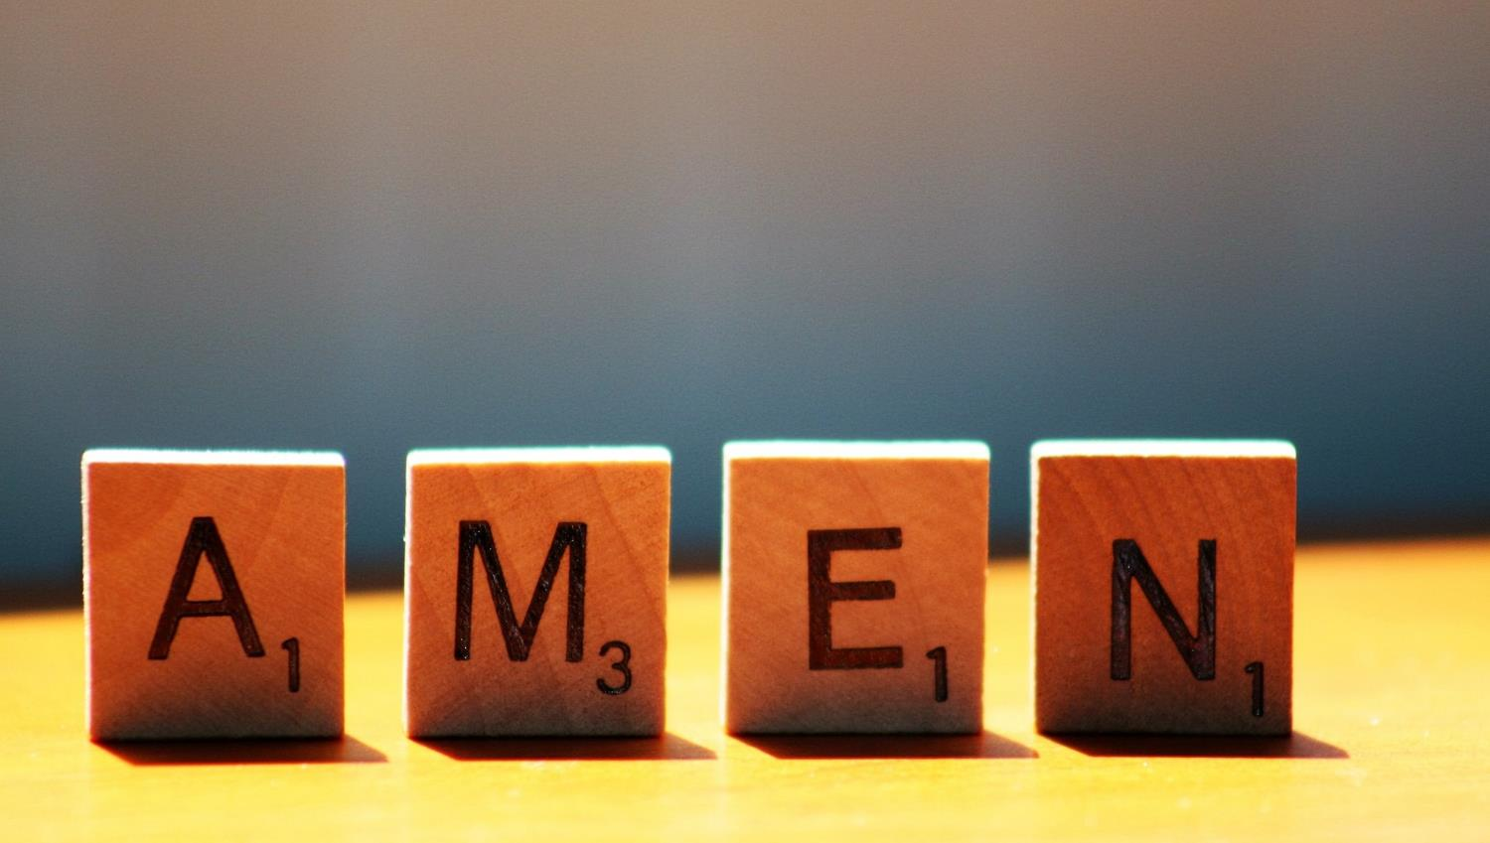

Slide 16
Leader: As we leave this place & time and go into the day ahead…
All: Let’s ‘go for gold’ in all that we do!
Notes:
Sending: Slide 16
Leader: As we leave this place & time and go into the day ahead…
All: Let’s go for gold* in all that we do!
*Again, you might need to unpick what we mean by ‘going for gold’ in the context of today’s words.

Slide 17
Notes:
Slide 17: Reflective areas
Make ‘pledge’ (promise) cards, for children to use to write or draw what they commit time and effort to to improve their ‘talent’. This could be anything, from a sporting endeavour to playing an instrument, or simply being helpful.

