Slide 1
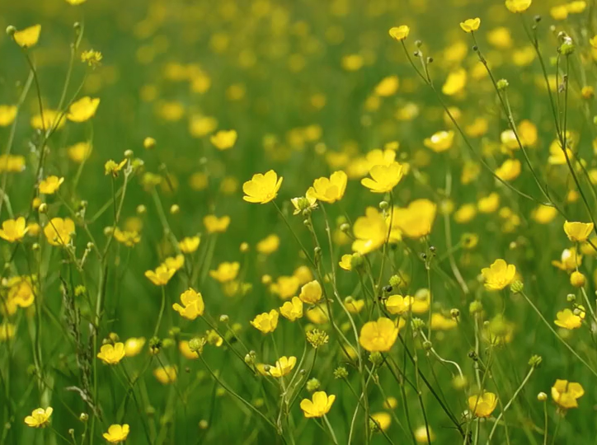




All pictures copyright-free from pixabay
Notes:
Slide 1: Spring flowers stilling exercise
Use the stilling slide if desired: the suggested words should be spoken slowly, leaving pauses inbetween to create a sense of stillness.
As you sit quietly, watch the spring flowers blowing gently in the breeze….[PAUSE]
Now practise slower breathing…..in…..and out…..in……and out…..keep this going as you continue to look at the flowers….[PAUSE]
You maybe notice that you are feeling calmer and more relaxed….[PAUSE]
As you breathe, think about how it feels to be in this special/sacred space….. [PAUSE]
We come into this special / sacred space and time to be still….to think deeply…..to be together as a school community…..
In our time together today, we will reflect on our ExploRE day together, watch a video, share some words and then use them to help us to think as we end this day together.
But first, let’s welcome one another as we begin….

Slide 2
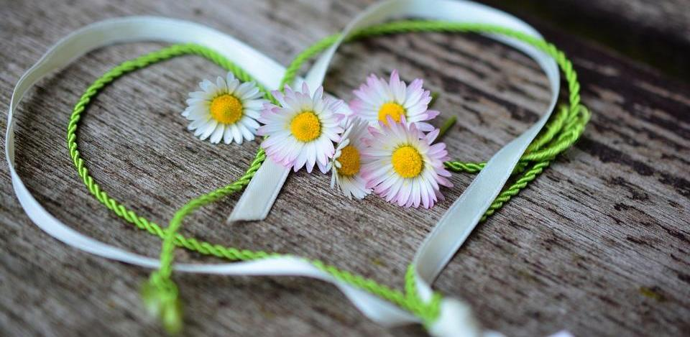
Leader: As we end this day together…
ALL: …we bring our thoughts and our hearts into this sacred space.
Notes:
Slide 2: Gathering
Leader: As we end this day together….
ALL: ….we bring our thoughts and our hearts into this sacred space.

Slide 3
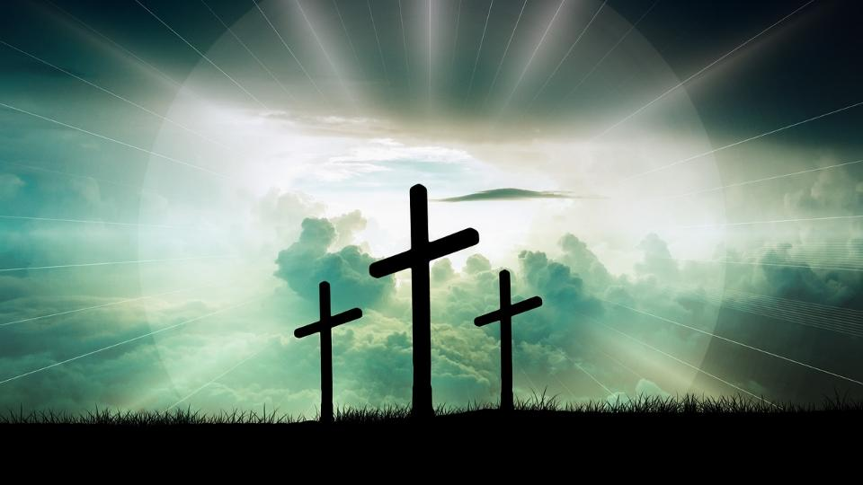

Explo RE Easter
Notes:
Slide 3: ExploRE Easter
Today, we have been exploring Easter in our school, and now we come together as a community to reflect and be grateful.
As we gather, we bring with us all the things that we have discovered today…..what we may have learned about this story……and what we may have learned about ourselves……or about others……

Slide 4

Notes:
Slide 4: In our school today, we have…..[remove any that don’t apply to your setting – we suggest you share a photo of each on this slide]
Used our emotions on a very special Easter egg hunt! (EYFS)
Been on a pilgrimage together – and collected reminders in our pilgrim bags (KS1)
Created landscapes that tell the whole story of Easter (LKS2)
Directed and created live sculptures of the most important parts of the story (UKS2)
Taken time to wonder about this story together (Reflective story & creative activities)
We are going to gather our thinking together now, with some wondering questions….. [Leave some space for quiet reflection after each: if time allows, you could ask pupils to talk to the person next to them, or choose a few children to share their thinking]

Slide 5

…I wonder what has stood out for you?…
Notes:
Slide 5: We have looked at the Easter story from lots of different angles. I wonder what has stood out for you as you have examined it?.....

Slide 6
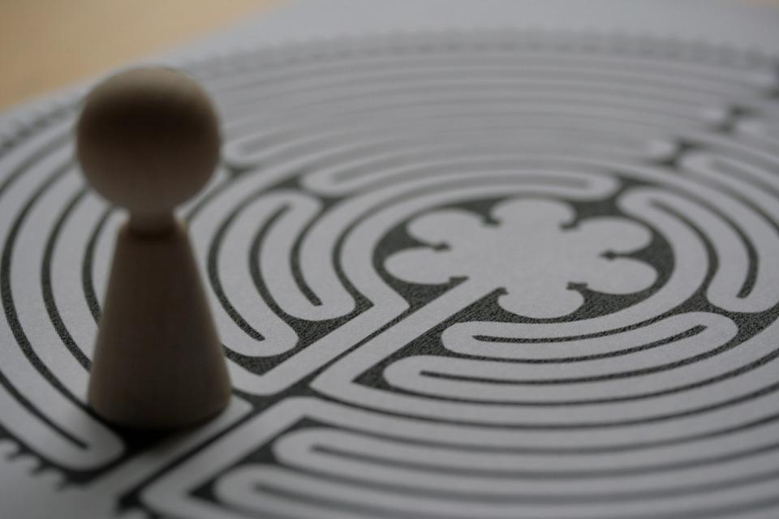
…I wonder if you might have seen things in a different way?...
Notes:
Slide 6: As you’ve journeyed through today, I wonder if you might have seen things in a different way?...

Slide 7
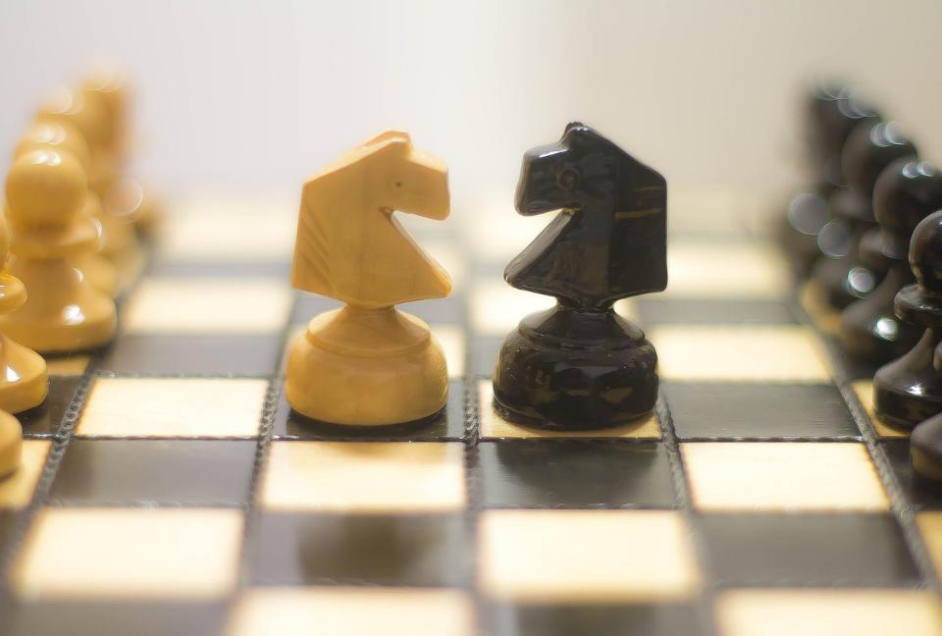
…or how your thinking might have changed?...
Notes:
Slide 7: …or how your thinking might have changed?

Slide 8
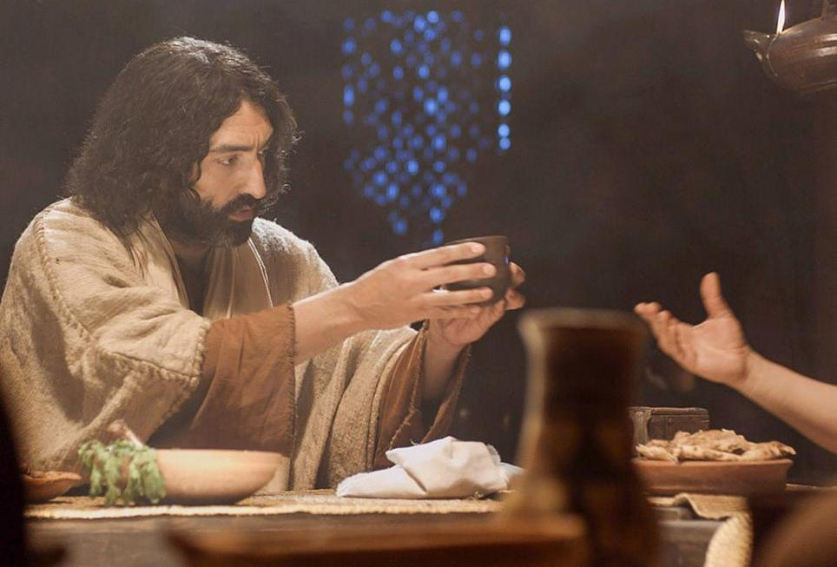

…I wonder what reminders you might take away?...
Notes:
Slide 8: We have heard how Jesus gave his followers a simple way to remember him. …I wonder what reminders you might take away from this day we’ve spent together?...

Slide 9

…or what you think is the most important message in this story?...
Notes:
Slide 9: ….or what you think is the most important message in this story?

Slide 10
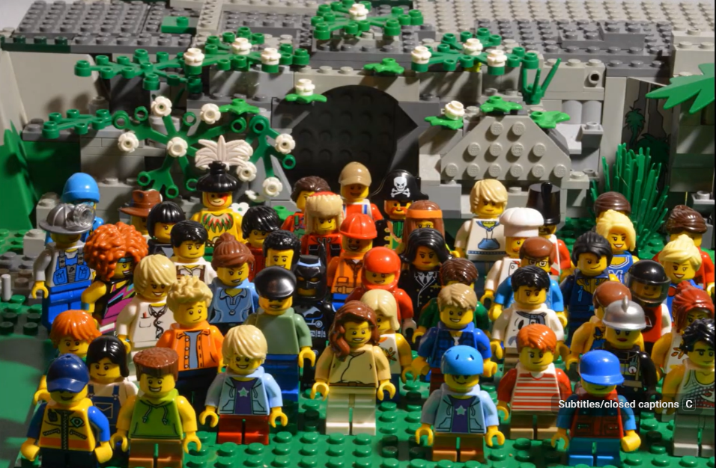
…I wonder what you think is the most important message in this story?...
Video © Lightbulb Head
Notes:
Slide 10: I wonder what you think is the most important message in this story?...
We are going to watch a 2-minute Lego® version of the Easter story now: as you watch, be thinking about the question….[Use the video link [click on the picture to take you to the YouTube video] to show this 2-minute version of the Easter story. You might also wish to give pupils time to chat together afterwards]
So, I wonder what conclusions we might have come to? [ask for some thoughts]
We’re going to hear some words from the Bible now, words that were used in the video – words that help to explain how a Christian might answer this question…

Slide 11
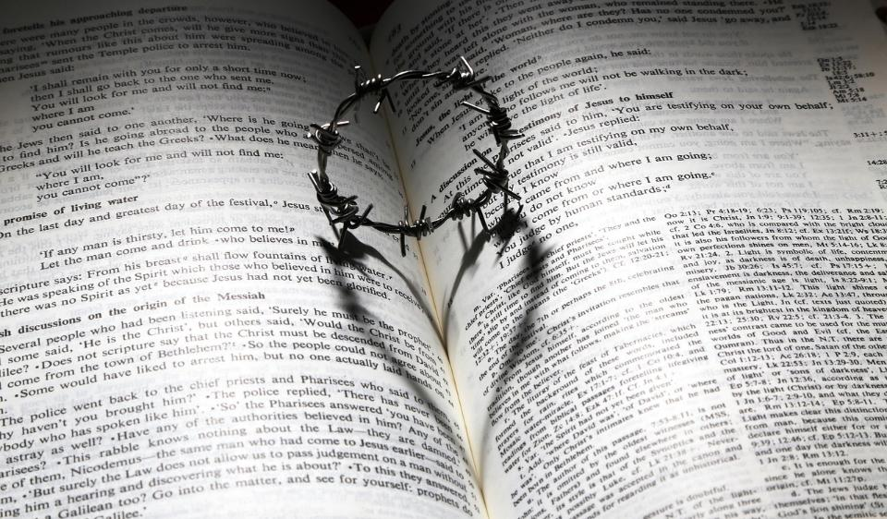


God loved the world so much that he gave his Son, Jesus….
Notes:
Slide 11: In John chapter 3 verse 16, it says this: God loved the world so much that he gave his Son, Jesus…..
For Christians, this is the message of Easter: that God gave Jesus as the priceless gift that would save the world, mend all that had been broken and open the door to life that will last forever…..as you may recall from your learning in RE, Christians call this salvation.

Slide 12
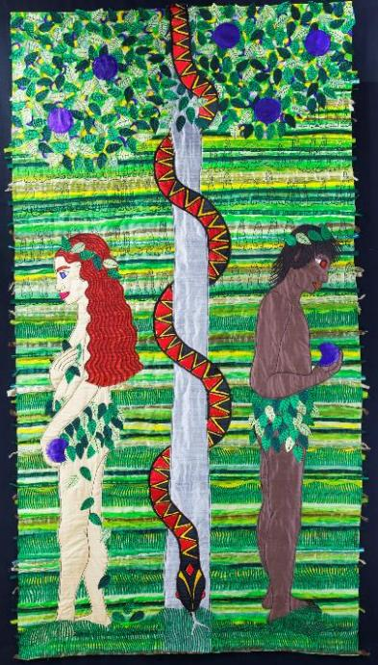
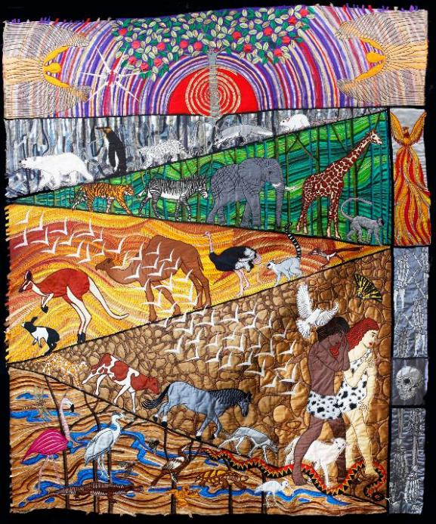
Notes:
Slide 12: You might also remember these panels from Jacqui Parkinson’s exhibition, and the story of how Adam and Eve listened to the snake in the garden, which spoiled God’s beautiful creation and brought darkness into people’s hearts…..
Christians believe that Easter is God’s plan to fix the brokenness and darkness in our world…..

Slide 13

….I wonder what you think about this message?....
….I wonder what difference it makes to how Christians live?....
God loved the world so much that he gave his Son, Jesus….
Notes:
Slide 13: Responding and words for worship
Christians believe that the message of Easter is that Jesus’ death and resurrection fixed what was broken in people’s hearts and one day will fix all that is broken in creation, so all will be as it should have been all along…..
Let’s just pause one final time and wonder together…..
….I wonder what you think about this message?....
….I wonder what difference it makes to how Christians live?....
We’re going to end our time together, and our Journey through Easter, with a blessing – which is a special type of prayer.

Slide 14
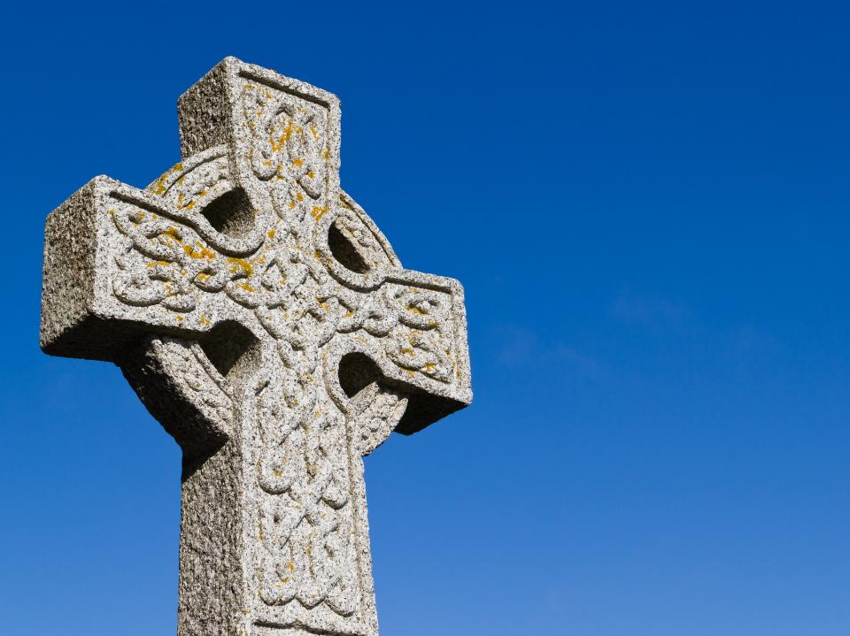
A Celtic Blessing – for the journey
Notes:
Slide 14: Prayer of blessing
It’s a blessing that is very old, probably from Ireland (which is one part of the British Isles) This blessing talks about wishing someone well as they go on their journey….that their journey will be an easy one. This may be an actual journey, but it could also mean the journey of people’s lives – and for us, as we end this school day and journey home. As you listen, you might not understand every word, because the language is like a poem, so I’m going to use some pictures to help us. If you want to pray this with me, then find a way to make these words your own
[Try to leave a pause between each slide, and resist the urge to explain the words: let them sink in and let the words and pictures ‘speak’ to children at whatever level they will absorb them, even if it’s only to enjoy how they sound. Read it more than once if you think it will help.]

Slide 15
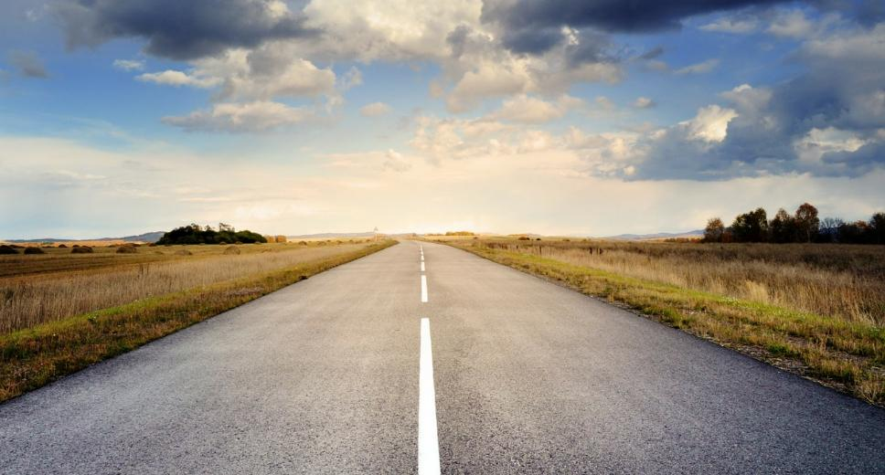
May the road rise up to meet you.

Slide 16
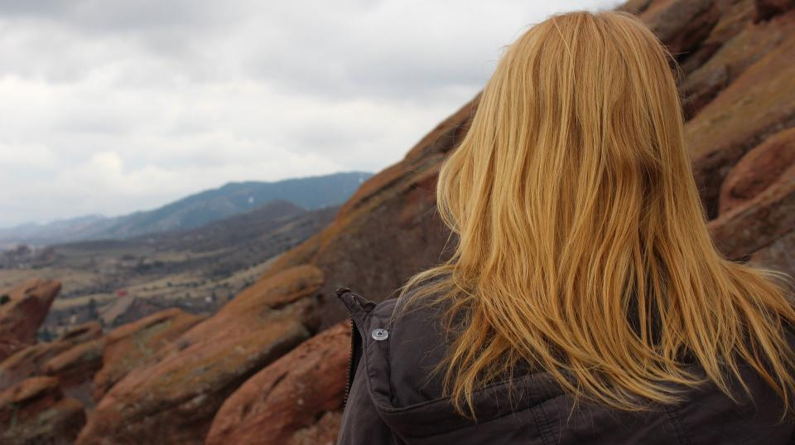
May the wind be always at your back.

Slide 17
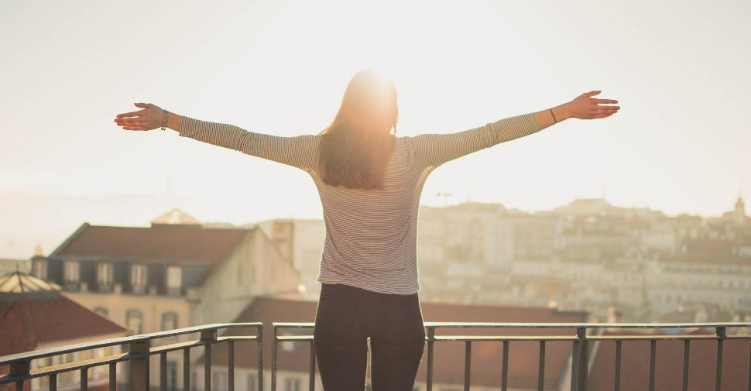
May the sun shine warm on your face,

Slide 18
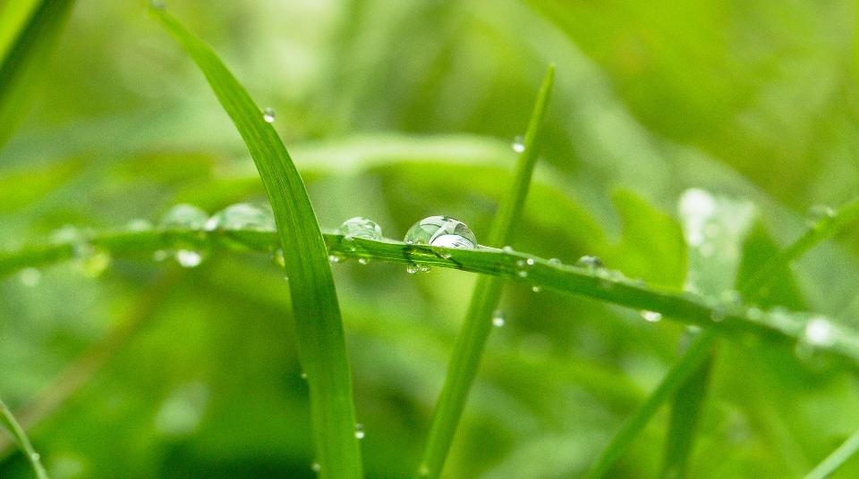
…the rains fall soft on your fields…

Slide 19

…and until we meet again,

Slide 20
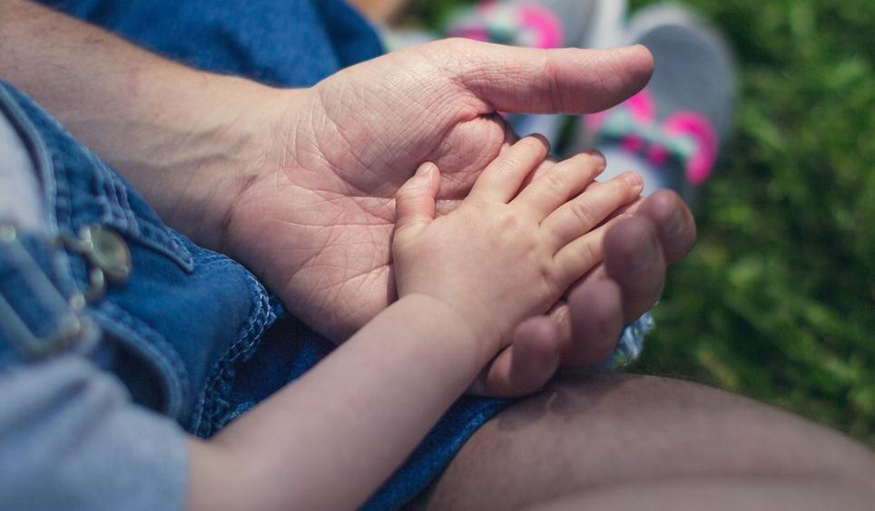
…may God hold you in the palm of his hand.

Slide 21
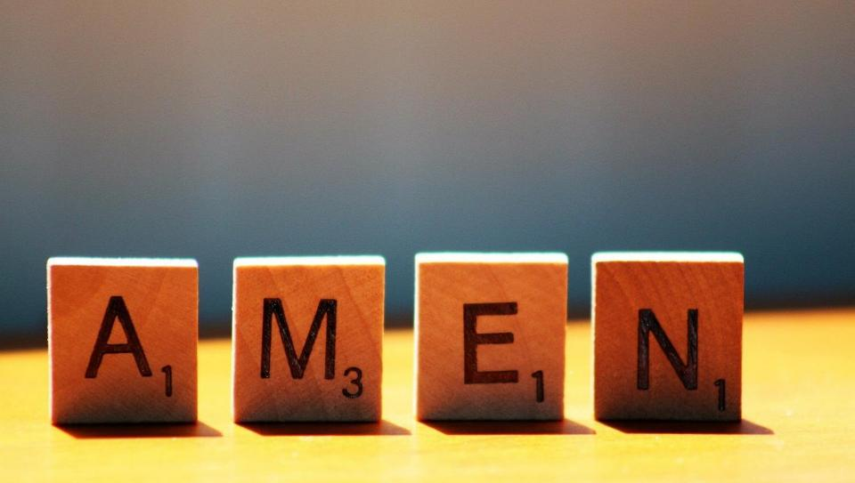

Slide 22
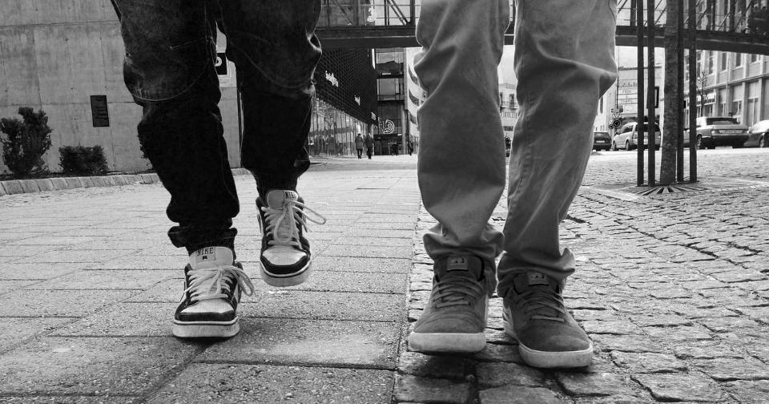


Leader: As we leave this place & time and continue our journeys…
All: May God go with us!
Notes:
Sending: Slide 25
Leader: As we leave this place & time and continue our journeys…..
All: May God go with us!

