Slide 1
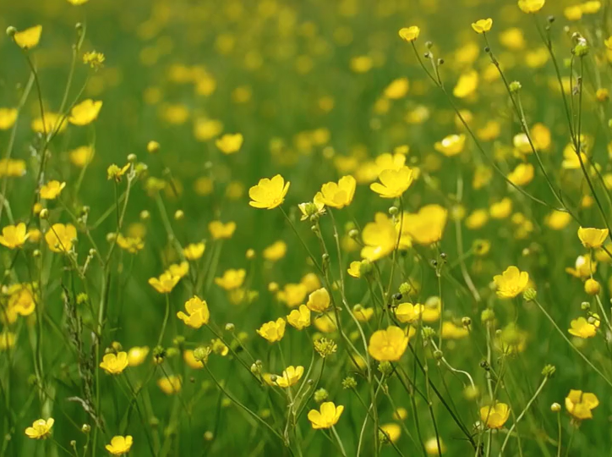



All pictures copyright-free from pixabay
Notes:
Slide 1: Spring flowers stilling exercise
Use the stilling slide if desired: the suggested words should be spoken slowly, leaving pauses inbetween to create a sense of stillness.
As you sit quietly, watch the spring flowers blowing gently in the breeze….[PAUSE]
Now practise slower breathing…..in…..and out…..in……and out…..keep this going as you continue to look at the flowers….[PAUSE]
You maybe notice that you are feeling calmer and more relaxed….[PAUSE]
As you breathe, think about how it feels to be in this special/sacred space….. [PAUSE]
We come into this special / sacred space and time to be still….to think deeply…..to be together as a school community…..
In our time together today, we will talk about some words together, share a story and then use it to help us to think as we begin our ExploRE Easter Day together.
But first, let’s welcome one another as we begin….

Slide 2

Leader: As we gather together today…
ALL: …we bring our thoughts and our hearts into this sacred space.
Notes:
Slide 2: Gathering
Leader: As we gather together today….
ALL: ….we bring our thoughts and our hearts into this sacred space.
Here are BSL actions for some of the words:
Leader’s words:
Gather: https://www.signbsl.com/sign/gather (1st video)
Today: https://www.signbsl.com/sign/today (1st video)
Pupils’ response:
Thoughts: https://www.signbsl.com/sign/thoughts (1st video)
Hearts: https://www.signbsl.com/sign/heart (1st video)

Slide 3
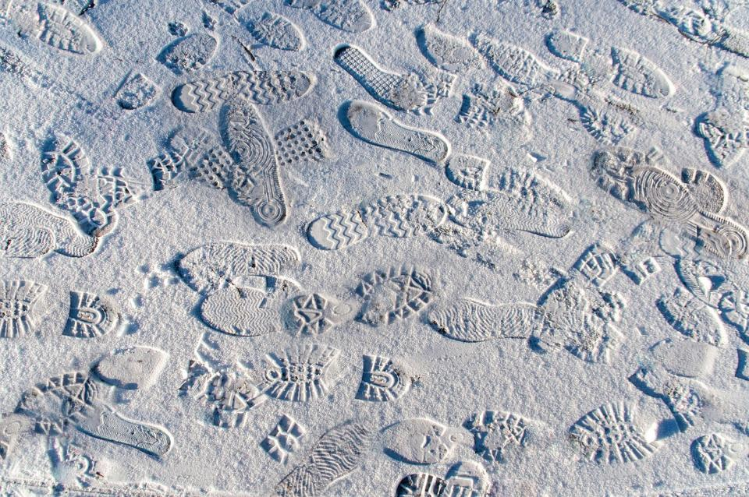
‘following in someone’s footsteps’
Notes:
Slide 3: ‘Following in someone’s footsteps’
Explain what it means to ‘follow in someone’s footsteps’. Ask adults & children to share examples from their own life experience e.g. their parent(s), a leader, someone who they admire etc.

Slide 4
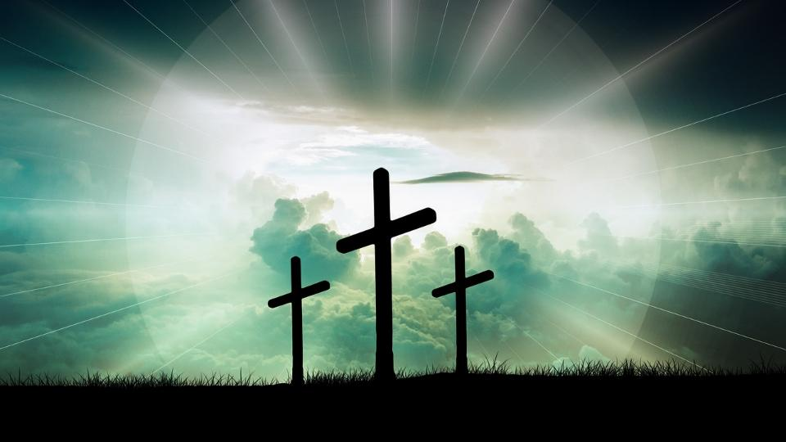

Explo RE Easter
Notes:
Slide 4: ExploRE Easter
Today, here in our school, we are going to explore the Easter story together, in lots of different ways, and extend our learning in RE a little bit further. To start our day together, we’re going to follow the footsteps of Jesus through the Easter story. The journey of Easter takes a whole week, from Palm Sunday to Easter Day, but we’re going to share a very short version of the story together now, as a reminder, with a special ‘join-in’ bit together: here are our words…..

Slide 5


We're on a special journey
of footsteps to the feast.
Jesus comes to rescue:
the last, the lost, the least.
Notes:
Slide 5: Refrain [you could use this refrain as a call and response, with pupils repeating each line]
We're on a special journey
of footsteps to the feast.
Jesus comes to rescue:
the last, the lost, the least.

Slide 6
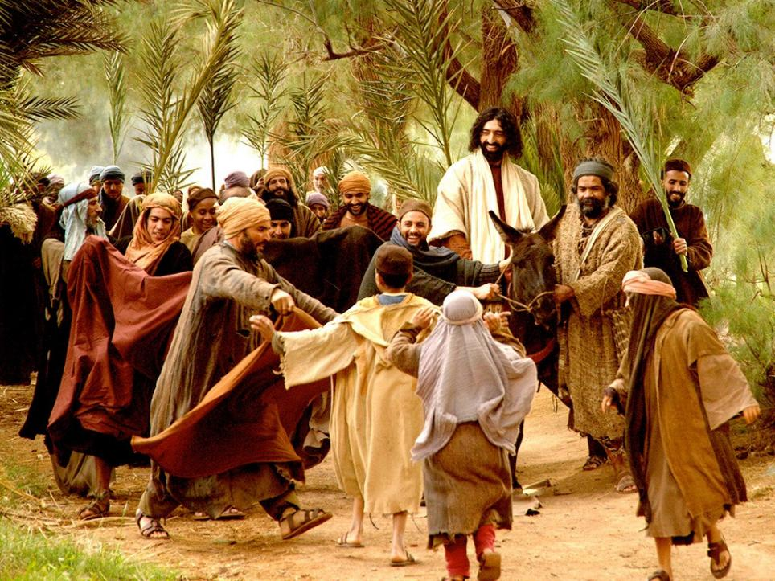

Praise Day
Notes:
Slide 6: On Palm Sunday, Jesus rode into Jerusalem as King…..people laid their cloaks down for him to walk on, and waved palm branches high in praise.

Slide 7
We're on a special journey
of footsteps to the feast.
Jesus comes to rescue:
the last, the lost, the least.

Slide 8
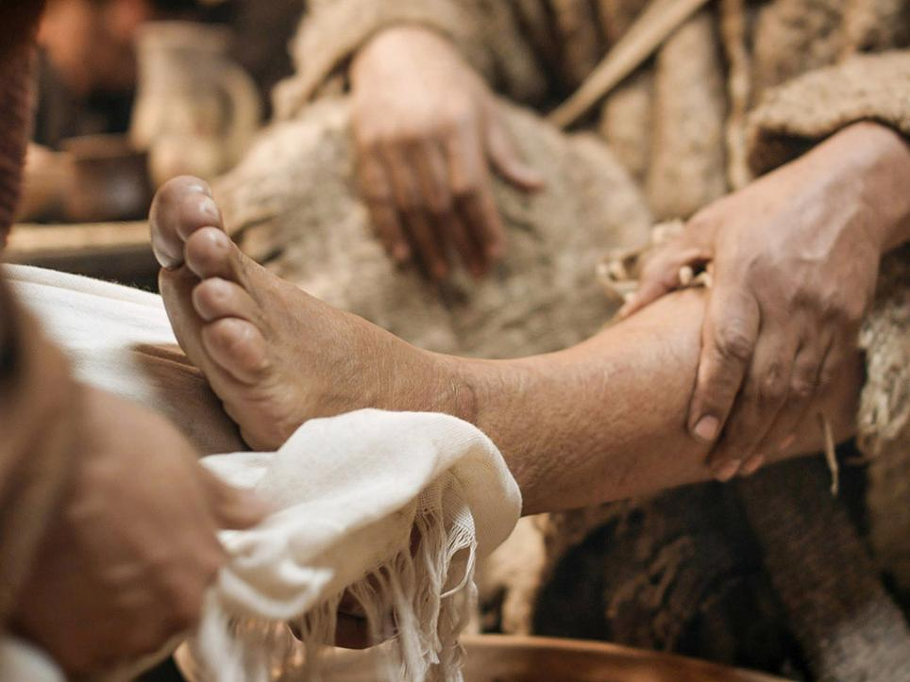
Passover Day
Notes:
Slide 8: A few days later, in the room that they had reserved to celebrate the Passover, Jesus washed the feet of his disciples…..

Slide 9
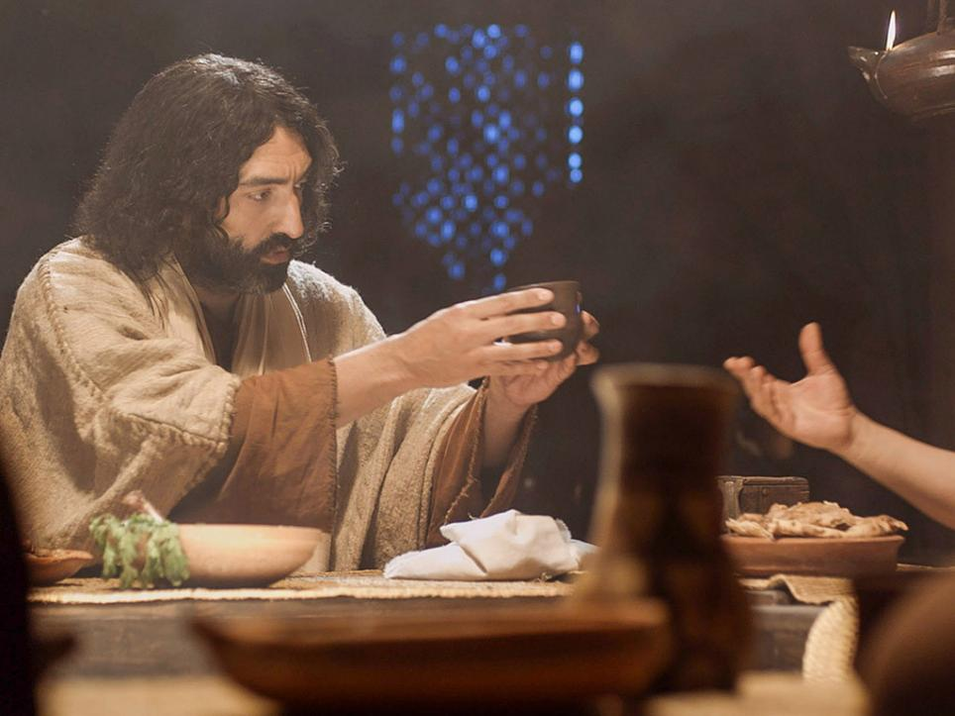
Passover Day
Notes:
Slide 9: ....and gave them bread and wine, asking his followers to ‘Remember him….’

Slide 10
We're on a special journey
of footsteps to the feast.
Jesus comes to rescue:
the last, the lost, the least.

Slide 11
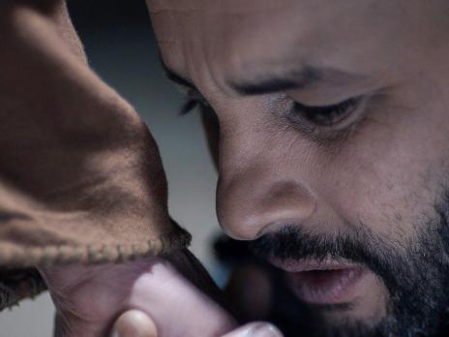
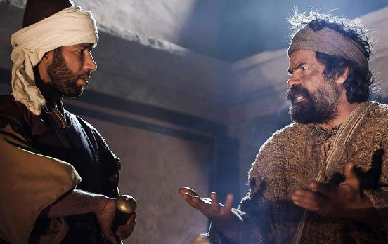
Painful Day
Notes:
Slide 11: Later that night, Jesus was betrayed by his closest friends…..

Slide 12
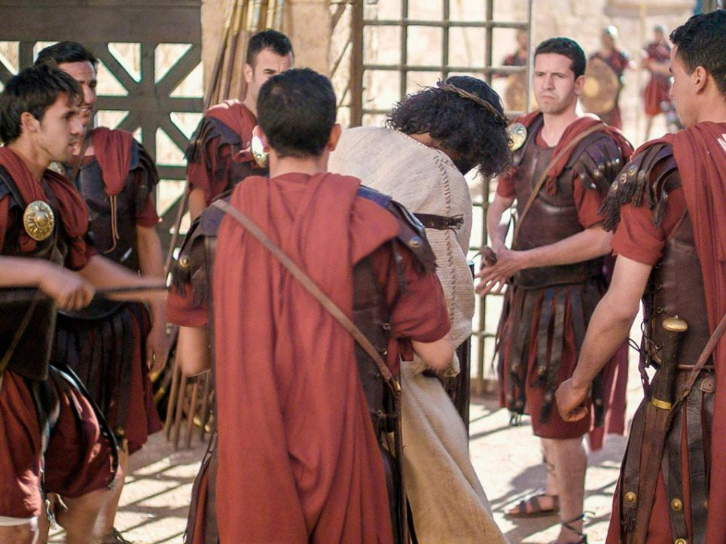
Painful Day
Notes:
Slide 12: .....and then was taken away, to be sentenced by the Romans….

Slide 13
We're on a special journey
of footsteps to the feast.
Jesus comes to rescue:
the last, the lost, the least.

Slide 14
Painful Day
Notes:
Slide 14: The next day, he died on a cross, with two thieves beside him…..

Slide 15
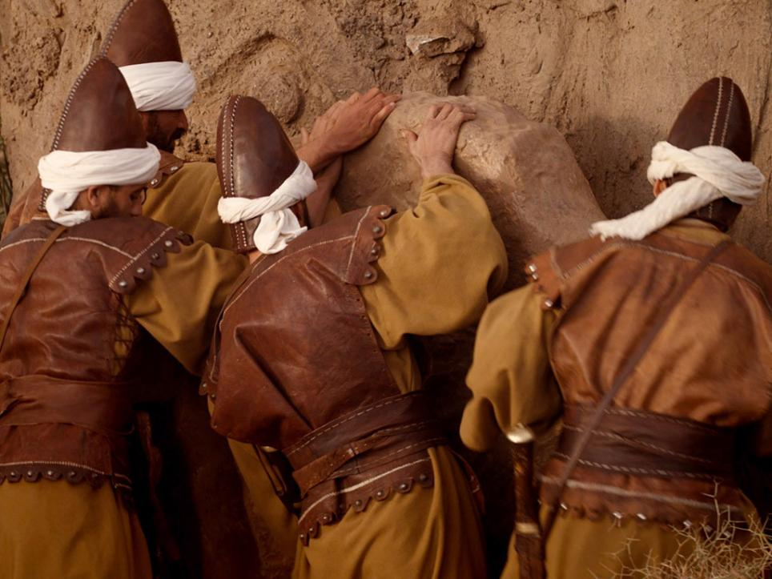
Painful Day
Notes:
Slide 15: ….and his body was placed into a stone tomb.

Slide 16
We're on a special journey
of footsteps to the feast.
Jesus comes to rescue:
the last, the lost, the least.

Slide 17
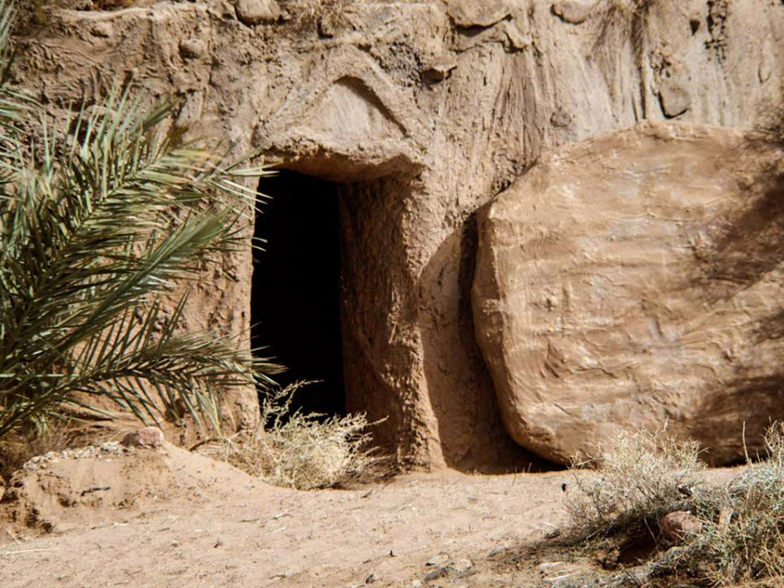
Promise Day
Notes:
Slide 17: But that’s not the end of the story! Three days later, women came to visit the tomb and found it empty!

Slide 18
We're on a special journey
of footsteps to the feast.
Jesus comes to rescue:
the last, the lost, the least.

Slide 19
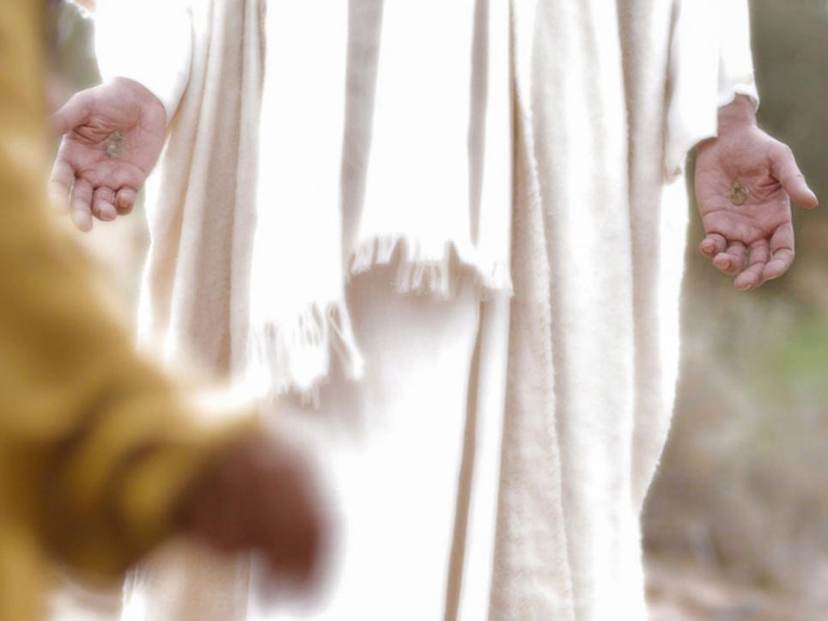
Promise Day
Notes:
Slide 19: Jesus was alive – and many people saw him!

Slide 20
We're on a special journey
of footsteps to the feast.
Jesus comes to rescue:
the last, the lost, the least.
The End!

Slide 21
‘If any of you want to be my followers, you must forget about yourself. You must take up your cross and follow me.’
Explo RE Easter
Notes:
Slide 21: Responding and words for worship
In our ExploRE Easter day today, we are going to work together in our classrooms to go deeper into the story.
[At this point, you might want to give a brief overview of what this looks like for your school, based on the materials you’ve selected from the resources]
But for now, we’re going to bring this time together to a close. We’ve heard how the Easter narrative is a very special part of the Bible for Christians, because it reminds them of how Jesus lived – how he served others & gave up his life to rescue the world.
Jesus once said this:
‘If any of you want to be my followers, you must forget about yourself. You must take up your cross and follow me.’ (Mark 8:34)
For Christians, following Jesus means forgetting about the things that they want, putting the needs of other people first and doing what he would do, even if it means facing difficulties, or even suffering, in their lives.

Slide 22
….I wonder how our school’s values might help us as we ‘ExploRE’ Easter together?.....
….I wonder how what we do today might make a difference?.....in how we understand others?.....or perhaps the things of God?....
Notes:
Slide 22: Responding and words for worship
As we share this day together, we will be exploring what this story means for Christians across the world….. We may also meet with challenges and difficult ideas, or beliefs we may not share…..so, we will need to work together to help each other…..and to try to see things from different points of view…..
As we begin this day together, some questions to help us wonder……
….I wonder how our school’s values might help us as we ‘ExploRE’ Easter together?.....
….I wonder how what we do today might make a difference?.....in how we understand others?.....or perhaps the things of God?....

Slide 23
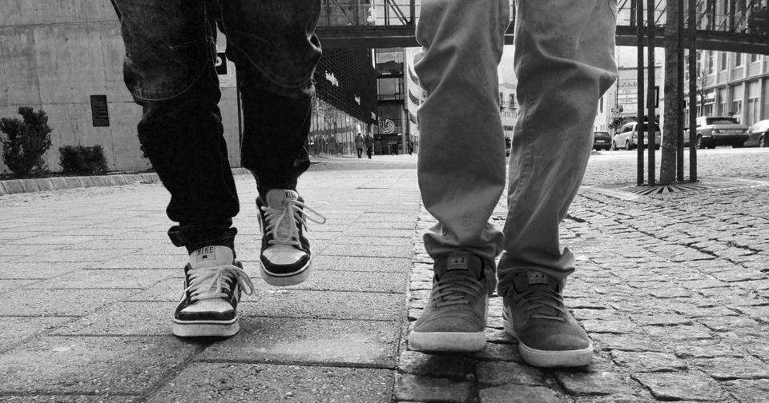
We're on a special journey of footsteps to the feast……
Jesus comes to rescue: the last, the lost, the least.
Notes:
Slide 23: Prayer
As we turn to prayer now, we’re going to use again the words that we spoke together in our story. Watch out for them as they come onto the screen…. ….and join in with the prayer if this is something that you are comfortable with.
We’re on a special journey of footsteps to the feast……
Please help us as we are companions together in our classrooms today, to listen to each other as we share this journey.
Jesus comes to rescue: the last, the lost, the least.
Please help us as we ExploRE what this story means for Christians – and to use, here in our school. Help us to value one another’s opinions, ideas and feelings – just as Jesus did.

Slide 24


Slide 25


Leader: As we leave this place & time and go into the day ahead…
All: May we journey well together!
Notes:
Sending: Slide 25
Leader: As we leave this place & time and go into the day ahead…
All: May we journey well together!

