Slide 1
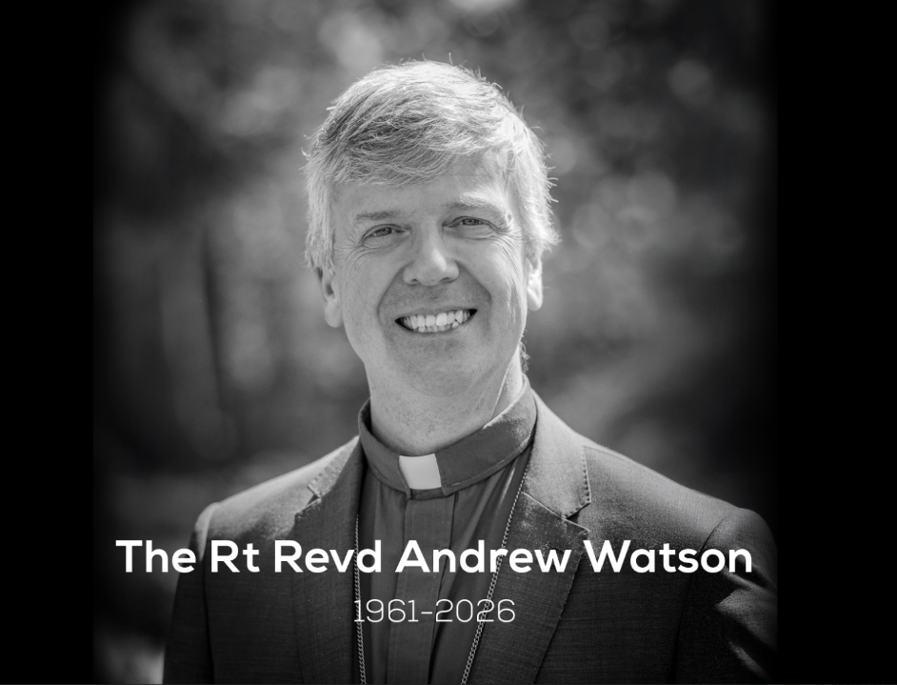
Notes:
Slide 1: This image is one that was shared for public use – please feel free to use this in your school setting if required.
We are very mindful that using these resources will depend very much on your context and on circumstances that may be challenging within your school community. Please exercise all the usual precautions before delivering! This resource about Bishop Andrew may trigger memories of grief for children and adults in your school community. As well as acknowledging the pain of the loss of our Bishop and friend, we have included joyful memories of him as well, because it helps us to remember and be thankful.
What we have discovered in writing these materials is that this absolutely fits with the spirituality offer that we have shared with you most recently. And so, in the script you have, we have deliberately used the language of our model to help understand how important spiritual flourishing is even through the more challenging times in life.
https://www.bing.com/videos/riverview/relatedvideo?q=ten+thousand+reasons&&mid=5DF79CA350598ABEF7AF5DF79CA350598ABEF7AF&FORM=VAMGZC

Slide 2
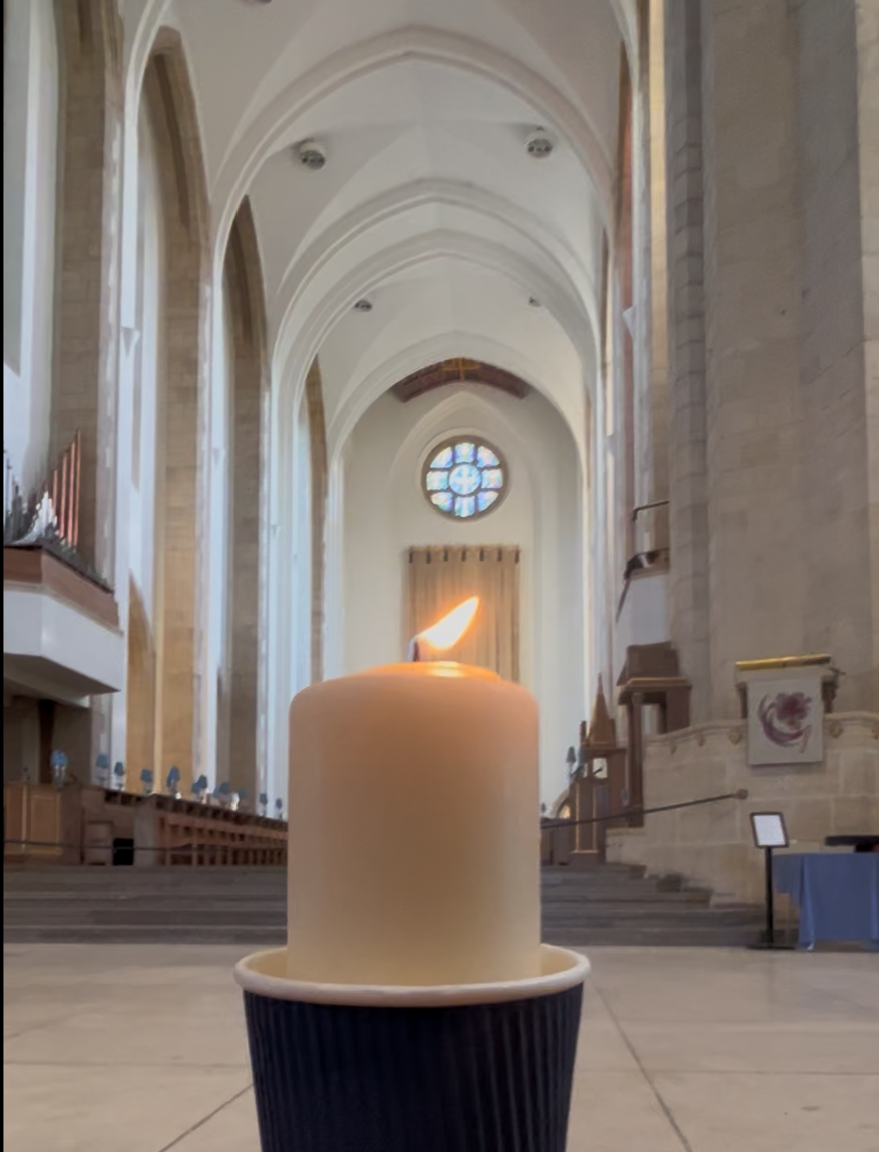
Notes:
Slide 2: Flickering Leavers’ Candle slide – for stilling.

Slide 3


Leader: As we gather together today…
ALL: …we bring our thoughts and our hearts into this sacred space.
Notes:
Slide 3: Gathering
Leader: As we gather together today….
ALL: ….we bring our thoughts and our hearts into this sacred space.

Slide 4
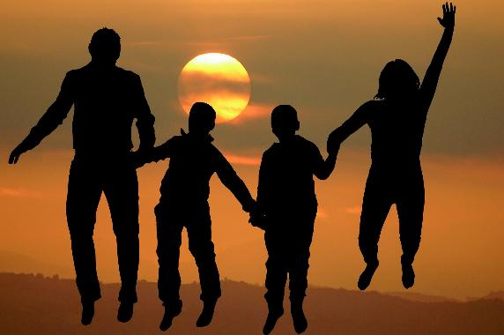
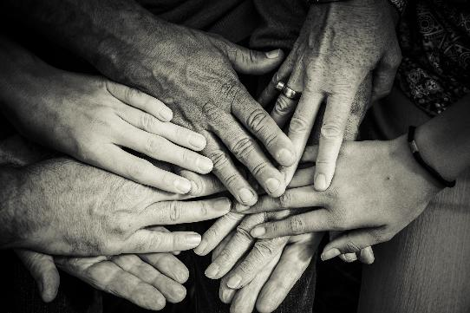
Notes:
Slide 4: Today, we gather to mark a unique and poignant moment in the life of our family of Churches and Church schools in the Diocese of Guildford.
Like all families, there are happy times and sad times that are shared together across our family and today is one of those sadder moments. But in our sadness, we may find comfort in words from the Bible and in each other as we gather as a community…..[emphasise here who children can talk to in your community, if they need to]

Slide 5
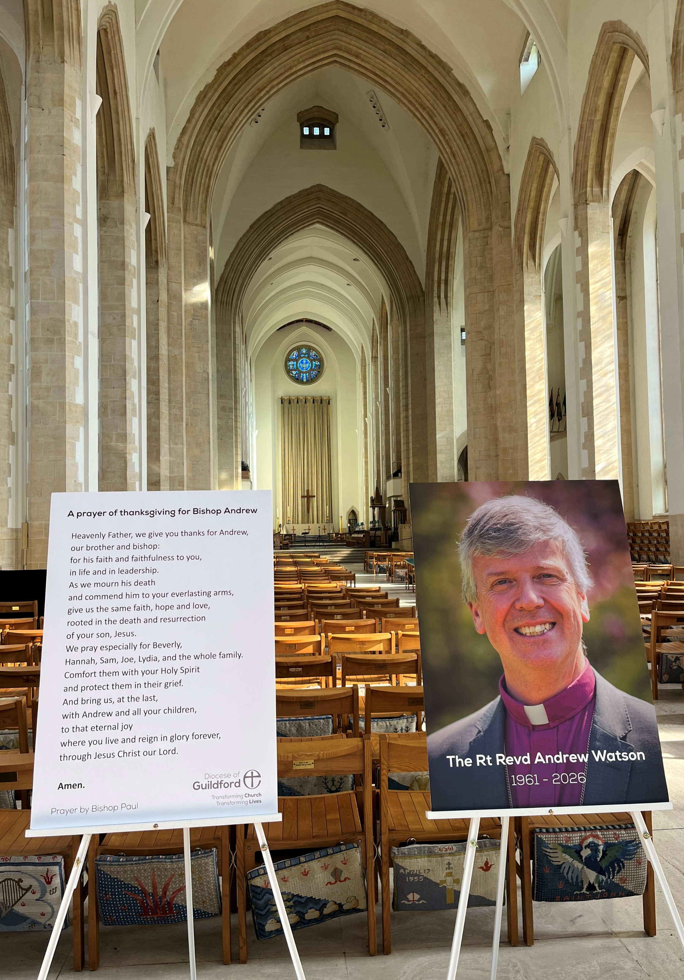
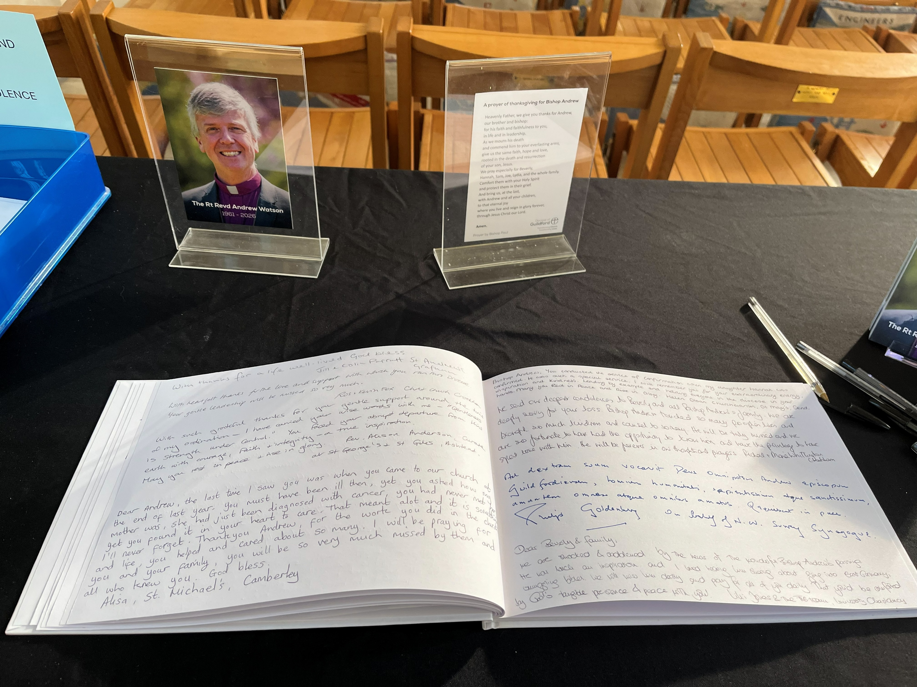
Messages in the book of condolence
Notes:
Slide 5: You may already have heard the news that our Bishop, the Bishop of Guildford – the Right Reverend Andrew Watson – has died. You can see here how he is being remembered in our Cathedral, which some of you may be visiting this summer for your Leavers’ Services. One of the ways that people from across the Diocese are helping to work through their feelings is by coming here, sitting quietly, lighting a candle or saying a prayer. Many people have written messages to Bishop Andrew’s family, or their memories of him in this special book of condolence.
And today, to help us too, we will tell something of his story….
[Some of you may have met him if he visited your school, do add extra context and photos here]
The role of a Bishop is not unlike the role of your headteacher, looking after everyone and helping to lead a whole community of people. It’s a big job, looking after all the churches in the Diocese!

Slide 6
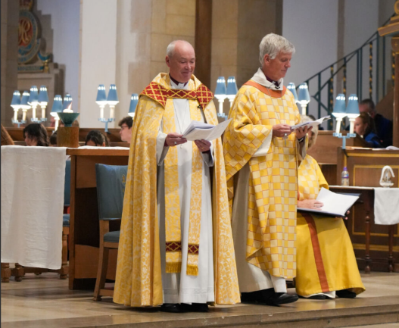
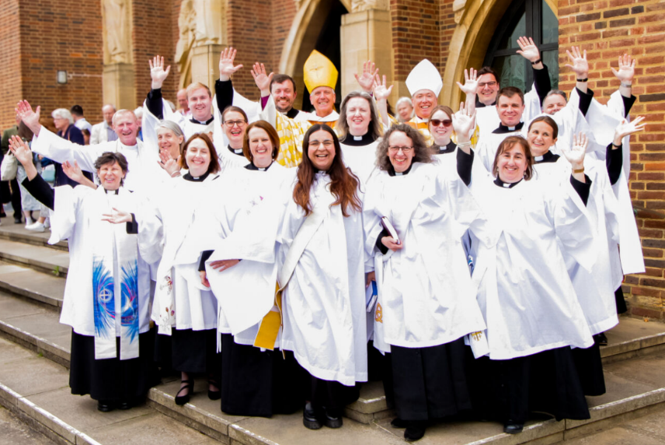
Bishop Paul with Bishop Andrew
Notes:
Slide 7: Bishop Andrew was important to lots of our schools and churches, but some of you may never have met him. Others of you may have met Bishop Paul (wearing the white mitre – the special Bishop’s hat), who is a bit like your school’s deputy head. He and Bishop Andrew were very good friends. Bishop Paul is taking on some of Bishop Andrew’s work over the coming months, and so we will pray for him later.

Slide 7
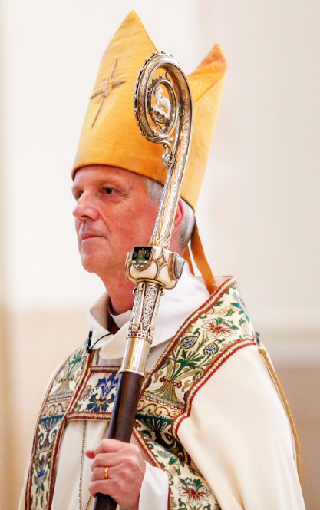
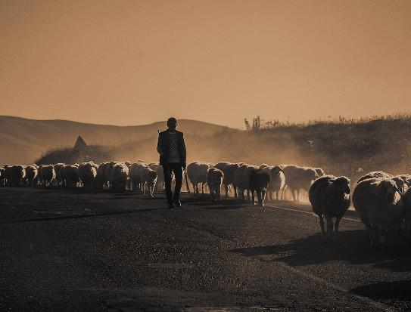
Notes:
Slide 7: One of the symbols of office that a Bishop carries is a crook – a reminder that a Bishop’s role is also a little bit like a shepherd, caring for and leading his sheep. But as well as being a leader, Bishop Andrew also had a family who will miss him, and so later, we will pause to pray for them especially.
In letters that Bishop Andrew wrote to the churches and schools in the Diocese of Guildford before he died, he wanted to remind us all that even though being a Bishop was a very important part of his life, he was also, very simply, a follower of Jesus – and wanted to be remembered as such. And so, over the next few slides, we’ll see some words from the Bible which were important to Bishop Andrew in wanting to be like Jesus…..

Slide 8
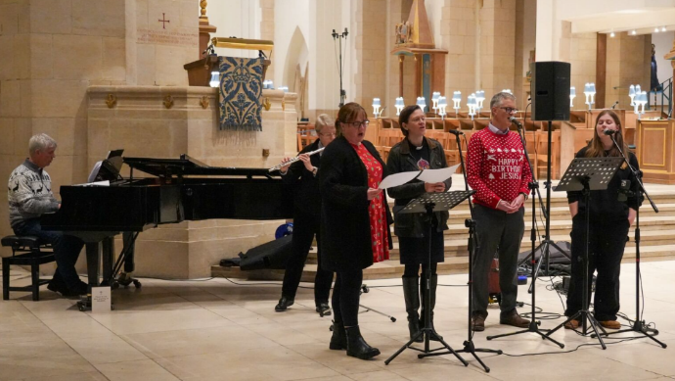
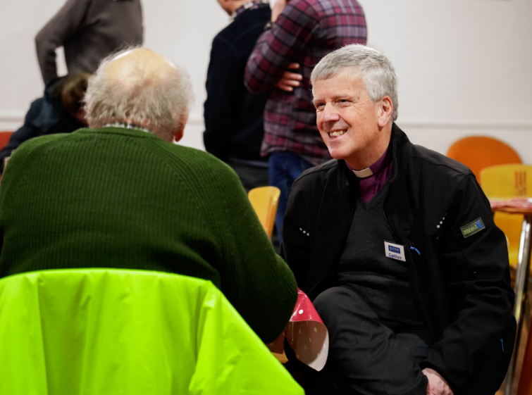
‘Serve one another, humbly, with love.’ Galatians 5:13
Notes:
Slide 8: ‘Serve one another, humbly, with love.’ Galatians 5:13
Many people have written words to Bishop Andrew’s family about what a kind and gentle man he was…..how he cared for people and served them so willingly, with such humility. He visited churches, and projects, and schools, and people, and every person he met was greeted with the same love and concern. What is less well-known, perhaps, is that he was also a very accomplished musician, and loved to use these gifts to serve others too. You can see him at the top, in the background, playing for the Diocesan staff carol service last year – with his Christmas jumper! He also wrote beautiful music for others to sing and to play, which we will probably hear in services over the coming weeks.

Slide 9
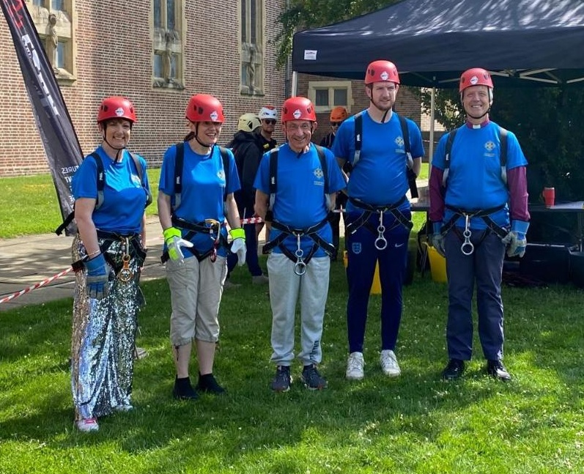
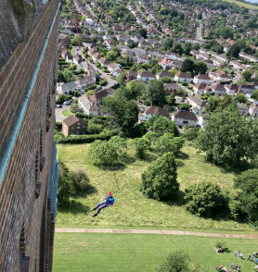
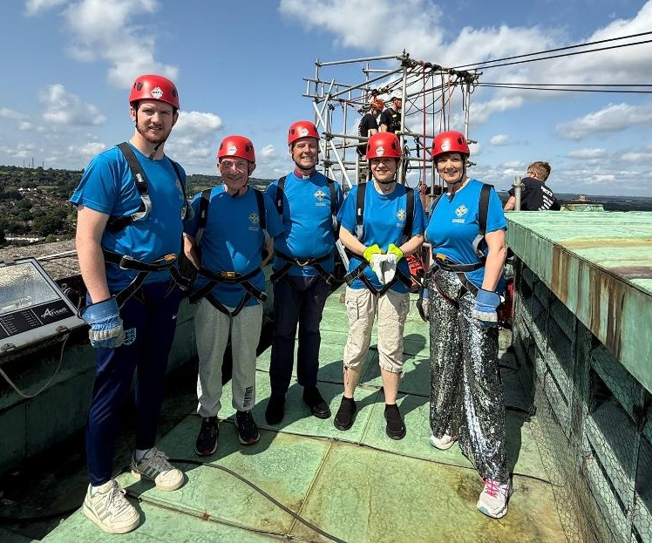
‘…be generous on every occasion...’ 2 Corinthians 9:11
Notes:
Slide 9: ‘…be generous on every occasion...’
Others have written about his generosity in giving his time and energy to help anyone who needed it. Last year, with some of his colleagues (people he worked with), he abseiled over 50 metres to the ground, from the tower of Guildford Cathedral. At the time, he said how terrifying this was and how glad he was to hear people cheering him on as he descended!
They raised over £10,000 to give to charities supporting some of the most vulnerable people in our wider community, and to help keep Guildford Cathedral open for any people who want to visit.

Slide 10
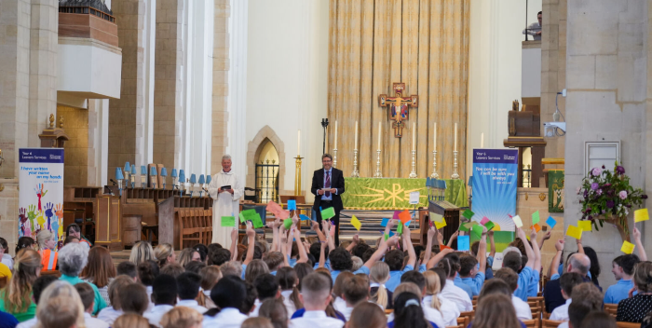
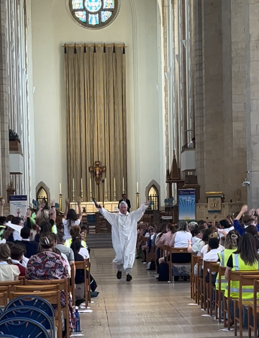
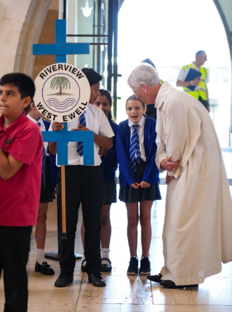
‘…let your words be full of grace...’ Colossians 4:6
Notes:
Slide 10: ‘…let your words be full of grace...’
For us in our schools, it’s maybe here in the Cathedral that most of us will remember him, at our Year 6 Leavers’ Services every June. As well as making sure that everyone had the chance to cheer as loudly as they could to fill the Cathedral with sound, Bishop Andrew would always stand at the doors of the Cathedral to speak to children and teachers as they left. He was always so interested to hear what the year 6 pupils had to say and took time to talk to them as if they were the only people in the room.
And of course, we won’t ever forget the year of the Big Mexican Wave! [there is the full video at the end if you would like to watch it]

Slide 11
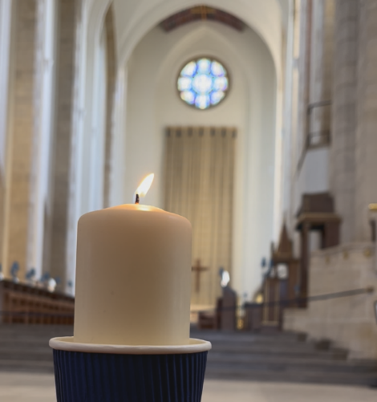
‘I am the light of the world. The person who follows me will never live in darkness. He will have the light that gives life.’
John 8:12
‘…..you should be a light for other people. Live so that they will see the good things you do. Live so that they will praise your Father in heaven.’
Matthew 5:16
Notes:
Slide 11: Responding and words of worship
The image that you saw flickering at the beginning is of one of our special Year 6 Leavers’ candles. It was Bishop Andrew’s idea that these candles should be given out at our Leavers’ Services, to use in collective worship back in school. In the Leavers’ Services, he often spoke these words, which were words spoken by Jesus: “…..you should be a light for other people. Live so that they will see the good things you do. Live so that they will praise your Father in heaven.” This was Bishop Andrew’s deepest prayer, to be a ‘light for other people’.
As you have listened today, I wonder which things there were about Bishop Andrew’s life that shone like a light for other people to see?.......[leave pause for thought] I wonder which things have made you think about your own life or people you want to remember?
As we move into a time when we can pray for Bishop Andrew’s family and for all those who will miss him, or be still with our own thoughts, let’s just take a few moments to pause and be quiet…..you might want to look again at the candle flame….
Jesus said: “I am the light of the world. The person who follows me will never live in darkness. He will have the light that gives life.”

Slide 12
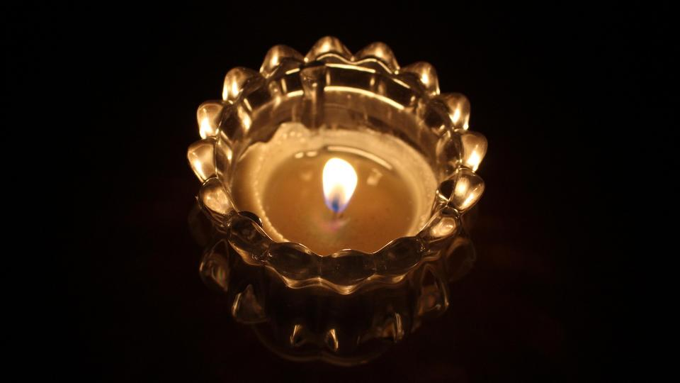
…shine in the darkness.
Notes:
Slide 12: Prayer
Bishop Andrew found great hope in Jesus being his light, especially in dark times, and so I am going to use some words about light in a prayer that I invite you to pray as well, if you would like to – or to be still and quiet with your own thoughts if you prefer.
When I say ‘Jesus, light of the world’, you might want to join in with ‘shine in the darkness’

Slide 13

…shine in the darkness.
Notes:
Slide 13: As we think of Bishop Andrew’s life, we give thanks for his kindness and gentleness and his care for the people in this Diocese. We think about how he wanted to be remembered, as an ordinary follower of Jesus….. light of the world….. shine in the darkness.

Slide 14
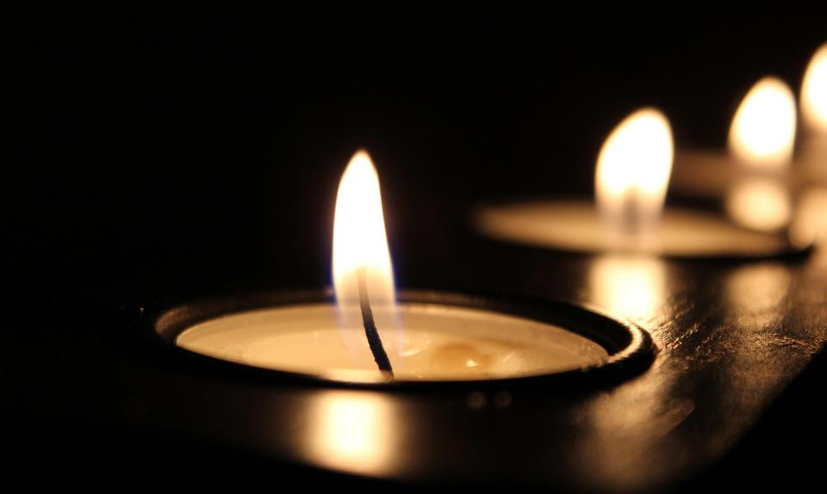
…shine in the darkness.
Notes:
Slide 14: We think of his family and his friends and his colleagues, and ask that you, O God, would be especially close to them at this time of great sadness.
May they draw comfort and hope from you, Jesus, light of the world….. shine in the darkness.

Slide 15

…shine in the darkness.
Notes:
Slide 15: We think of all those who will carry on the good work that Bishop Andrew began and pray especially that you will help Bishop Paul as he continues to guide and support the churches, the schools and the people of the Diocese of Guildford.
Jesus, light of the world….. shine in the darkness.

Slide 16
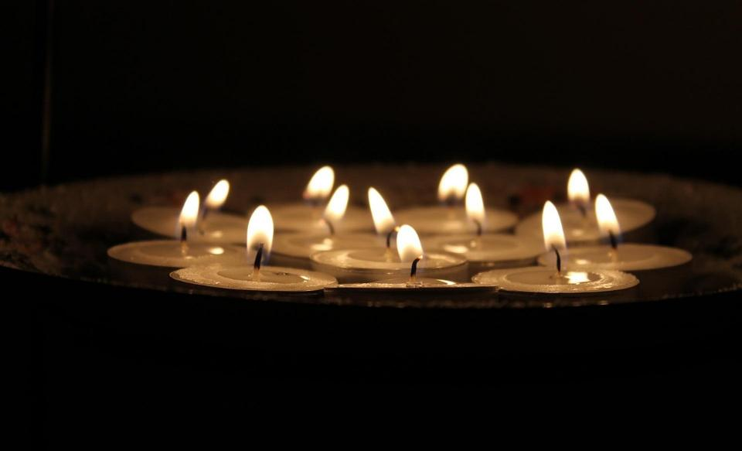
…shine in the darkness.
Notes:
Slide 16: And now let’s think for a moment about ourselves…..and what we might take away from this time into the rest of our day…..[leave a few moments of quiet here]
May our actions today also be like lights in the darkness.
Jesus, light of the world….. shine in the darkness.

Slide 17


Slide 18
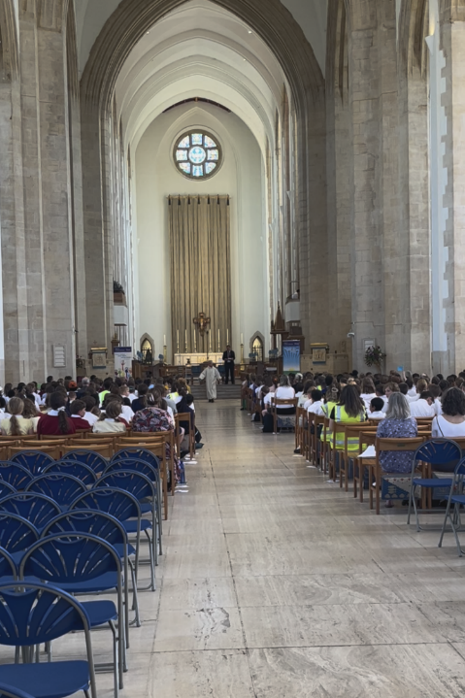
Notes:
In order to limit the file size, we have created a link to the video on this slide. Click on the photo and it should take you to the video on YouTube. You will need to have this loaded before you start the collective worship.
Slide 18: To end this time, we are going to see Bishop Andrew’s Mexican wave, from our Year 6 Leavers’ Services last year. It is full of joy, which is how Bishop Andrew thought of his life. Enjoy!

Slide 19
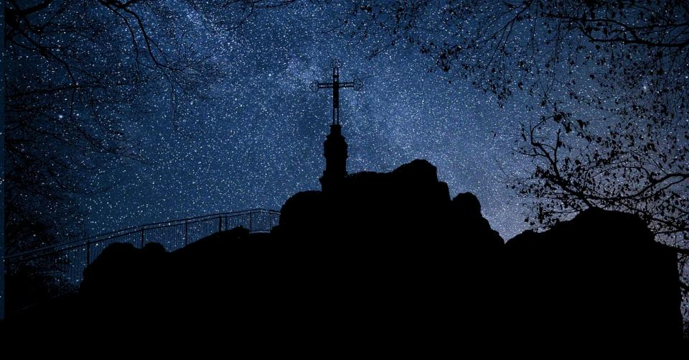


Leader: As we leave this place & time and go into the day ahead…
All: May we shine like stars!
Notes:
And so as we end this special time of reflection, we will leave with our familiar words for this term….
Leader: As we leave this place & time and go into the day ahead…
All: May we shine like stars!
[NB If you feel you need to, remind children of who they can talk to in school if they want to.]

Slide 20
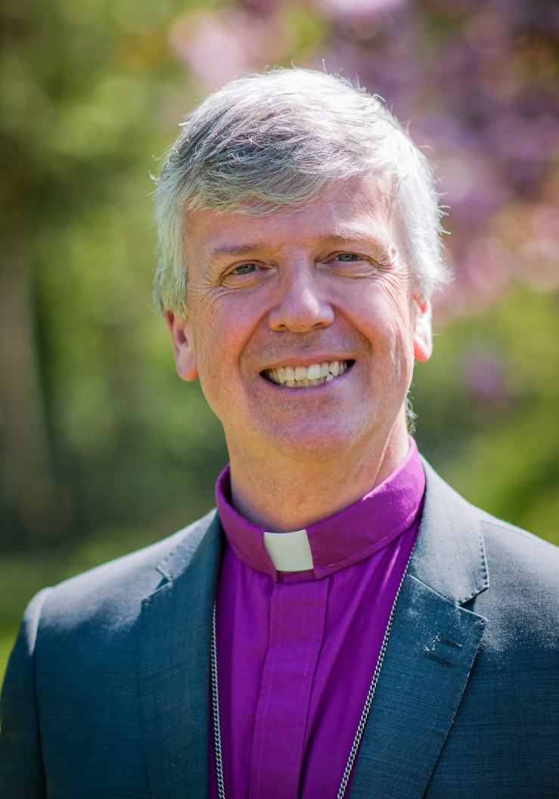
Heavenly Father,
We give you thanks for Andrew, our brother and bishop: for his faith and faithfulness to you in life and in leadership.
As we mourn his death and commend him to your everlasting arms, give us the same faith, hope and love rooted in the death and resurrection of your son, Jesus.
We pray especially for Beverly, Hannah, Sam, Joe, Lydia and the whole family. Comfort them with your Holy Spirit and protect them in their grief.
And bring us, at the last, with Andrew and all your children, to that eternal joy where you live and reign in glory forever, through Jesus Christ our Lord.
Amen.
Notes:
This is a special prayer that has been written by Bishop Paul to help remember Bishop Andrew and to pray for his family.
Please do use this in school if it helps your community.

